Slide 1
Basics of Negative Pressure Wound Therapy (NPWT)
Catherine Koutroumpis, BSN, RN, CWOCN

Slide 2
Objectives:
Know the benefits of NPWT
Know indications, contraindications and precautions for NPWT
Identify desired outcomes of NPWT
Know the role of the unit nurse in NPWT
View the minimal steps of placing a wound vac dressing
Review troubleshooting of dressing and NPWT device

Slide 3
Negative Pressure Wound Therapy
NPWT is the use of sub-atmospheric (negative) pressure to a wound through suction & polyurethane foam underneath a non-occlusive dressing to facilitate quicker healing.

Slide 4
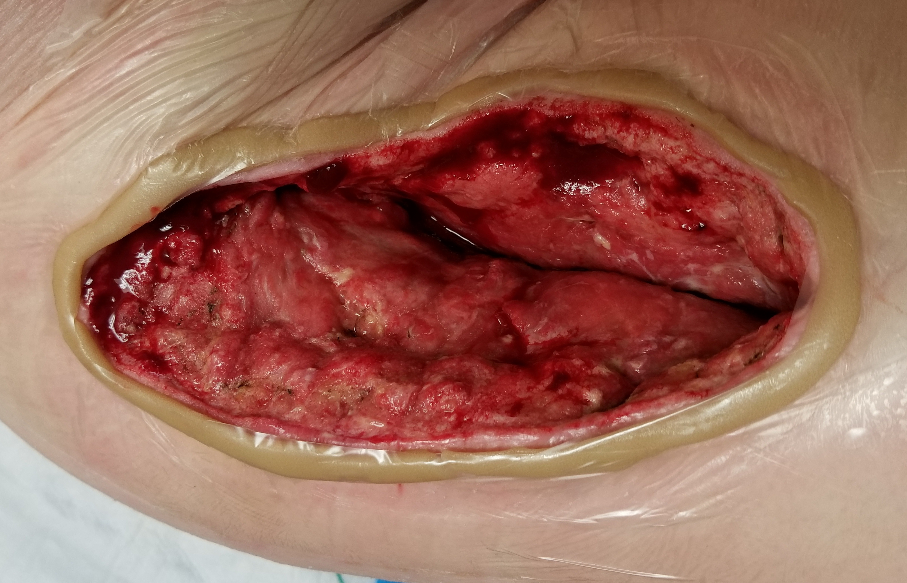
How does NPWT Speed Up Healing?
Moisture management
Too much drainage or not enough moisture is a barrier to wound healing.
Excess wound drainage is removed from the wound bed by suction through the tubing into a collection canister on the device.
In dry wounds, the suction helps bring moisture and blood flow to the wound bed.
This trochanter wound drained anywhere from 50 to 100 cc of exudate daily, too much drainage for traditional dressings to handle.

Slide 5
How does NPWT Speed Up Healing?
Reduces edema and inflammation at the site
The general healing cascade for wounds is as follows:
Hemostasis → Staunch blood flow (if applicable)
Inflammatory Phase → Clean the wound bed
Proliferation Phase → Fill & cover the wound
Maturation Phase → Tissue gains strength & flexibility

Slide 6
How does NPWT Speed Up Healing?
Reduces edema and inflammation at the site
By reducing edema & inflammation, the wound can move out of the inflammatory phase and into the proliferation phase quicker with NPWT.
Some chronic wounds get stuck in a prolonged inflammatory phase. NPWT can help break that stalemate so healing can progress.

Slide 7
How does NPWT Speed Up Healing?
During the proliferative phase, the suction from NPWT helps further stimulate formation of vascular growth and granulation tissue.

Slide 8
How does NPWT Speed Up Healing?
All the work that occurs in wound healing is helped along more quickly by NPWT because the negative pressure pulls the wound void into a smaller area/volume. NPWT facilitates this “contraction” so the body has less wound to fill in.
Open wound
Turn wound vac on
Edges pull closer together
Open wound

Slide 9
Indications – When do we use it?
NPWT is not exclusive to only certain types of wounds. We look at the wound’s assessment and patient’s condition. NPWT should be considered if the wound has any of the following:
Depth over 0.5 cm
In need of improved circulation
In need of exudate management
Has a high risk for infection
Also, consider NPWT if the patient’s comorbidities are barriers to wound healing.

Slide 10
Contraindications – Do not use it.
Untreated osteomyelitis
Malignancy in the wound
Active bleeding or very bloody wounds

Slide 11
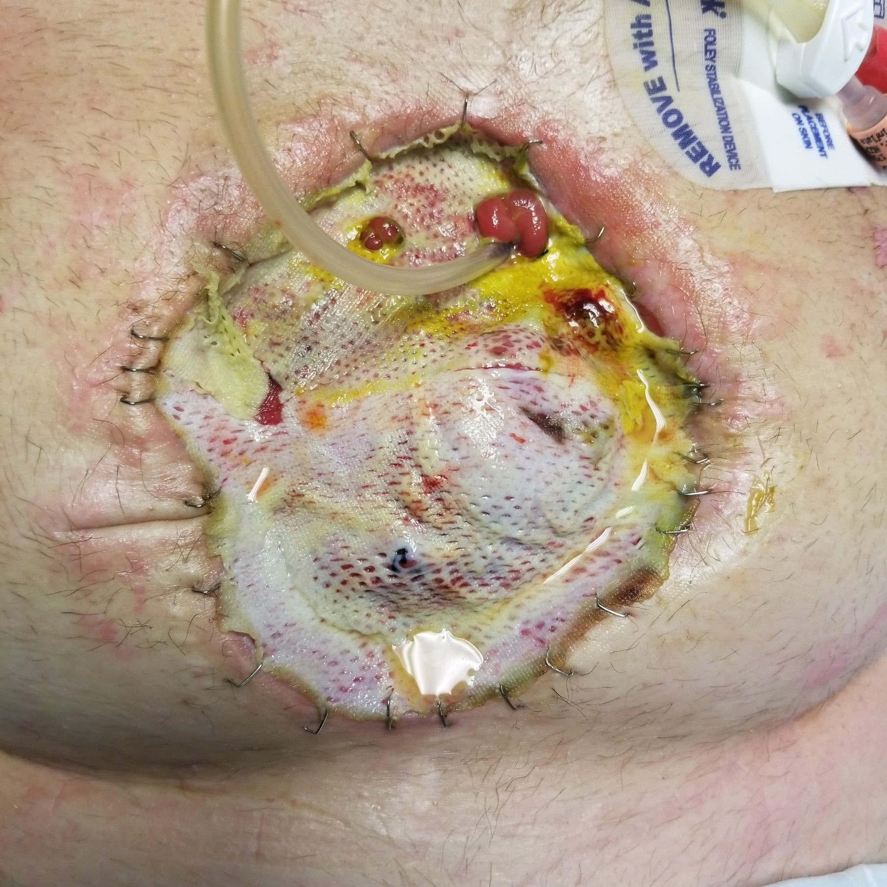
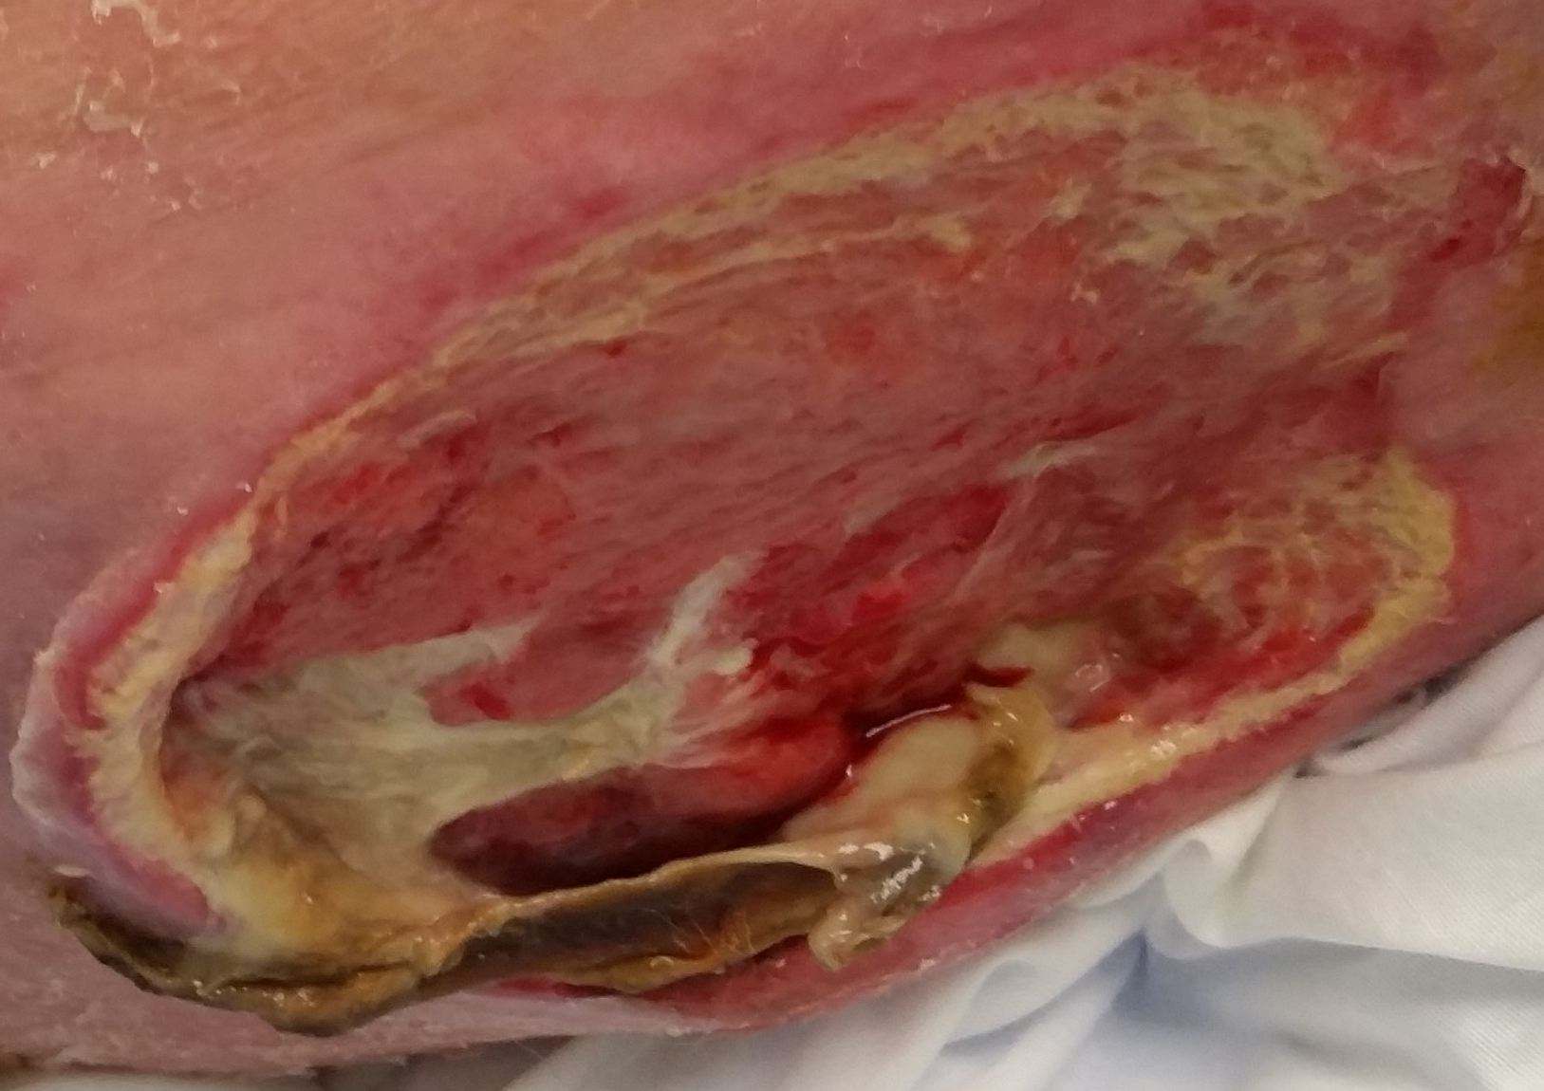
Precautions
It is alright to use NPWT in the following circumstances, but these patients and their wounds would call for more cautious monitoring if NPWT were put into place:
Necrotic tissue (slough or eschar) in the wound bed
Patient is receiving anticoagulant therapy or has abnormal hematology lab values
Fistulas
Blood vessels, organs, or bowel are visible

Slide 12
Assessment and Monitoring
So we have decided our patient would benefit from NPWT and a dressing has been placed. How do we know healing is occurring?
Formation of granulation tissue
Decrease in wound drainage
Reduction in wound dimensions

Slide 13
Termination of VAC therapy
When would the situation call for discontinuing NPWT?
Wound base is looking nicely granulated, depth is 0.5 cm or less and it is time to allow regeneration of epidermis.
Pain associated with the VAC is too much for the patient to manage despite therapeutic interventions, analgesics, and/or turning the NPWT suction pressure down.
If a wound is deteriorating or stagnant after 2-3 changes, we may stop and reassess any possible barriers to healing.

Slide 14
Termination of VAC therapy
The VAC is stopped, so now what?
Change to conventional dressings
Possible skin graft or flap surgery

Slide 15
The Role of a Unit Nurse
At the beginning of each shift
Check that the pressure settings in the order matches what the device is set on. FYI: 125 mm HG continuous is a very common setting.
Ensure the dressing is clean and collapsed
Ensure the machine is on and working.
Mark the drainage canister with a line, date, time to monitor I&O’s
Plug the unit into the electric outlet when the patient is in the room to ensure a well charged battery if the patient must leave the unit.

Slide 16
Clean & Collapsed Dressing

Slide 17
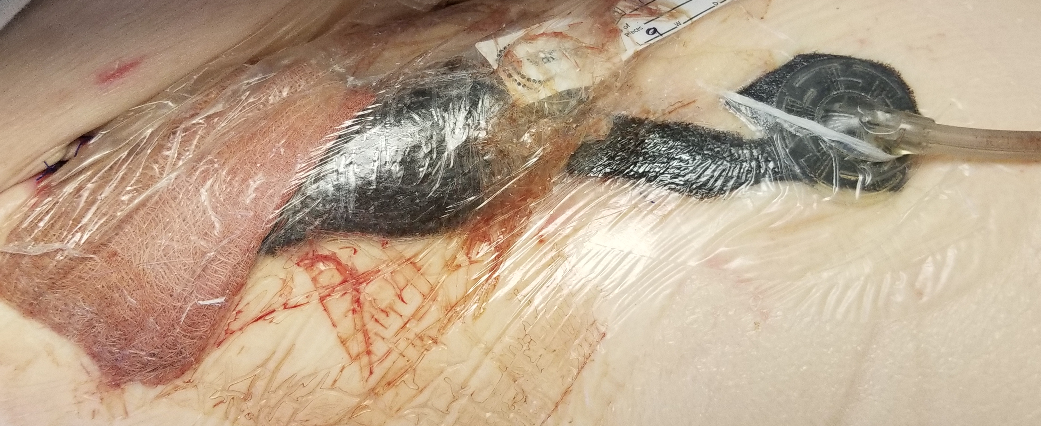
NOT Clean & Collapsed Dressing

Slide 18
The Role of a Unit Nurse
During your shift, check in on the device and dressing about every two hours to make sure:
VAC is operating & no alarms are sounding
Battery is charged or plugged into the outlet
Canister is not approaching full
Canister contents are not abnormal

Slide 19
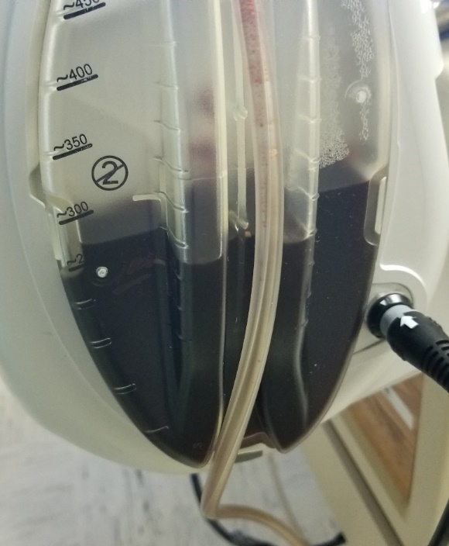
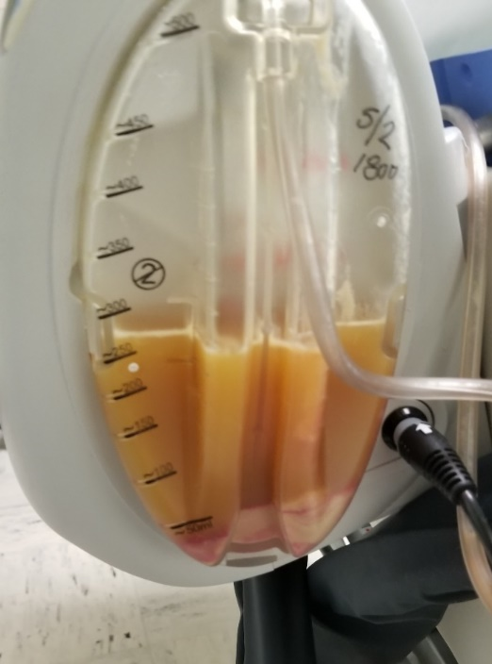
Questionable Canister Contents
Extremely Low Platelets:
Thin, dark red/purple exudate
Thick, Purulent Exudate

Slide 20
The Role of a Unit Nurse
Incontinent patients: If the dressing is at risk for contact with stool or urinary incontinence, caregivers should be instructed to wipe away from the direction of the dressing edge.
Check the dressing carefully after voiding and cleansing to ensure the seal remains intact and the dressing clean.

Slide 21
The Role of a Unit Nurse
Review your facility’s related policies and order sets so you know:
what to do if NPWT cannot be maintained.
your facility’s policies on who can remove and place NPWT dressings.
Dressing change schedule
Most NWPT dressings are changed 2-3 times per week, with three times per week being most common. A clinician may recommend only twice weekly dressing changes if a patient is experiencing uncontrollable pain during dressing changes or the wound is not highly exudative and is healing nicely. Changing less often than 2-3 times per week is not recommended in most circumstances.

Slide 22
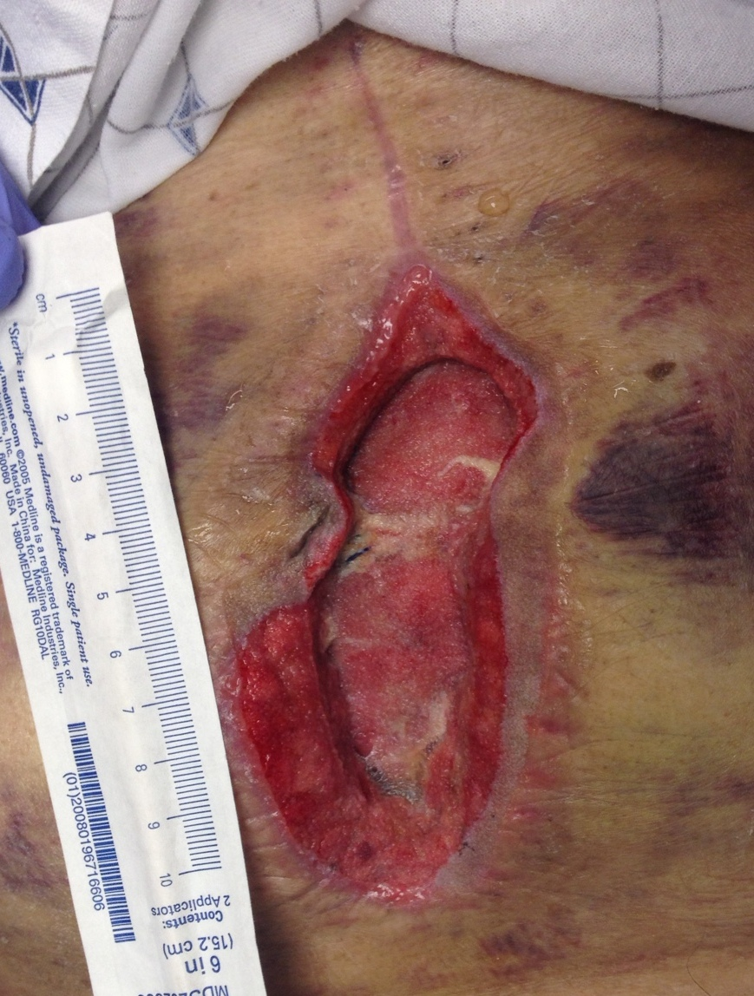
Case Study
This patient had emergency abdominal surgery, and then unfortunately suffered a post-surgical paralytic ileus that required additional surgery.
Two major abdominal surgeries and a few weeks later, the resulting wound had suddenly become stuck and needed a boost.
We ruled out other possible barriers, and then started NPWT, which did the trick.
Here is her wound story.

Slide 23
Day 1:
The wound walls leading down to the wound base is the patient’s abdominal adipose layer, now covered with granulation tissue.
The wound base is muscle; The tan “marbling” tissue was thought to be a combination of dried up umbilical stalk tissue in the center and devitalized muscle tissue that is a result of the bed being too dry.

Slide 24
Day 1:
Fascia is not intact here but the abdominal wound has filled in enough to seal off any communications with the internal abdominal cavity. There is no undermining or tunnels.
If there was communication from the outside of the body into the peritoneal cavity, this would be called an “Open Abdomen” and would require a different and more cautious type of wound vac therapy specific to open abdomen wounds.

Slide 25
NPWT System Parts
Collect your supplies
Wound cleansing supplies
Negative pressure device (Vac unit)
Drainage canister
Foam (Polyurethane: Black, White, Gray)
Cover dressing (Drape)
TRAC pad
Skin prep
Tip: Some facilities own the vac devices, some rent them. It is useful to know which applies to your employer, so accidental (and expensive) misplacements do not occur.

Slide 26
NPWT Application Steps
Cleanse the wound well, then cleanse the periwound
Apply skin protective product (i.e. Skin prep) to periwound skin
“Window frame” the wound with drape
Fill tunnels & undermining with white foam. Cover muscle, tendon, ligament with white foam or a contact layer before black foam.
Fill remainder of wound with black foam & cover all with drape
Cut a quarter size hole in drape & attached the TRAC pad over that hole
Connect tubing to the canister, connect canister to the machine, and turn the device on after putting in the proper settings.
Gently help press the dressing down or bring the edges of the wound closer as suction is turned on.

Slide 27
After cleansing the wound bed and then the periwound area of debris and bacteria, NPWT application begins.
To protect the periwound skin from maceration or trauma from negative pressure suction, “window frame” the wound with NPWT drape.
There are two popular ways of window framing a wound:
Lay drape over the wound, trace the wound void outline with a marker, cut out the drape inside the outline, apply the drape. The picture on this slide shows this method.

Slide 28
The second way to window frame a wound is to cut strips of drape and place them one by one along the edges, moving circumferentially around it until the immediate periwound area is protected. The yellow lines in this photo represent strips of drape.
It is easier to work with strips of drape then large sections of drape because once the stabilizer layer is removed, drape is very flimsy and floaty. If it floats back on itself and sticks, that piece is out of commission.

Slide 29
Day 1:
← This wound does not have tunnels or undermining, but because the fascia was not in tact, we decided to place a layer of white foam first as a precaution, which is more dense and stays more moist.
Black foam tops the white foam, filling in the remainder of the void. We came above the level of the skin, because the NPWT suction will collapse the dressing once turned on →

Slide 30
← Clear drape material covers the foam and a quarter size hole is cut to allow the suction T.R.A.C. pad to attach.
T.R.A.C. pad adheres over the hole, connect tubing to the vacuum, turn it on, and gently help wound edges move into place →

Slide 31
← Sometimes the T.R.A.C. pad is too wide to adhere over the black sponge without edges pressing on intact periwound below, possibly causing pressure or suction injury.
Add a round piece of black foam on top (don’t forget to cut the hole in the drape before placing the “mushroom cap” on top) and it bridges the pieces together to make a continuous path for the suction →
← Everything is connected and protected. If foam is in contact with foam, the suction will travel from the TRAC pad through the entire dressing set up.

Slide 32
Day 1
Measurement: 11 x 5 x 1.5 cm

Slide 33
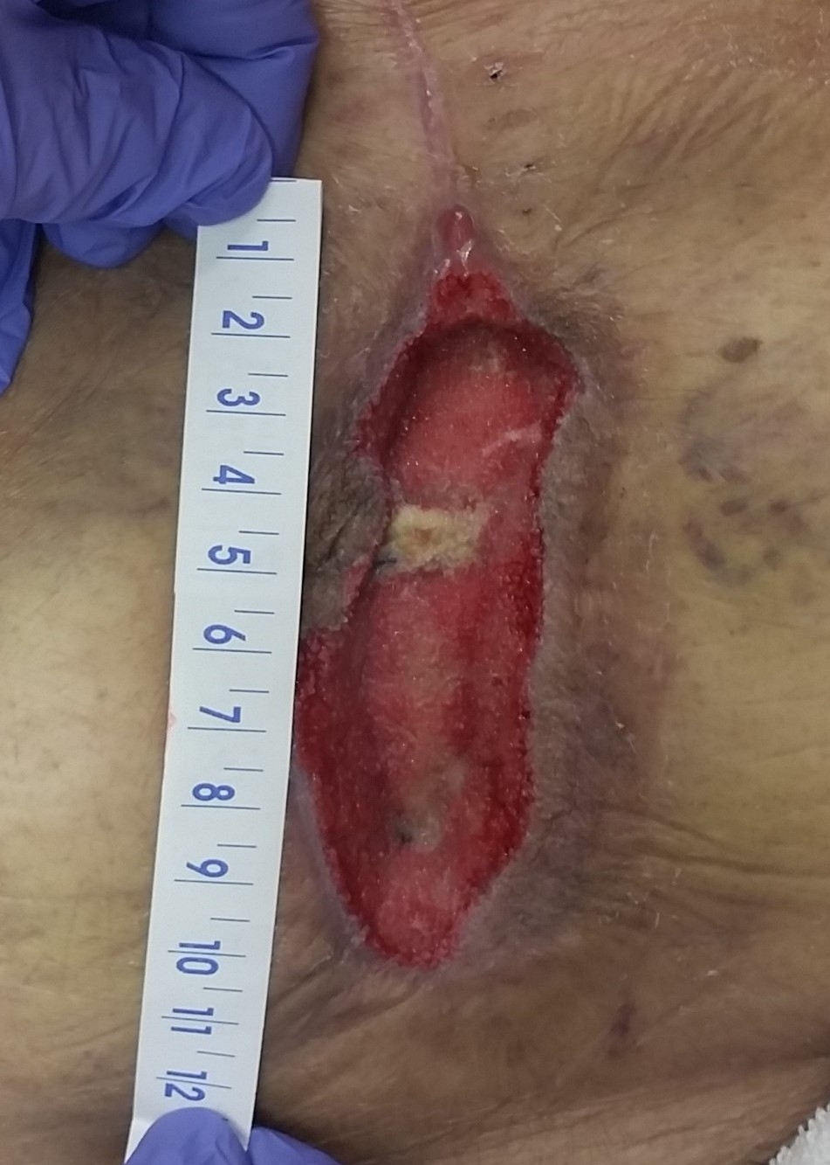
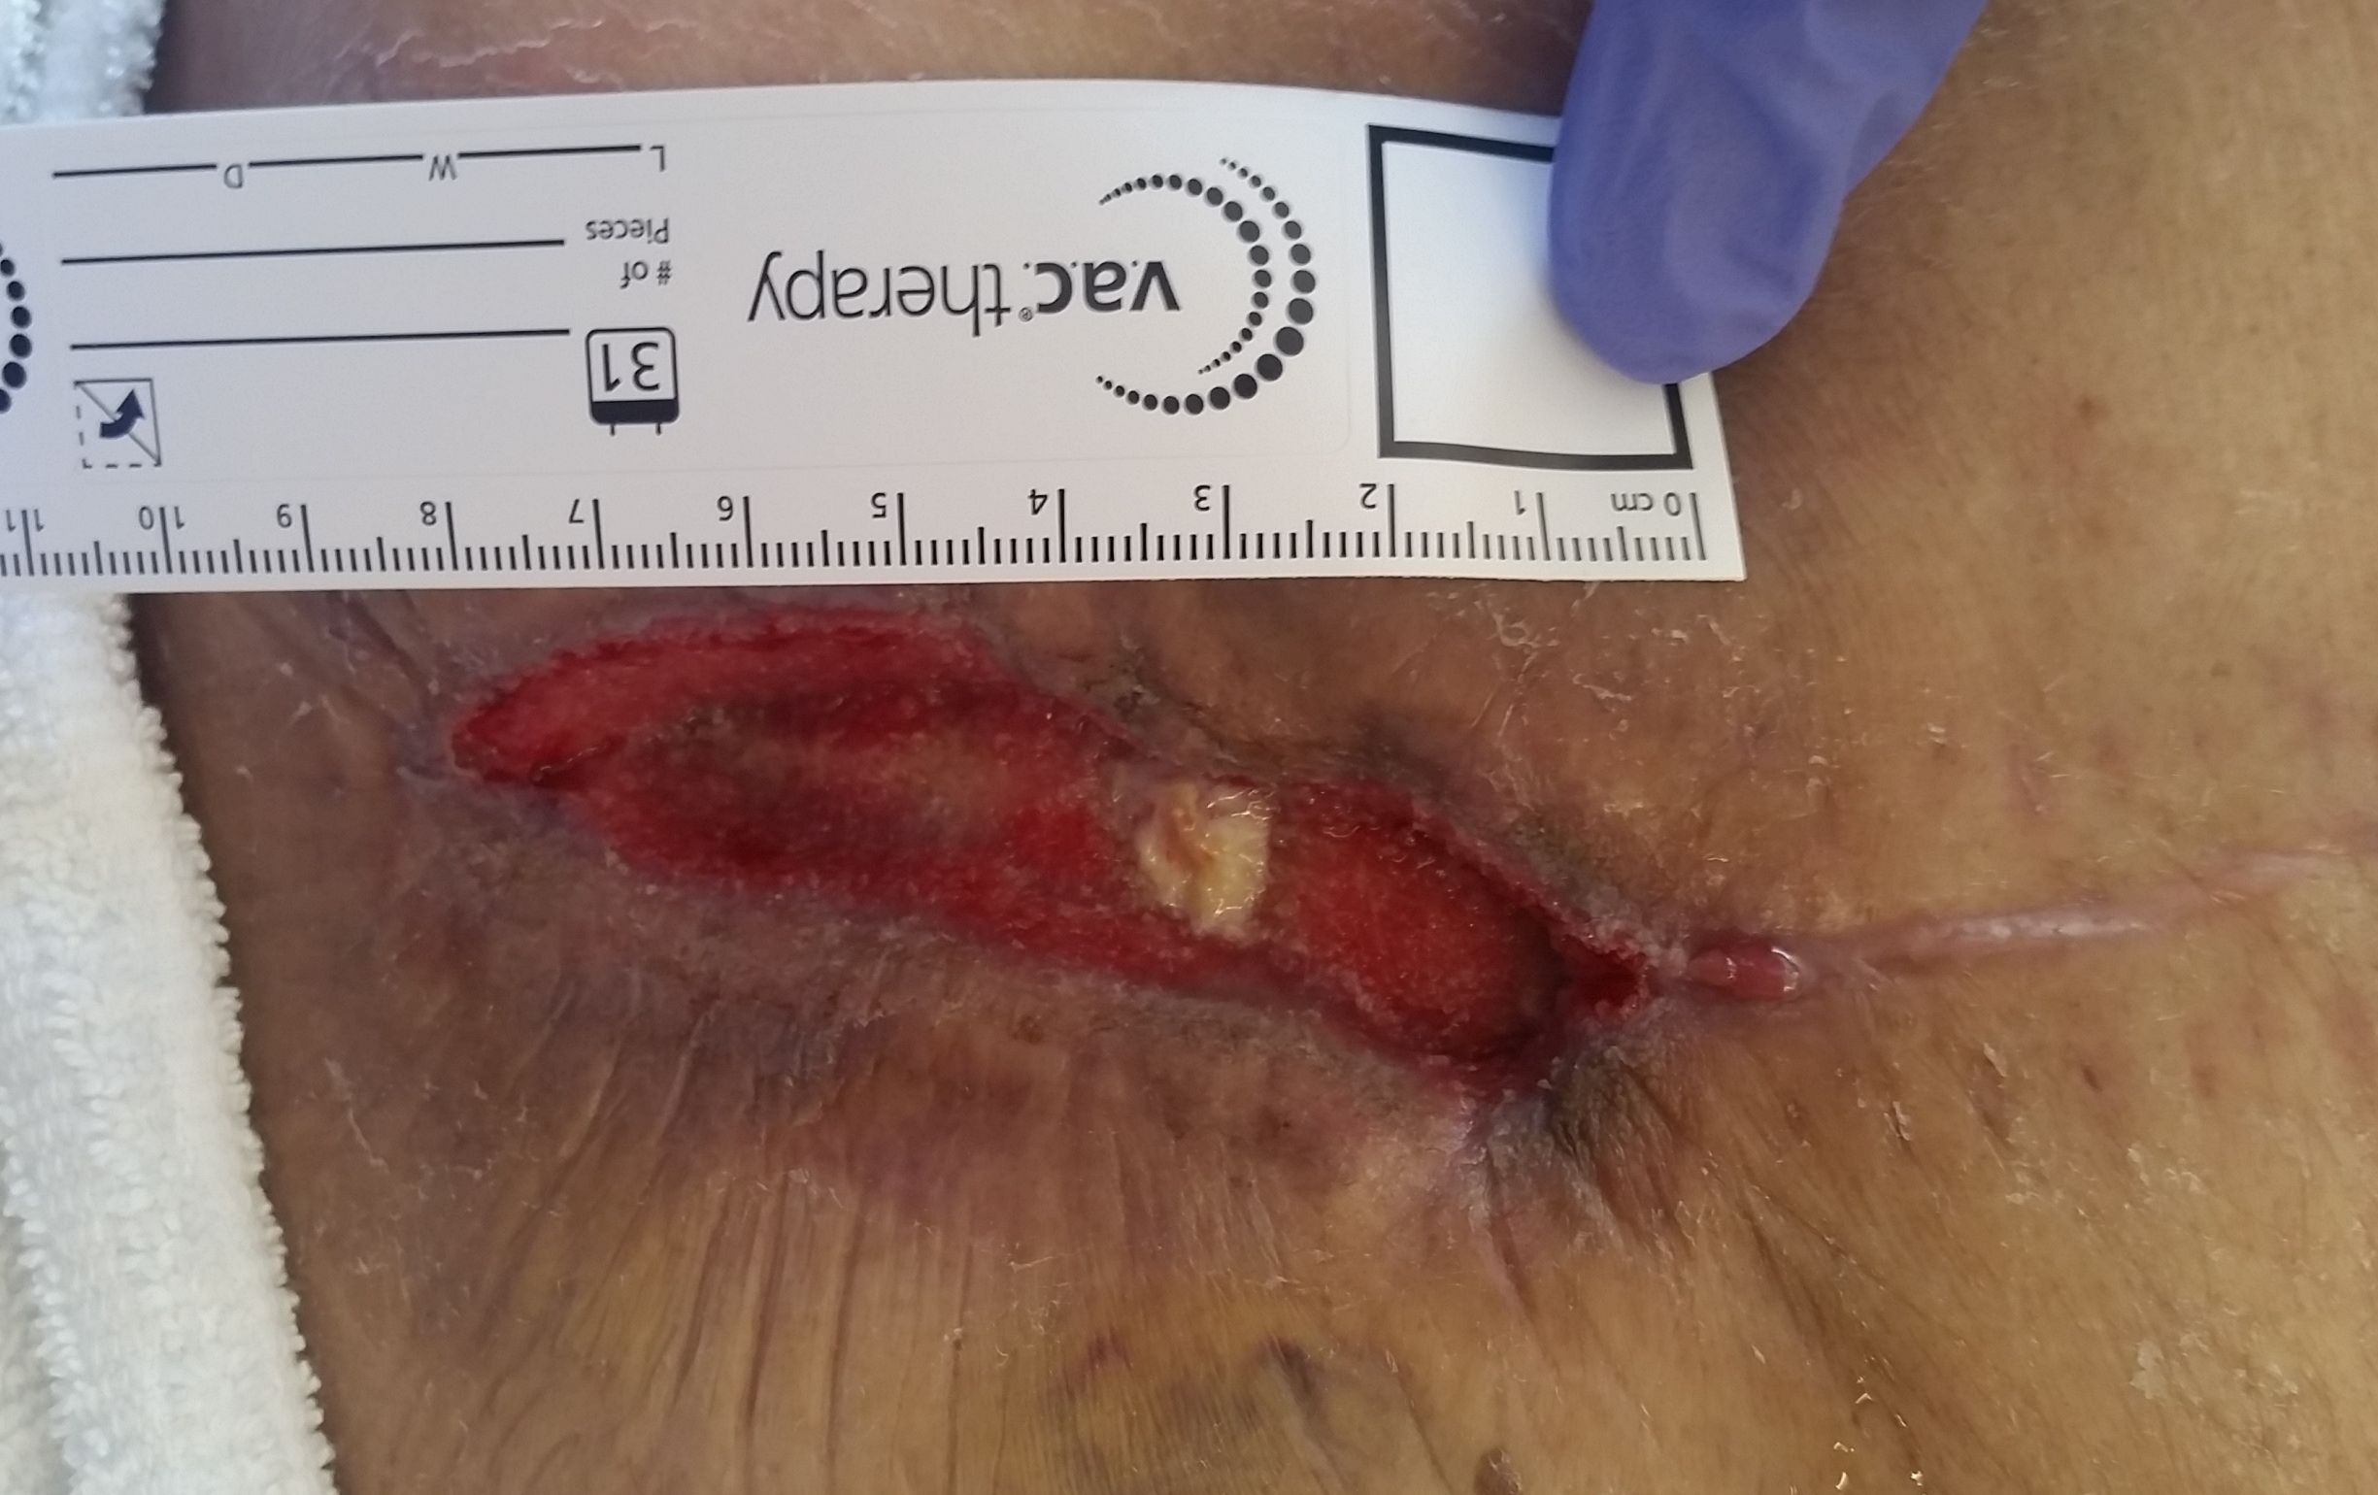
Day 7
Measurements 10 x 3 x 1.5
Day 9
Measurements 8 x 2 x 1.25

Slide 34
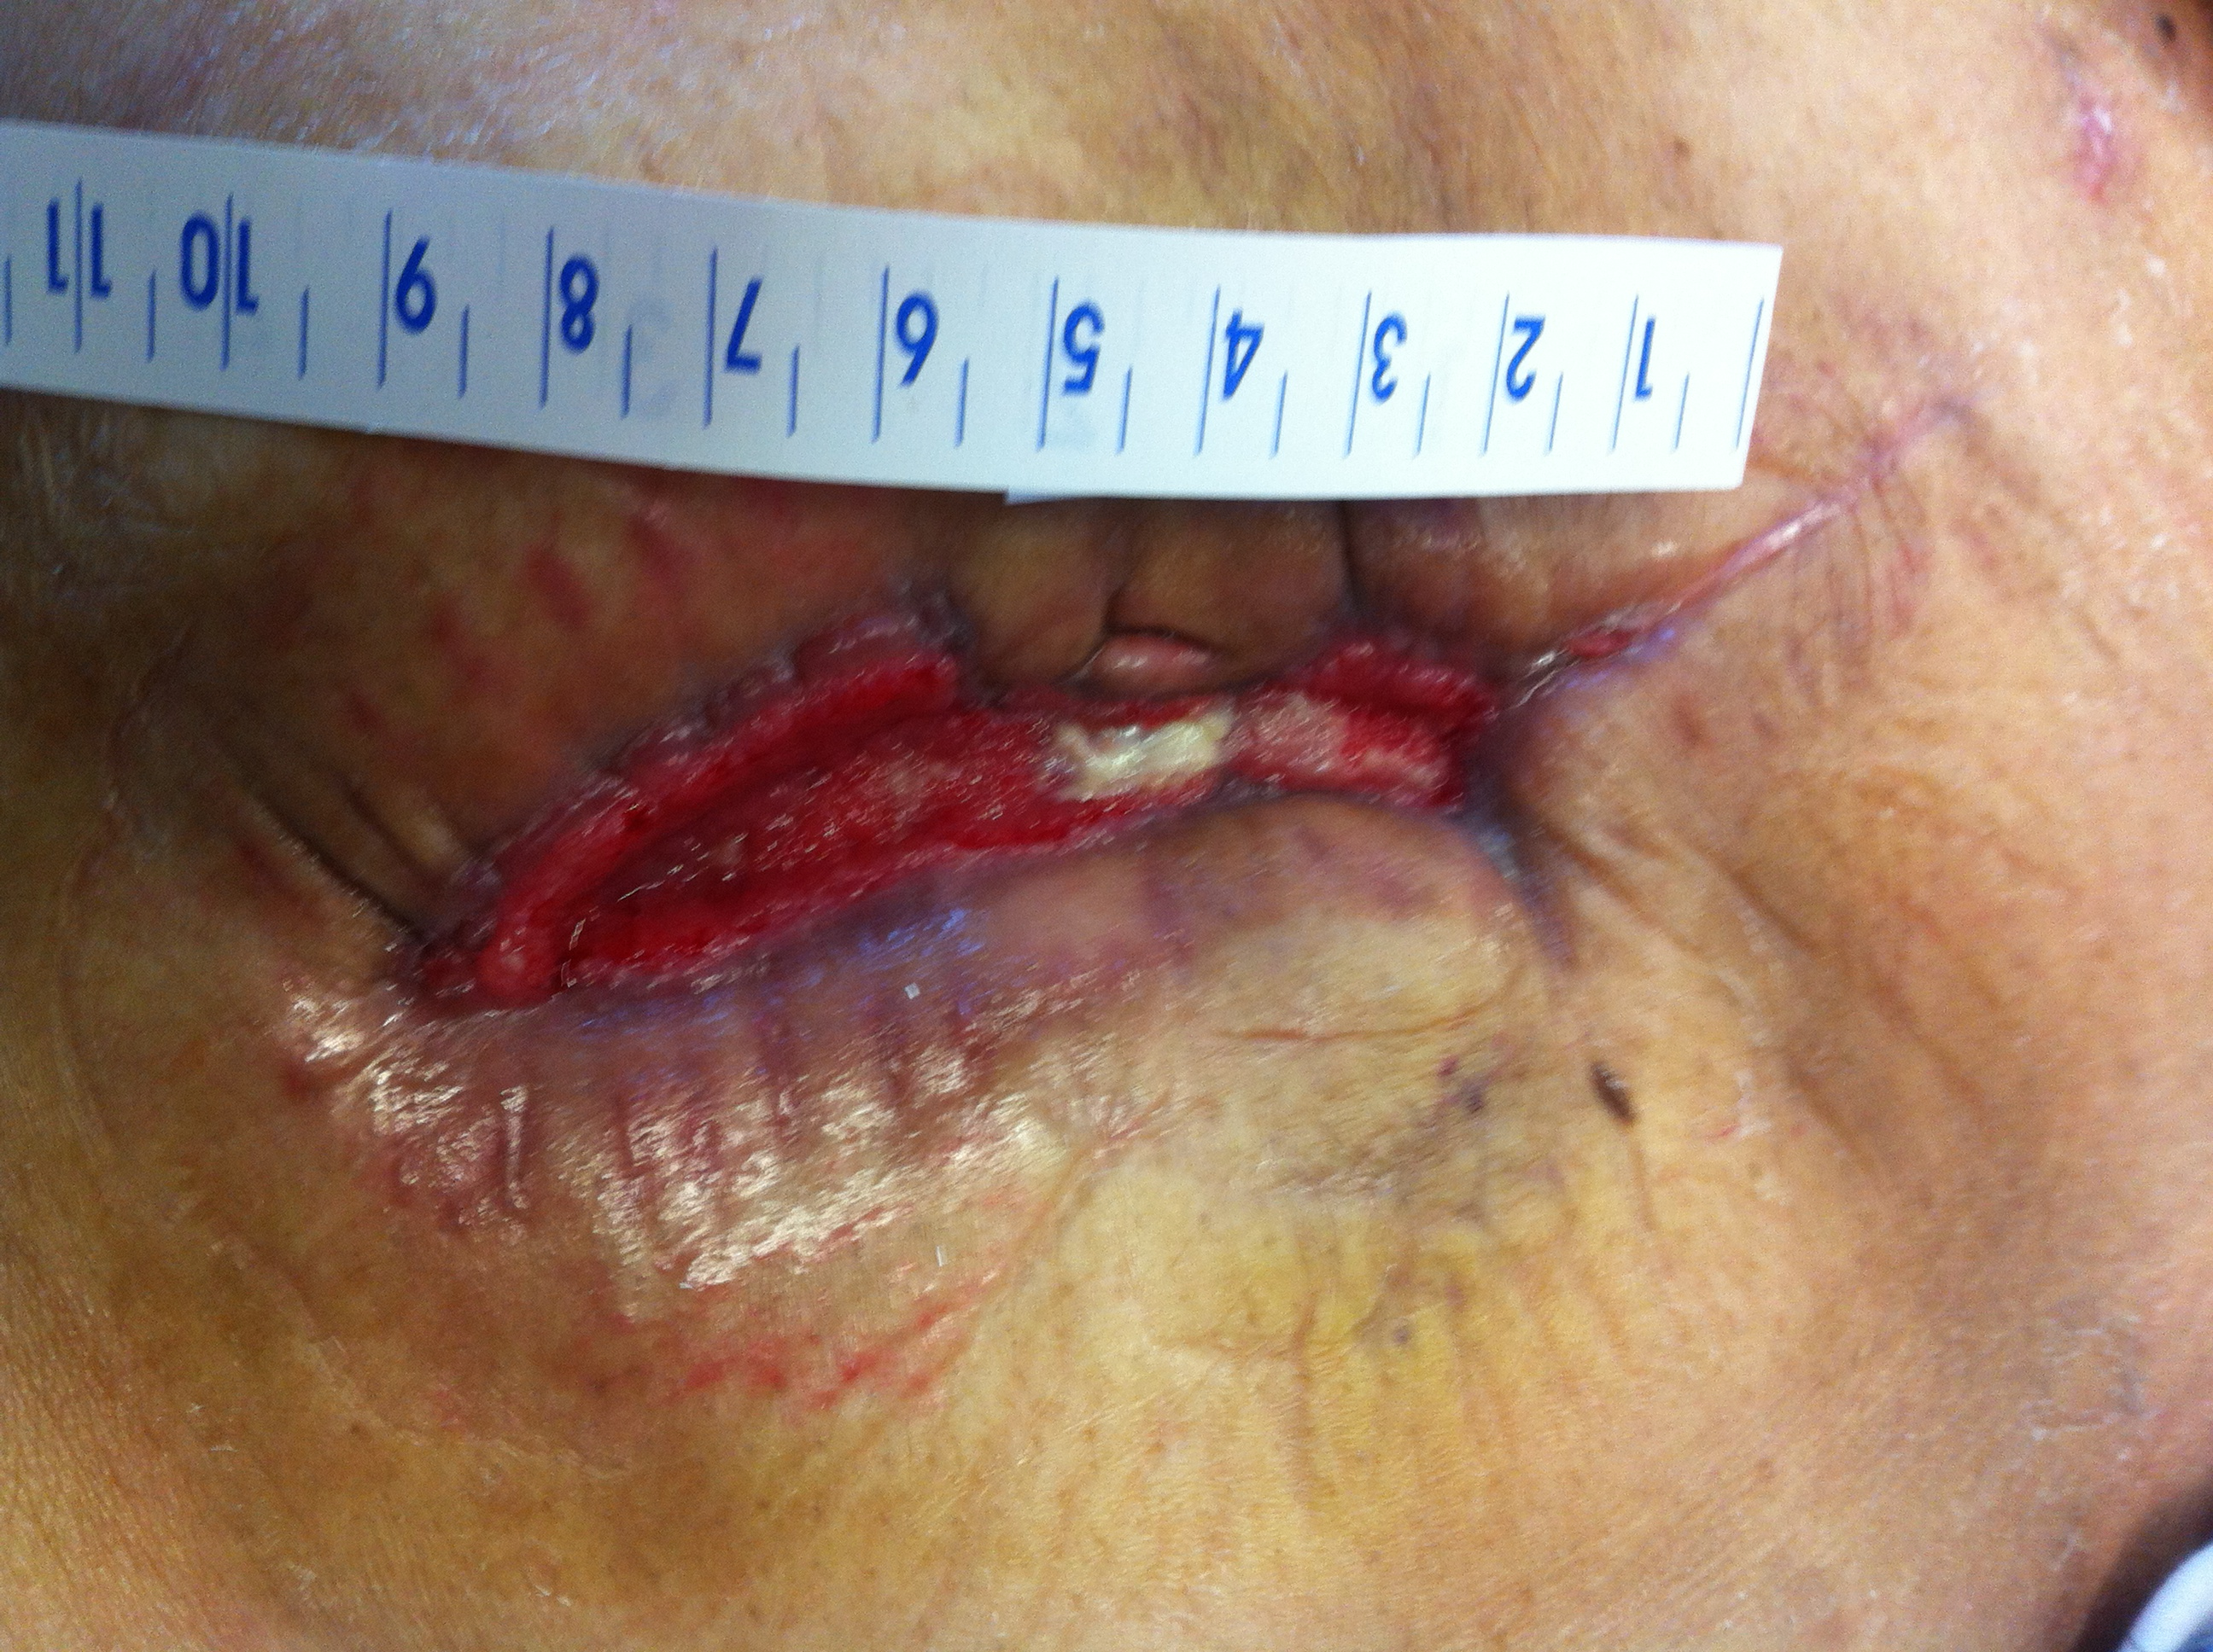
Day 1 NPWT:
Measurement: 11 x 5 x 1.5 cm
Day 16 NPWT
Measurements 7 x 1.5 x 0.5 cm

Slide 35
Day 16 NPWT
The wound has decreased in size and depth, the tissue is almost entirely beefy red granulation tissue. The white center is the previously mentioned umbilical stalk.
The epidermal tissue of several sections of the wound edge has rolled over onto itself, causing contact inhibition. This rolling of wound edges is called “Epibole” (Eh-pib-o-lee) and will need re-opening with silver nitrate treatment or sharps debridement so the epidermis can continue covering the wound.

Slide 36
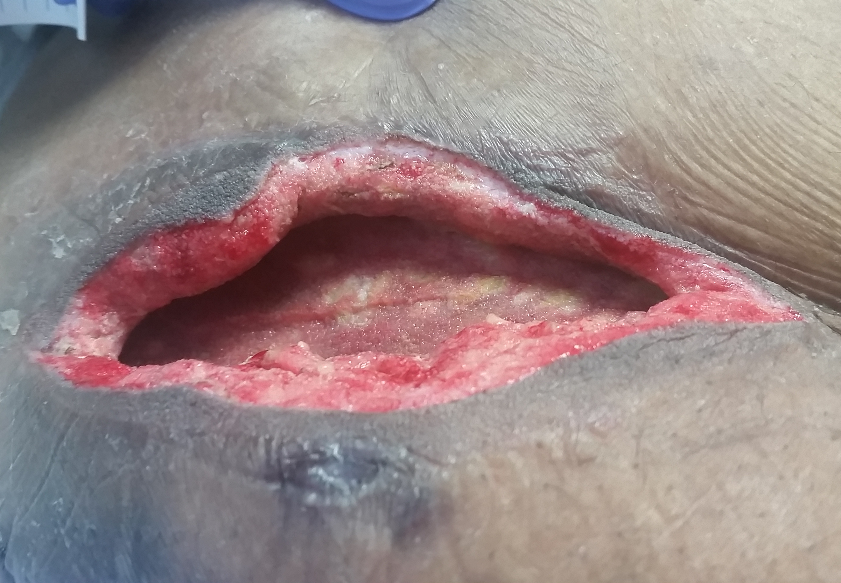
Hemicraniotomy Flap Storage
This wound is a good example of when to use white foam. This wound is where the excised skull flap from a hemicraniotomy was stored in the abdomen until reimplantation could occur after a decompression surgery was conducted related to a traumatic brain injury.
The skull flap failed to survive, and the wound required surgical debridement to remove hard eschar that had formed. The swabs show the depth of the undermining. A piece of white foam should be cut to slide all the way into the depth of these pockets BUT THEN gently pulled back 0.5 cm to allow a space in the tunnel or undermined area for the body to fill in with granulation tissue under NPWT.

Slide 37
Tips on Placement & Removal
Soak the foam with normal saline solution before removal
Snip holes in the drape and apply normal saline or sterile water to foam slowly. You can visualize the foam wicking up the normal saline.
Let sit 20-30 minutes before removal.
Do not apply “circumferential” dressings: If you apply drape all the way around a limb until it overlaps, the limb can swell and end up with complications.
After applying skin prep to the periwound, apply a strip of barrier ring around the wound edges. Then place the “window frame” drape over the barrier ring. This will protect and treat periwound maceration and really helps the dressing stay in place.

Slide 38
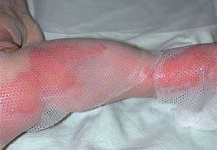
Tips on Placement & Removal
For painful wounds, apply a contact layer before the foam, as it will lift away MUCH easier.
If you are not going to use white foam over bone, ligament, tendon, then place a contact layer before black foam so the foam does not catch or adhere to those more unyielding layers.

Slide 39
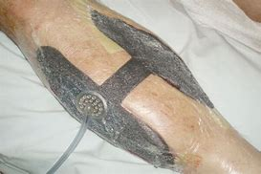
Bridging Technique
Bridge your dressing to an area that will not place pressure on the TRAC pad or tubing. In the photo, the bridge is connecting two wounds so only one machine is needed.

Slide 40
Application & Removal Precautions
VERY IMPORTANT
Count and label the dressing with how many pieces
of each color foam and contact layers GO INTO the wound
AND
Count and document how many pieces
of each color foam and contact layer COME OUT of the wound.

Slide 41
Alarms
If the NPWT device is giving a “Leakage” alarm, it may mean:
The closed system has been disrupted somewhere between the wound itself and the canister hooked into the Vac by an opening allowing air to enter or exit.
Check the dressing at creases, folds, TRAC pad edges, overlapping points in drape for possible leaks. Patch with pieces of drape.
Wiping the entire outer dressing with a skin prep wipe can help smooth down all the overlapping drape piece edges and quiet a leak alarm as well.
Check to ensure canister is locked into the side of the machine securely.

Slide 42
Alarms
If the NPWT device is giving a “Blockage” alarm, it may mean:
The TRAC pad or tubing is clogged (or thinks it is clogged)
It could be thickened drainage, clot or larger particle caught at the TRAC pad or in the tubing.
It may be the TRAC pad edges are curling down at the edges, causing a disruption in the flow.
The clamps on the tubing are still clamped.

Slide 43
Alarms
If the NPWT device is giving a “Low battery” alarm:
Just like a cell phone, the NPWT device has a battery. Several hours of battery life when charged well.
If the battery alarm sounds, plug in the charger.
TIP: Check when you patient returns from being off unit; Sometimes the machine does not get plugged back in upon return.

Slide 44
Conclusion
Negative Pressure Wound Therapy is an amazing adjunct therapy to wound healing.
It can help a wound heal up to twice as fast.
Dressing changes are less frequent, meaning less discomfort.
The dressing tends to be more secure, avoiding leakage of wound contents onto the periwound.
This same dressing security decreases bacteria invading the wound bed.
NPWT can frequently counter the negative affects of comorbidities on wound healing.

