Slide 1

IV Therapy Series: Taking Orders
Olympia Resol, RN, MPH, CRNI, CARN

Slide 2
Course Objectives
At the end of the course, the student should be able to:
Identify the most common reasons for IV therapy;
Determine who can give IV therapy orders;
Particularize what are included in an IV therapy order;
Understand the guidelines related to intravenous therapy;
Ascertain the two main types of venous access;
And lastly, the student should get acquainted with health information technology (HIT) integration in IV therapy.

Slide 3
Introduction
Intravenous therapy is treatment that infuses intravenous solutions, medications, blood, or blood products directly into a vein (Perry, Potter, & Ostendorf, 2014). Intravenous therapy is an effective and fast-acting way to administer fluid or medication treatment in emergency situations, and for patients who are unable to take medications orally. Approximately eighty percent (80%) of all patients in the hospital setting will receive intravenous therapy.

Slide 4
According to (Waitt, Waitt, & Pirmohamed (2004), the most common reasons for IV therapy include:
1. To replace fluids and electrolytes and maintain fluid and electrolyte balance: The body’s fluid balance is regulated through hormones and is affected by fluid volumes, distribution of fluids in the body, and the concentration of solutes in the fluid. If a patient is ill and has fluid loss related to decreased intake, surgery, vomiting, diarrhea, or diaphoresis, the patient may require IV therapy.

Slide 5
According to (Waitt, Waitt, & Pirmohamed (2004), the most common reasons for IV therapy include:
2. To administer medications, including chemotherapy, anesthetics, and diagnostic reagents: About forty percent (40%) of all antibiotics are given intravenously.

Slide 6
According to (Waitt, Waitt, & Pirmohamed (2004), the most common reasons for IV therapy include:
3. To administer blood or blood products: The donated blood from another individual can be used in surgery, to treat medical conditions such as shock or trauma, or to treat a failure in the production of red blood cells. The infusion restores circulating volumes, improving the ability to carry oxygen and replace blood components that are deficient in the body.

Slide 7
According to (Waitt, Waitt, & Pirmohamed (2004), the most common reasons for IV therapy include:
4. To deliver nutrients and nutritional supplements: IV therapy can deliver some or all of the nutritional requirements for patients unable to obtain adequate amounts orally or by other routes.

Slide 8

Who can give IV therapy orders?
IV fluid therapy is ordered by a physician or nurse practitioner.

Slide 9
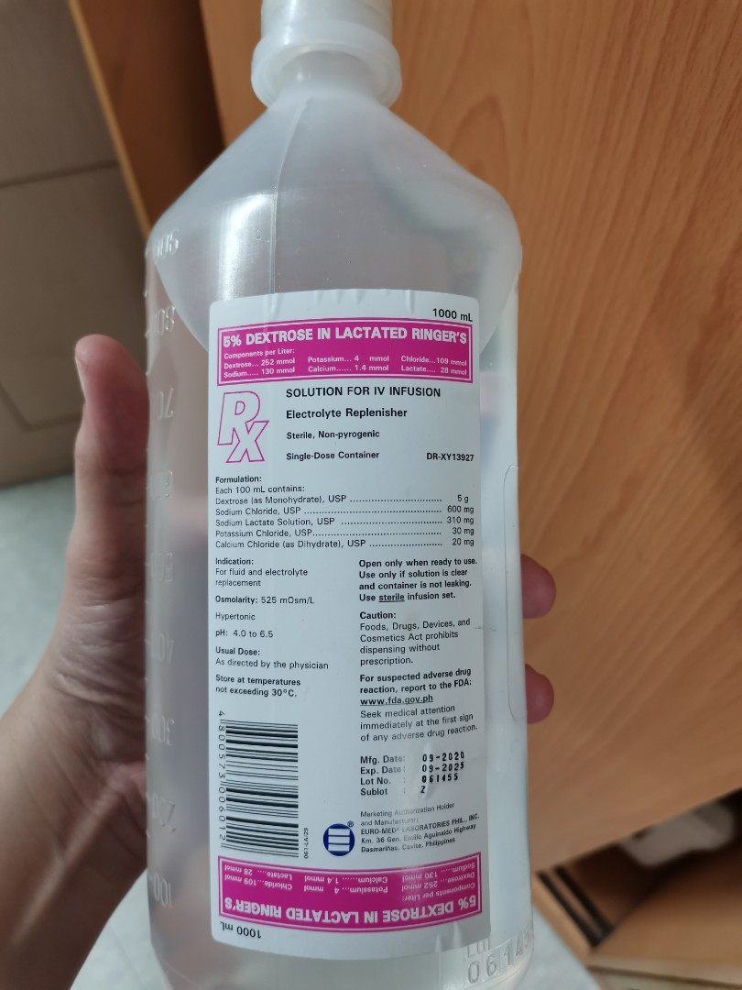
What are included in an IV therapy order?
The order must include
the type of solution or
medication, rate of
infusion, duration, date,
and time.

Slide 10
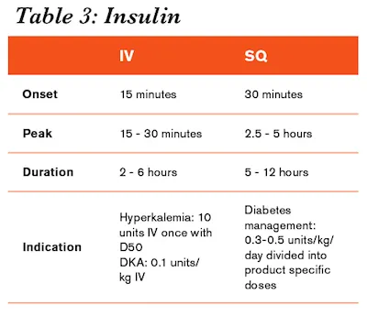
How long does IV therapy take place?
IV therapy may be for short or long duration, depending on the needs of the patient (Perry et al, 2014).

Slide 11
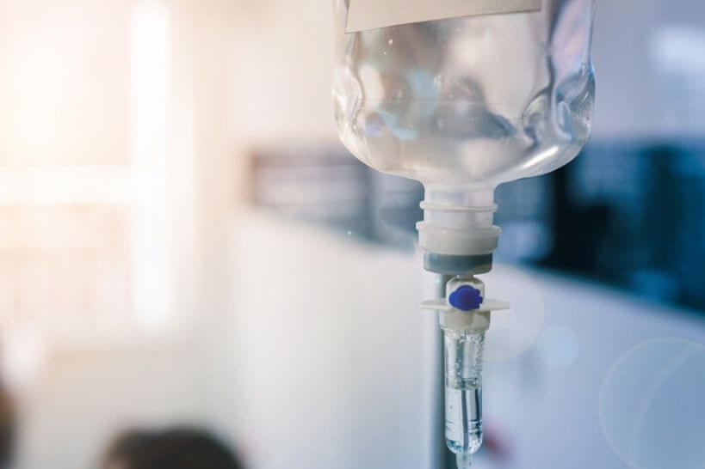
Guidelines Related to Intravenous Therapy
IV therapy is an invasive procedure, and therefore significant complications can occur if the wrong amount of IV fluids or the incorrect medication is given.

Slide 12
Guidelines Related to Intravenous Therapy
Aseptic technique must be maintained throughout all IV therapy procedures, including initiation of IV therapy, preparing and maintaining equipment, and discontinuing an IV system. Always perform hand hygiene before handling all IV equipment. If an administration set or solution becomes contaminated with a non-sterile surface, it should be replaced with a new one to prevent introducing bacteria or other contaminants into the system (Centers for Disease Control [CDC], 2011).

Slide 13
Guidelines Related to Intravenous Therapy
Understand the indications and duration for IV therapy for each patient. Practice guidelines recommend that patients receiving IV therapy for more than six days should be assessed for an intermediate or long-term device (CDC, 2011).

Slide 14
Guidelines Related to Intravenous Therapy
If a patient has an order to keep a vein open, or “TKVO,” the usual rate of infusion is twenty (20) to fifty (50) ml per hour (Fraser Health Authority, 2014).

Slide 15
Guidelines Related to Intravenous Therapy
Complications may occur with IV therapy, including but not limited to localized infection, catheter-related bloodstream infection (CR-BSI), fluid overload, and complications related to the type and amount of solution or medication given (Perry et al., 2014).

Slide 16
Guidelines Related to Intravenous Therapy
For an infusing peripheral IV, the site must be assessed every two (2) hours and p.r.n.
A saline lock site must be assessed every twelve (12) hours and p.r.n.

Slide 17
Types of Venous Access
Safe and reliable venous access for infusions is a critical component of patient care in the acute and community health setting. There are a variety of options available, and a venous access device must be selected based on the duration of IV therapy, type of medication or solution to be infused, and the needs of the patient. In practice, it is important to understand the options of appropriate devices available. This section will describe two types of venous access: peripheral IV access and central venous catheters.

Slide 18
Peripheral IV
A peripheral IV is a common, preferred method for short-term IV therapy in the hospital setting. A peripheral IV (PIV) (see Figure 8.1) is a short intravenous catheter inserted by percutaneous venipuncture into a peripheral vein, held in place with a sterile transparent dressing to keep the site sterile and prevent accidental dislodgement (CDC, 2011). Upper extremities (hands and arms) are the preferred sites for insertion by a specially trained health care provider. If a lower extremity is used, remove the peripheral IV and re-site in the upper extremities as soon as possible (CDC, 2011; McCallum & Higgins, 2012). The hub of a short intravenous catheter is usually attached to IV extension tubing with a positive pressure cap (Fraser Health Authority, 2014).

Slide 19
Peripheral IV
PIVs are used for infusions under six days and for solutions that are iso-osmotic or near iso-osmotic (CDC, 2011). They are easy to monitor and can be inserted at the bedside. CDC (2011) recommends that PIVs be replaced every 72 to 96 hours to prevent infection and phlebitis in adults. Most agencies require training to initiate IV therapy, but the care and preparation of equipment, and the maintenance of an IV system can be completed each shift by the trained health care provider.

Slide 20
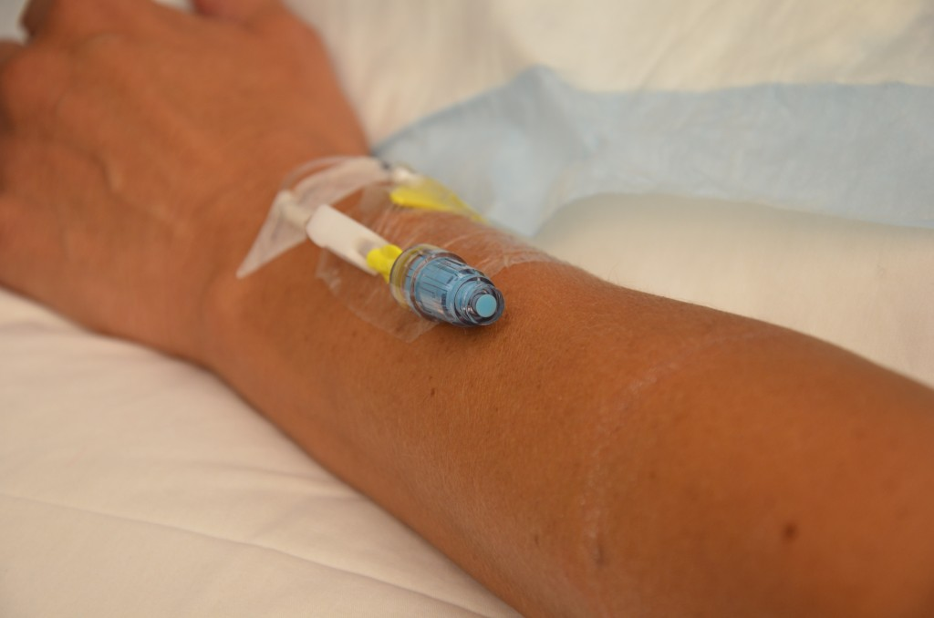
Peripheral IV
PIVs are prone to phlebitis and infection, and should be removed (CDC, 2011) as follows:
Every 72 to 96 hours and p.r.n.
As soon as the patient is stable and no longer requires IV fluid therapy
As soon as the patient is stable following insertion of a cannula in an area of flexion
Immediately if tenderness, swelling, redness, or purulent drainage occurs at the insertion site
When the administration set is changed (IV tubing)
Figure 8.1 Peripheral intravenous (IV) catheter (PIV)

Slide 21
Peripheral IV
Several potential complications may arise from peripheral intravenous therapy. It is the responsibility of the health care provider to monitor for signs and symptoms of complications and intervene appropriately. Complications can be categorized as local or systemic. Most complications are avoidable if simple hand hygiene and safe principles are adhered to for each patient at every point of contact (Fraser Health Authority, 2014; McCallum & Higgins, 2012).

Slide 22
Central Venous Catheters
A central venous catheter (CVC) (see Figure 8.2), also known as a central line or central venous access device, is an intravenous catheter that is inserted into a large vein in the central circulation system, where the tip of the catheter terminates in the superior vena cava (SVC) that leads to an area just above the right atrium. CVCs have become common in health care settings for patients who require IV medication administration and other IV treatment requirements. CVCs can remain in place for more than one year. Some CVC devices may be inserted at the bedside, while other central lines are inserted surgically. Central lines are inserted by a physician or specially trained health care provider, and the use of ultrasound guided placement is recommended to reduce time of insertion and complications (Safer Healthcare Now, 2012).

Slide 23
Central Venous Catheters
A CVC has many advantages over a peripheral IV line, including the ability to deliver fluids or medications that would be overly irritating to peripheral veins, and the ability to access multiple lumens to deliver multiple medications at the same time (Fraser Health Authority, 2014). Central venous catheters can be inserted percutaneously or surgically through the jugular, subclavian, or femoral veins, or via the chest or upper arm peripheral veins (Perry et al., 2014). Femoral veins are not recommended, as the rate of infection is increased in adults (CDC, 2011; Safer Healthcare Now, 2012). To have a CVC inserted or removed, an order by a physician or nurse practitioner must be obtained. Site selection for a CVC may be based on numerous factors, such as the condition of the patient, patient’s age, and type and duration of IV therapy.

Slide 24
Central Venous Catheters
The majority of patients in an ICU will have a CVC to receive fluids and medications. A chest X-ray is given to determine correct placement before inserting, or to confirm a suspected dislodgement (Fraser Health Authority, 2014). An IV pump must be used with all CVCs to prevent complications.

Slide 25
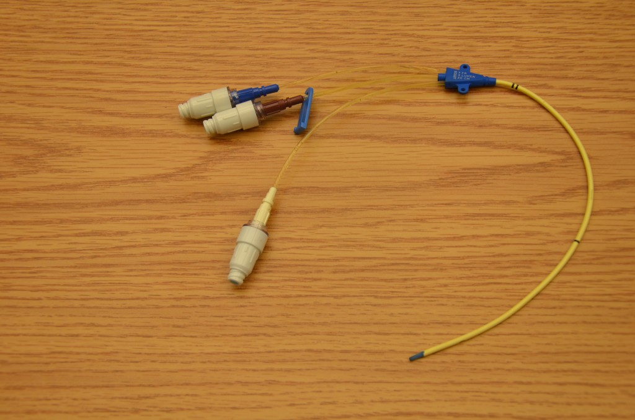
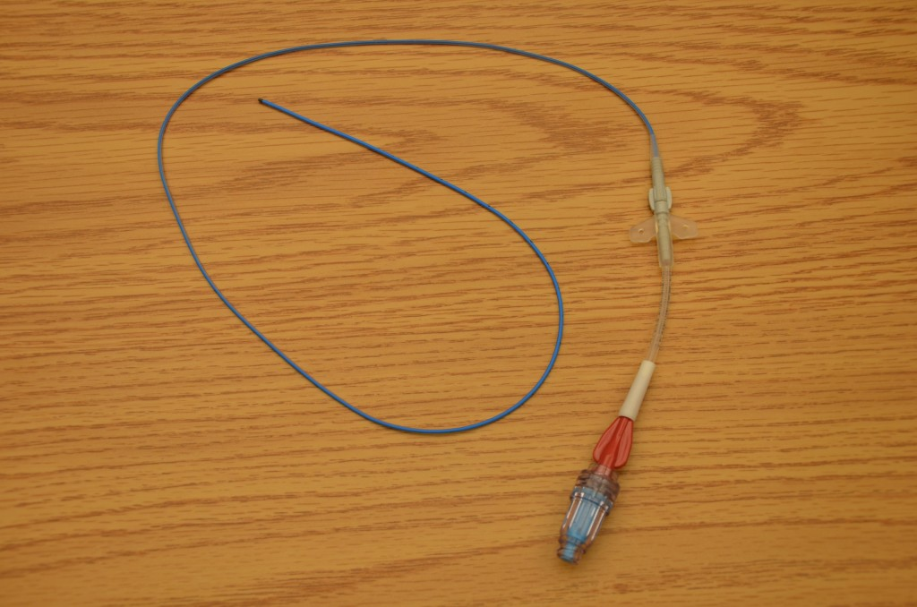
Central Venous Catheters
CVCs are typically inserted for patients requiring more than six days of intravenous therapy or who:
Require antineoplastic medications
Are seriously or chronically ill
Require vesicant or irritant medications
Require toxic medications or multiple medications
Require central venous pressure monitoring
Require long-term venous access or dialysis
Require total parenteral nutrition
Require medications with a pH greater than 9 or less than 5, or osmolality of greater than 600mOsm/L
Have poor vasculature
Have had multiple PIV insertions/attempts (e.g., two attempts by two different IV therapy practitioners)
Figure 8.2 Central venous catheter (CVC) with three lumens
Figure 8.3 Peripherally inserted central catheter (PICC)
with one lumen

Slide 26
Central Venous Catheters
A central line is made up of lumens. A lumen is a small hollow channel within the CVC tube. A CVC may have single, double, triple, or quadruple lumens (Perry et al., 2014). Depending on the type of CVC, it may be internally or externally inserted, and may have an open-ended or valved tip. Open-ended devices are those in which the catheter tip is open like a “straw.” These have a higher risk for complications, such as hemorrhage, air embolism, and occlusion from fibrin or clots. Valved devices are those in which the tip is configured with a three-way pressure-activated valve (Perry et al., 2014). It is important to know what type of central line is being used, as this will impact how to care for and manage the equipment for specific procedures.

Slide 27
Types Of Central Venous Catheters (CVCS)
Safety considerations:
CVC care and maintenance requires specialized training to prevent complications.
Central lines heighten the risk for patients to develop a nosocomial infection. Strict adherence to aseptic technique is required for all CVC care.

Slide 28
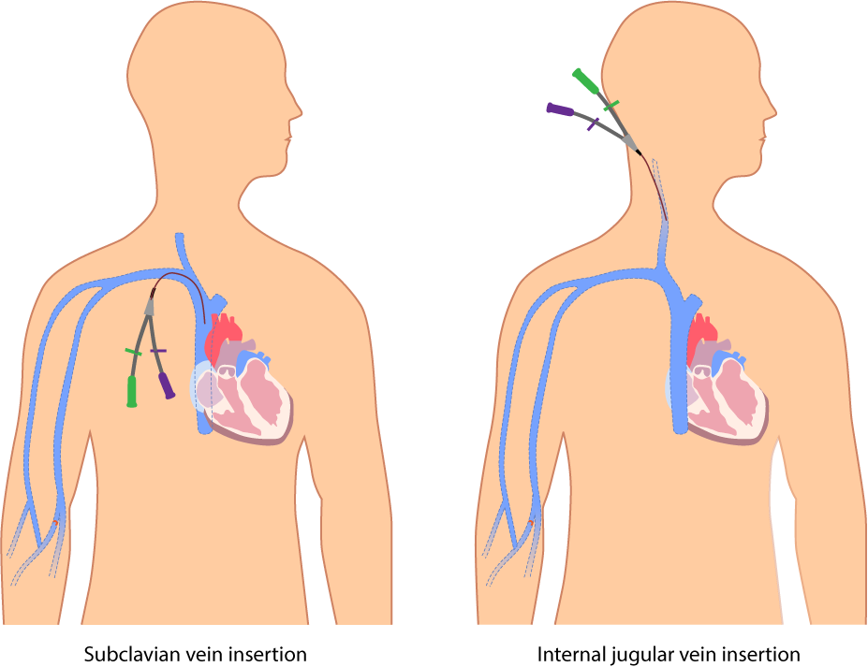
Percutaneous central venous catheter (CVC)
Tip location: The tip of the catheter is located in the SVC. The entry site is the exit site.
Can be inserted at the bedside by specially trained physician or nurse. The percutaneous CVC is inserted directly through the skin. The internal or external jugular, subclavian, or femoral vein is used.
Central venous catheters

Slide 29
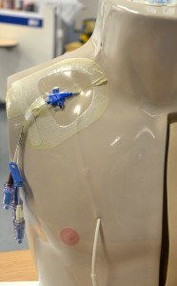
Percutaneous central venous catheter (CVC)
Most commonly used in critically ill patients. Can be used for days to weeks, and the patient must remain in the hospital. Usually held in place with sutures or a manufactured securement device.
Internal jugular venous catheter (upper CVC)

Slide 30
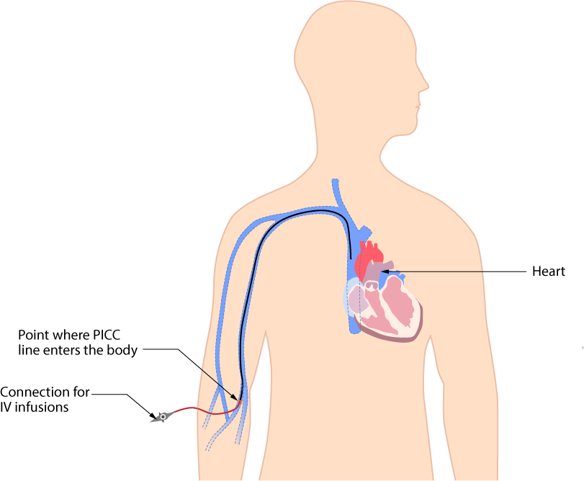
Peripherally inserted central catheter (PICC)
Tip location: The tip is located in the SVC.
A PICC (see Figure 8.3) may be inserted at the bedside, in a home or radiology setting. The line is inserted through the antecubital fossa or upper arm (basilic or cephalic vein) and is threaded the full length until the tip reaches the SVC. Can provide venous access for up to one year. The patient may go home with a PICC. PICCs can easily occlude and may not be used with dilantin IV. It is held in place with sutures or a manufactured securement device.
PICC line inserted in the upper arm (through the basilic vein)

Slide 31
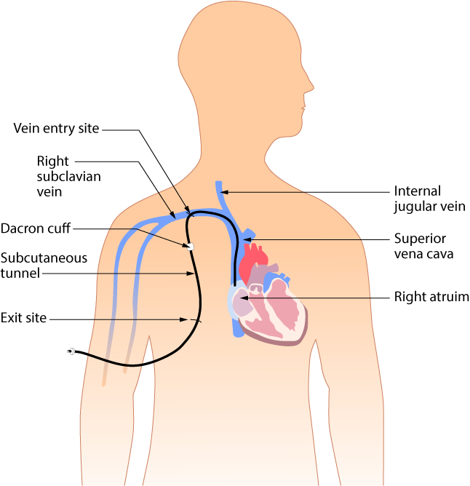
Subcutaneous or tunnelled central venous catheter
A tunnelled CVC, also known as a Hickman, Broviac, or Groshong, is a long-term CVC with a proximal end tunnelled subcutaneously from the insertion site and brought out through the skin at an exit site. Insertion is a surgical procedure, in which the catheter is tunnelled subcutaneously under the skin in the chest area before it enters the SVC. A tunnelled catheter may remain inserted for months to years. These CVCs have a low infection rate due to a Dacron cuff, an antimicrobial cuff surrounding the catheter near the entry site, which is coated in antimicrobial solution and holds the catheter in place after two to three weeks of insertion.
Tunnelled CVC

Slide 32
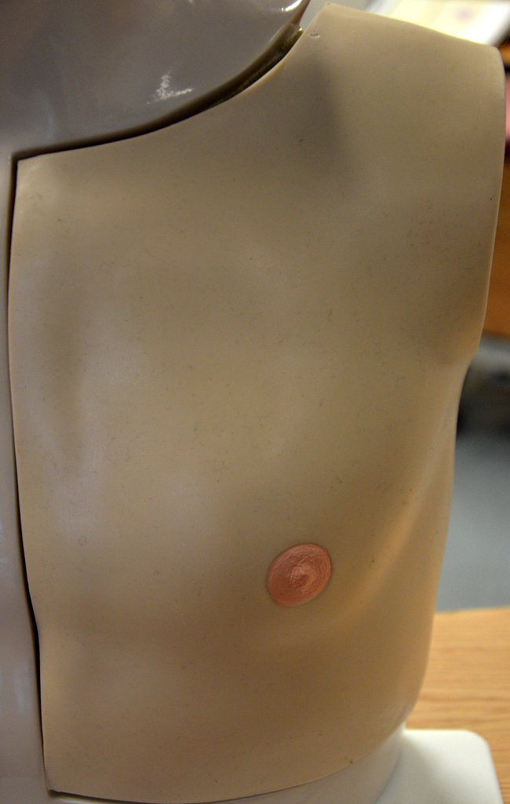
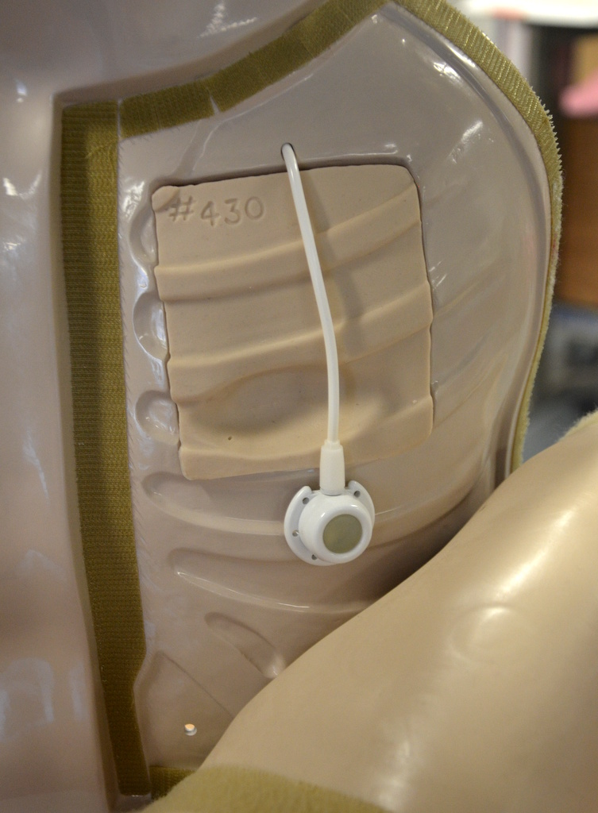
Implanted central venous catheter (ICVC, port a cath)
The implanted central venous catheter (ICVC) is inserted into a vessel, body cavity, or organ and is attached to a reservoir or “port,” located under the skin. The ICVC is also referred to as a port a catheter or port a cath. A surgical procedure is required to insert the device, which is considered permanent. The device may be placed in the chest, abdomen, or inner aspect of the forearms. It is often better for body image. The ICVC can be accessed using a non-coring needle. A patient may return home with this type of CVC.
Chest with ICVC inserted
ICVC under the skin
Data source: Fulcher & Frazier, 2011; Perry et al., 2014

Slide 33
Central Venous Catheters
CVCs have specific protocols for accessing, flushing, disconnecting, and assessment. All health care providers require specialized training to care for, manage complications related to, and maintain CVCs as per agency policy. Never access or use a central line for IV therapy unless trained as per agency policy.

Slide 34
Central Venous Catheters
Health care providers should assess a patient with a central line at the beginning and the end of every shift, and as needed. For example, if the central line has been compromised (pulled or kinked), ensure it is functioning correctly.

Slide 35
Central Venous Catheters
Each assessment should include:
Type of CVC and insertion date:
reason for CVC
Dressing: is it dry and intact?
Lines: secure with stat-lock, sutures,
or Steri-Strips?
Review: patient still requires a CVC?
Insertion site: free from redness, pain, swelling?
Positive pressure cap: attached securely?
IV fluids: running through an IV pump?
Lumens: number of lumens and type of fluids running through each?
Vital signs: fever?
Respiratory/cardiovascular check: any signs and symptoms of fluid overload?

Slide 36
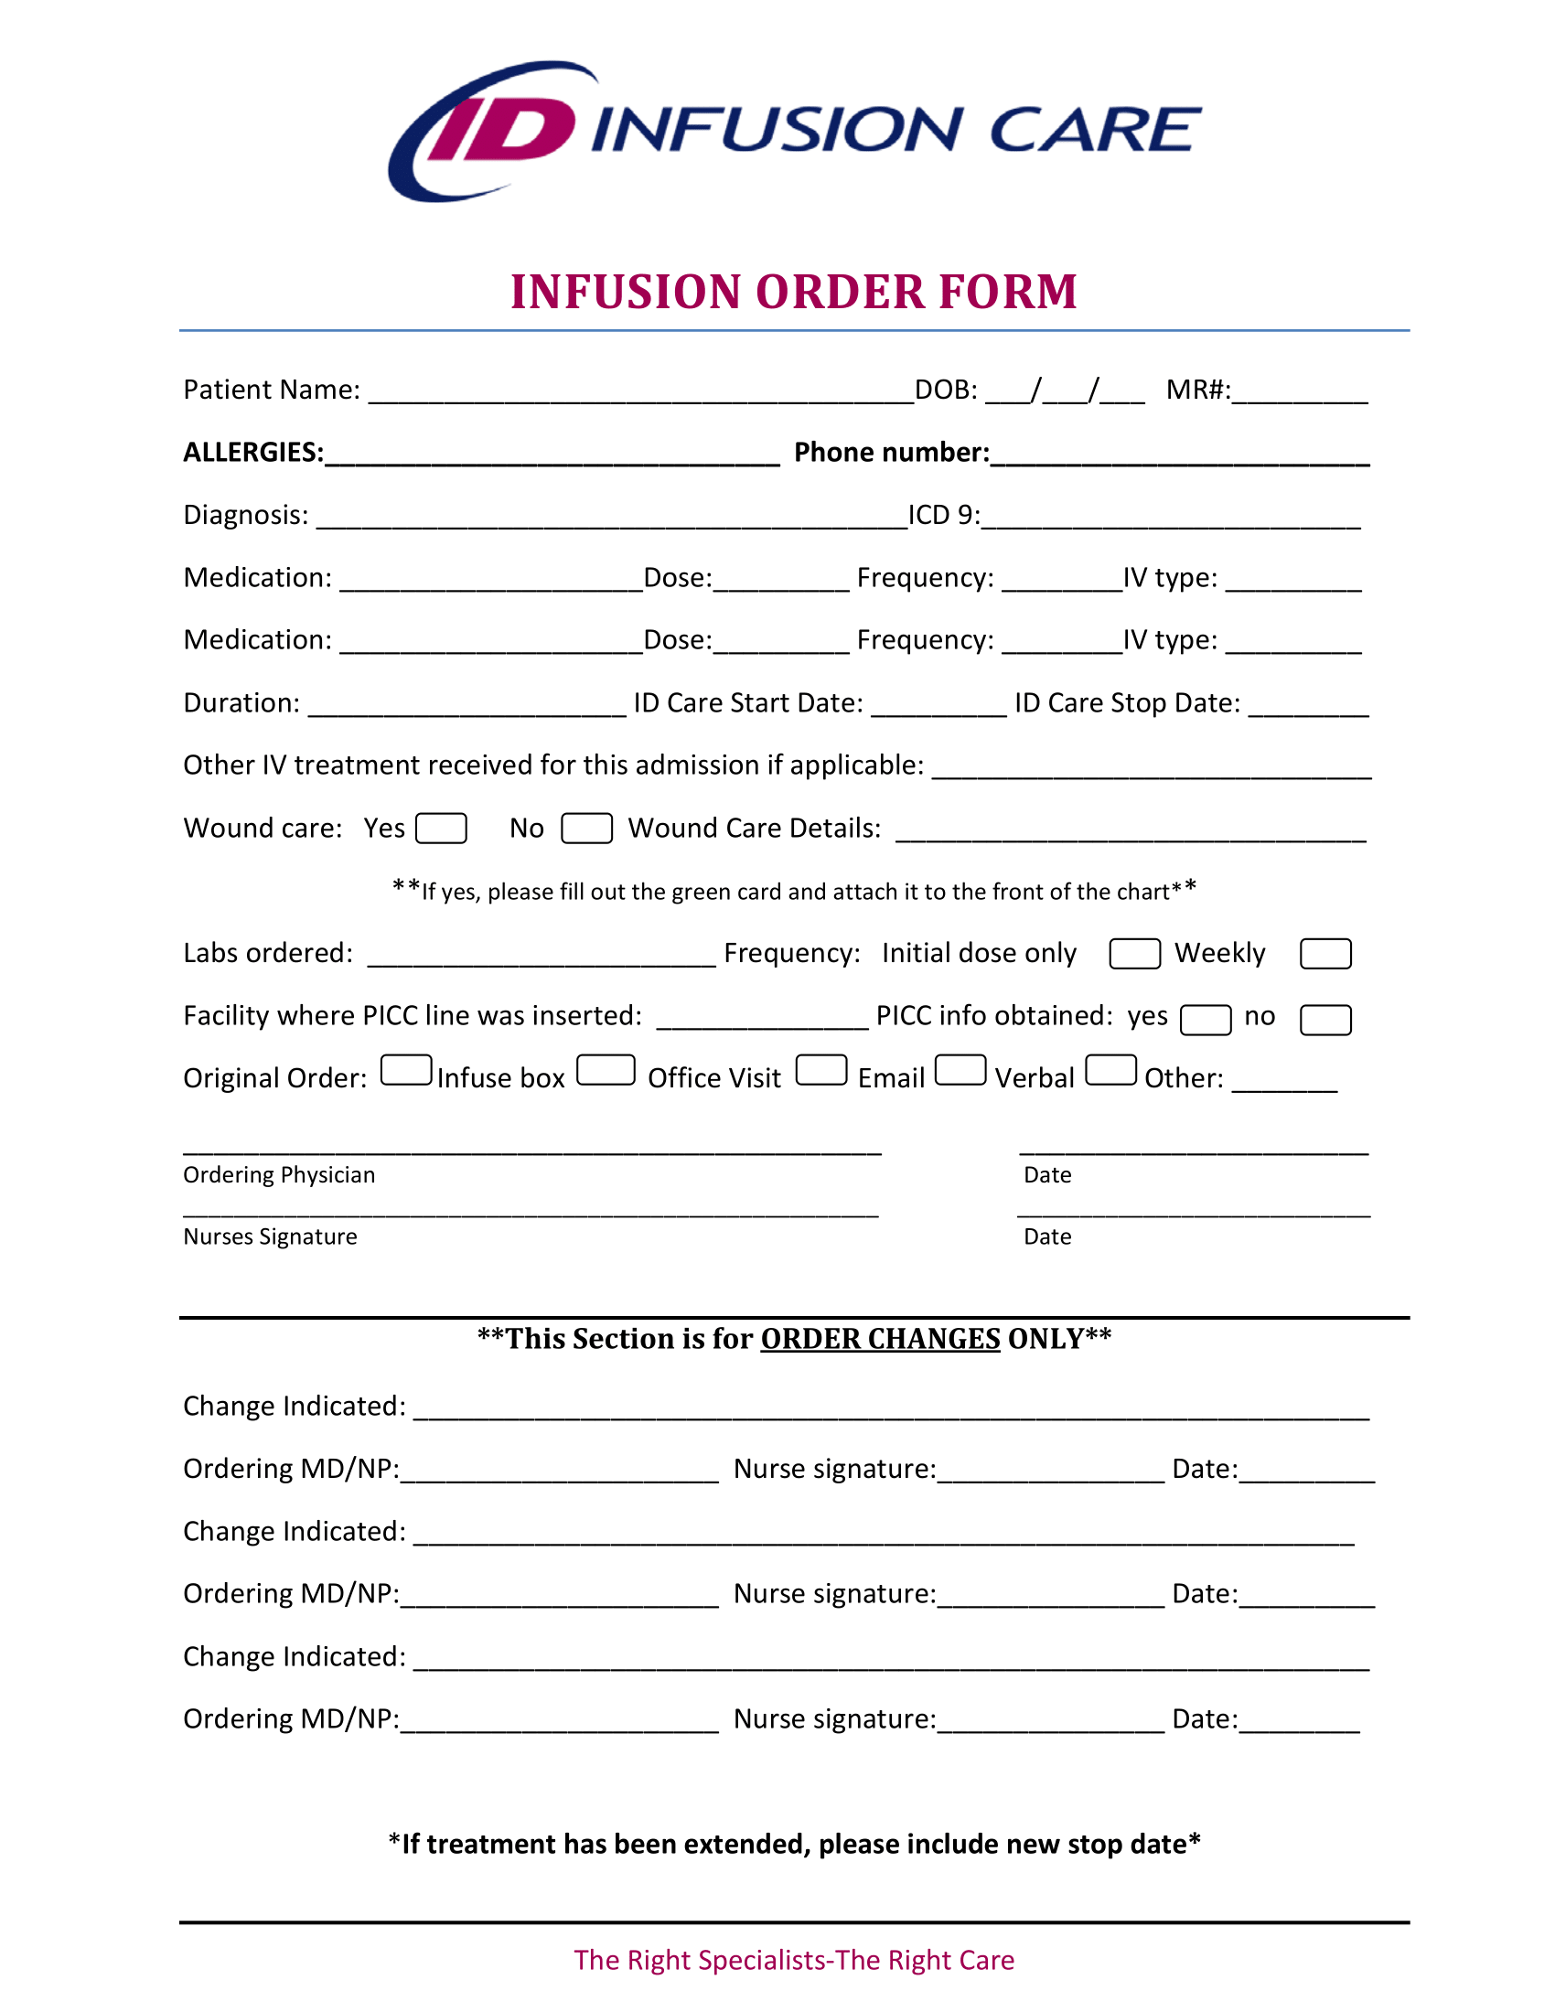
Infusion Order Form Example

Slide 37
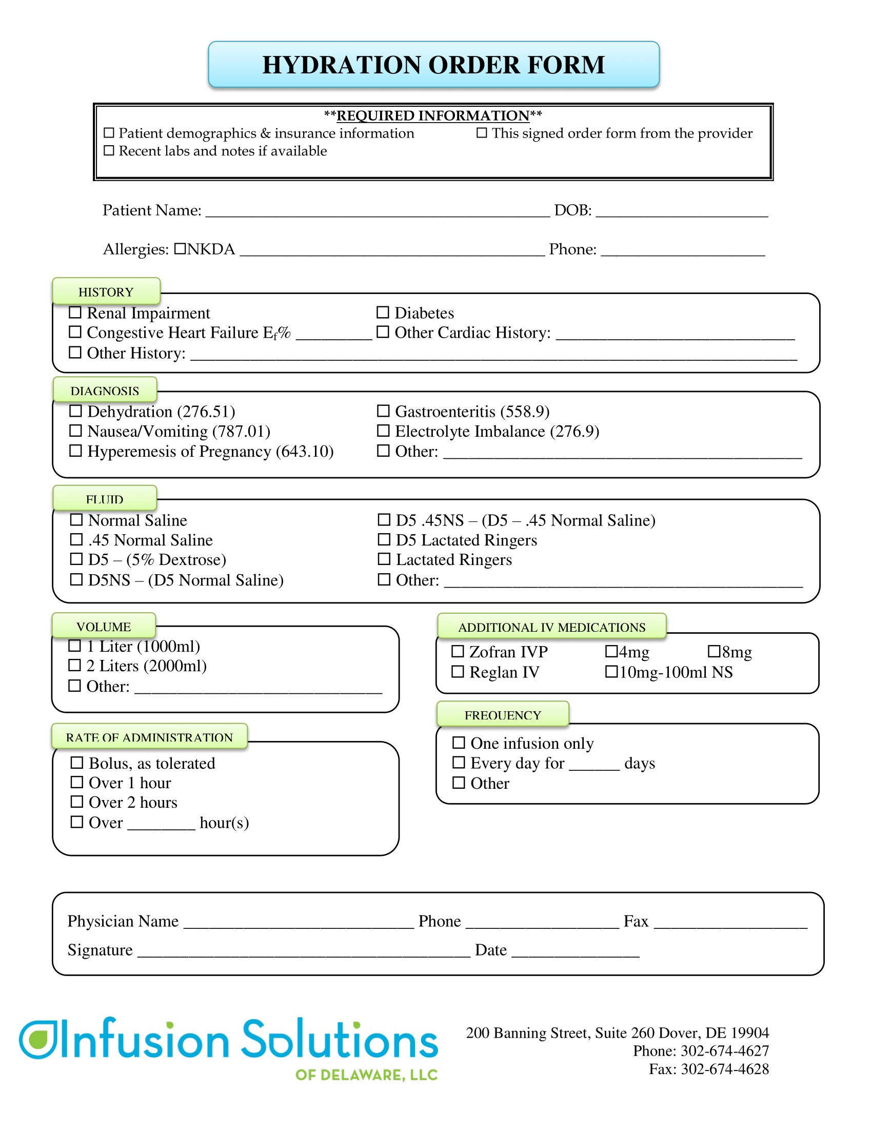
Infusion Order Form Example

Slide 38
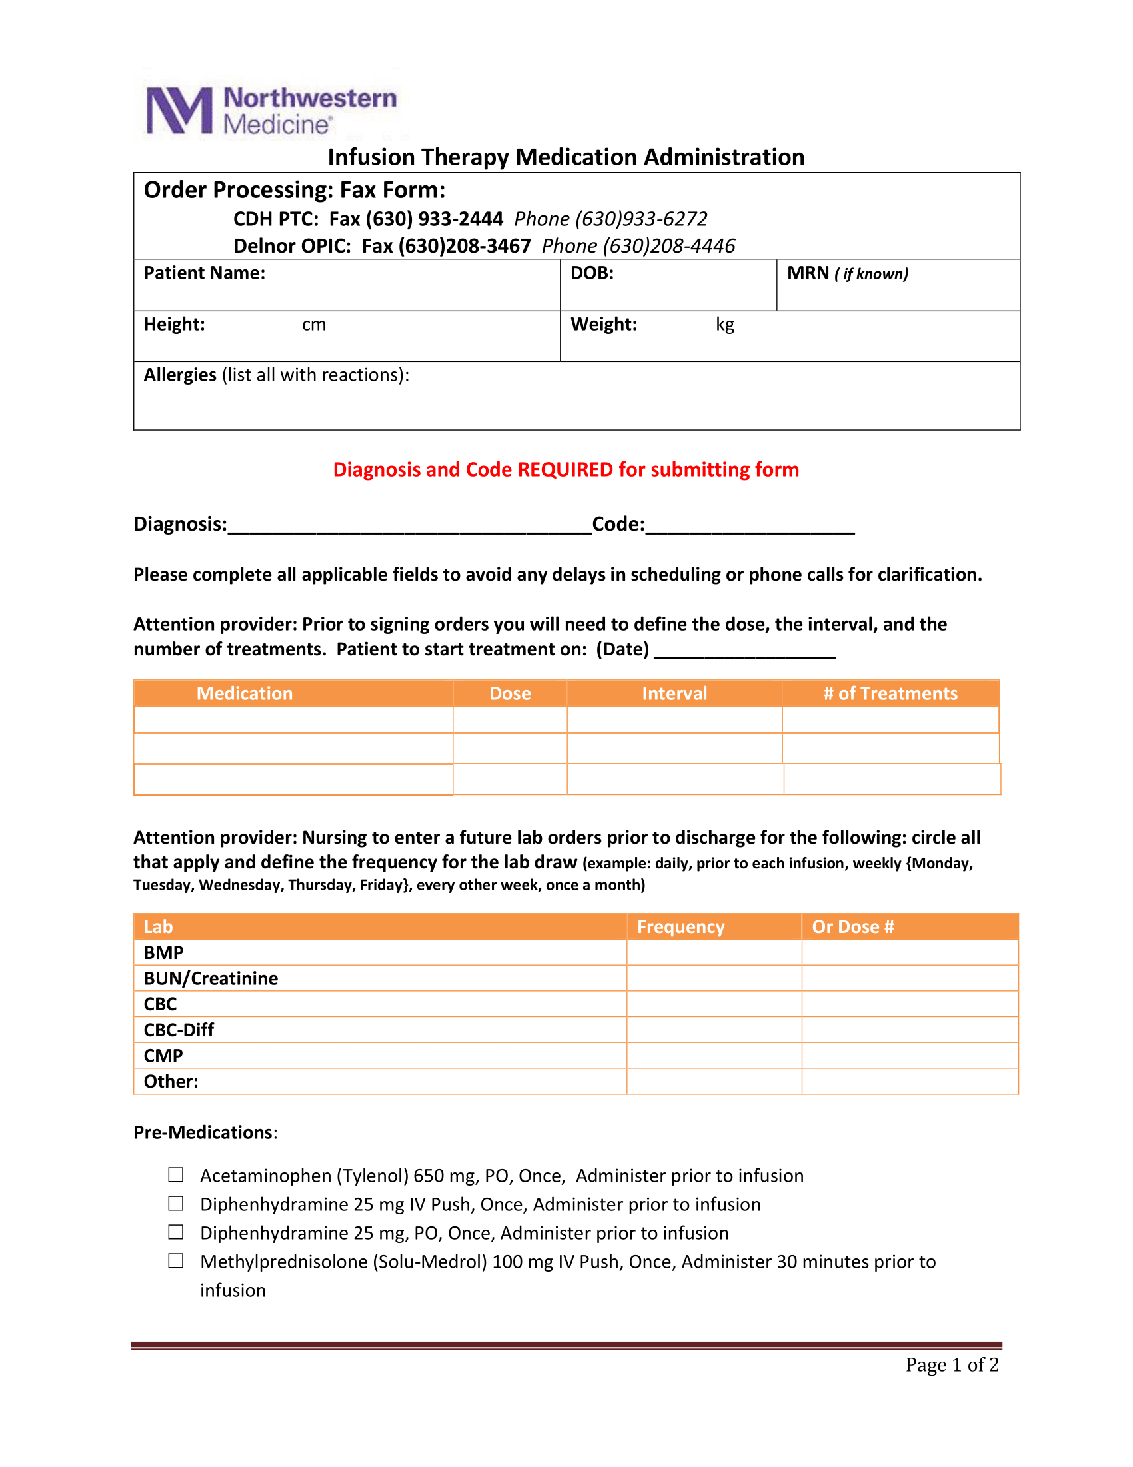
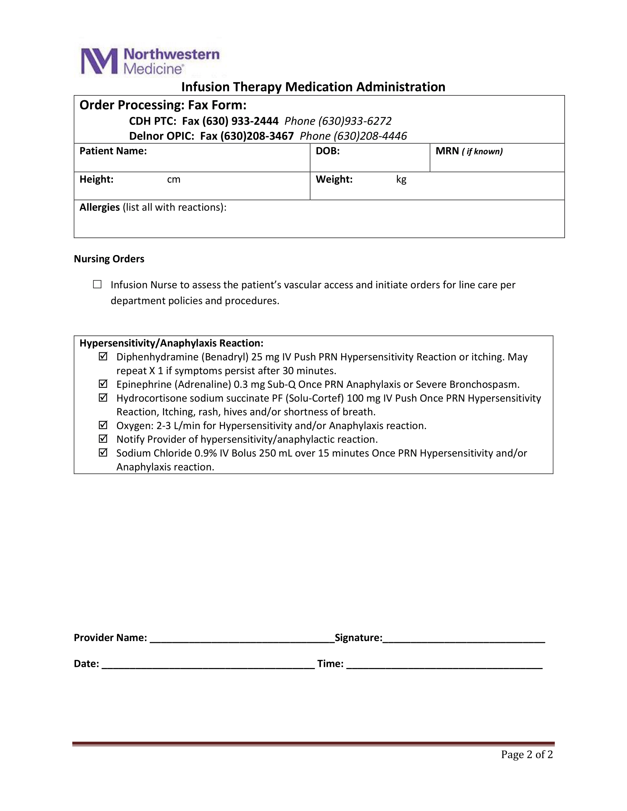

Slide 39
Health Information Technology Integration
The American healthcare system, like those in other developed nations, has begun to aggressively embrace health information technology (HIT) as a panacea for improving value (i.e., benefit/cost ratio), safety, efficiency, and even patient satisfaction. In fact, the scientific evidence supporting the widespread belief in this “technology elixir” is limited, and examples of false starts and abject failures are numerous. Nonetheless, HIT is here to stay and does provide opportunities to improve the safety and efficiency of infusion management.
Disclaimer: The following technologies are expensive (at least currently) so do not expect your facility to have them unless you work in a big network.

Slide 40
Automated Programming and Documentation
If the existing HIT already contains the essential patient-specific medication therapy information, why isn't this information routinely and automatically sent to and available on the appropriate infusion pump (i.e., electronic data input)? Why don't pumps routinely and automatically send their infusion information to the existing HIT for therapy verification, clinical documentation, and other purposes like decision support (i.e., electronic data output)? These notions are not new, and the impediments are not primarily technological. In fact, some pump vendors are already doing one or both with selected HIT vendors in selected clinical sites. However, appreciable impediments to ubiquitous bidirectional data sharing between pumps and HIT remain, with the same being true for other bedside devices (e.g., physiological monitors).

Slide 41
Patient-Specific Therapy
To date, infusion pumps have accommodated patient identification as well as weight and height, but these have had to be entered by the bedside provider manually. In addition, other patient-specific attributes influencing therapy effectiveness or safety have not been available at the pump. For example, if an infused drug to which the patient is allergic is inadvertently ordered, administration is the last chance to catch the error and prevent harm. If the pump “knew” a patient's medication allergies, it could generate an alert during pump programming. Few clinicians are willing to enter patient allergies or other patient-specific data manually on an infusion pump (and manual entry is problematic due to potential data input errors). These factors underscore the value of a robust HIT system that is interconnected to the infusion system software.

Slide 42
Electronic Dashboards
Additional HIT integration benefits are beginning to be realized through the development and use of electronic displays of infusion therapy status. These displays, sometimes called dashboards, can be synchronized via wireless with all pumps in a unit. Such dashboards have the capacity to strengthen clinical workflow by highlighting issues and events as they occur and thereby allowing for intermediary action. For example, a dashboard on a tablet computer carried by a ward nurse who is covering eight patients can inform her of an ongoing occlusion alarm in one room or a fluid infusion that has run dry.

Slide 43
Electronic Dashboards
Similarly, an infusion dashboard at the central nursing station can highlight an air-in-line alarm in one room or a new medication ordered to be administered to another patient. Nurses can thereby monitor multiple active pumps from a single screen, increasing efficiency, and more readily coordinating timely care with other clinicians on their team. Thus, with this technology, a fleet of pumps can be viewable and managed contemporaneously as they are being handled intelligently at the bedside. Such integrated task management technology can also reside as a web app on a cell phone to provide the nurse with a continually updated to-do list.

Slide 44
Electronic Dashboards
Further, dashboards can help keep track of the pump fleet on a unit, facilitate acquisition of an unused pump, and avoid pump hoarding. With a different dashboard, pharmacists can monitor a unit's pump fleet to identify when new infusions need to be mixed and delivered to the unit. Similarly, the pharmacist can identify any pumps that have not been upgraded to the latest version of the institution's drug library. Another dashboard can allow healthcare technology managers to be able to monitor an entire hospital's pump fleet for maintenance issues (e.g., need for battery replacement) or software upgrades. Much like the smart pump user interface, these dashboards need to provide usable, useful, and actionable information and be more widely available.

Slide 45
Example Case: The Future of Infusion Therapy
Nurse Jim Smith receives a text message on his cell phone that an IV gentamycin dose is due on his patient Gilda Jones (who was admitted to the hospital with a pneumonia requiring IV antibiotics). Jim goes to the medication dispensing station and types in Gilda Jones' name. Because it is due in a few minutes, the gentamycin order is presented at the top of the list of all of Mrs. Jones' medication orders.

Slide 46
Example Case: The Future of Infusion Therapy
After Jim reviews and selects the gentamycin, the correct unit dose is dispensed in an IV bag that also contains an RFID tag. Jim takes the bag into the patient room and assesses Mrs. Jones. Jim then logs into the IV pump (currently administering maintenance fluid therapy) with his fingerprint after the pump automatically recognizes him from the RFID tag on his hospital name badge. The pump then asks Jim to confirm the patient's name and medical record number. He does this with a secure custom application on his cell phone, linked by Bluetooth to the pump, that reads the RFID tag on Mrs. Jones wristband and transmits it to the pump. The pump then presents a list of pending orders for Mrs. Jones, where the gentamycin order appears first (because there were no overdue orders, and it is the most current). Jim selects the gentamycin order, confirms all of the “five rights” on the screen, connects the distal end of the gentamycin bag's tubing into the pump's secondary inlet port, and hits “start infusion.”

Slide 47
Example Case: The Future of Infusion Therapy
The time at which the infusion began, and its other attributes are automatically sent to the EHR, as well as to the pharmacy's computer system. During the infusion, the pump monitors downstream pressure and flow characteristics and uses advanced software algorithms to identify potential changes, such as pending infiltration. Concurrently, Jim can monitor the infusion's status from an infusion status display on his smart phone. Further, in near real time, the amount of drug infused is sent to Mrs. Jones' electronic medical record so that her physician can see the progress of the prescribed treatment.

Slide 48
Sources
Doyle, G. R., &amp; McCutcheon, J. A. (2015, November 23). 8.2 intravenous fluid therapy. Clinical Procedures for Safer Patient Care. Retrieved October 26, 2021, from https://opentextbc.ca/clinicalskills/chapter/intravenous-therapy-peripheral-and-central-venous-catheters/.
Weinger, M. B., &amp; Kline, A. (2016, July 1). Reflections on the current state of Infusion therapy. Biomedical Instrumentation &amp; Technology. Retrieved October 26, 2021, from https://meridian.allenpress.com/bit/article/50/4/253/201016/Reflections-on-the-Current-State-of-Infusion.

