Slide 1
Pressure Injury Staging
Catherine Koutroumpis, MSN, RN, CWOCN
Notes:
Done to here

Slide 2
objectives
By the end of this course participants will be able to:
Recognize different wound etiologies
Be familiar with different wound categorizing, staging systems
Identify a pressure injury
Identify all 6 stages of pressure injuries
Be familiar with common tissue types
Notes:
Done to here

Slide 3
Common Wound Types
Surgical
Pressure Injury (Bed sore)
Trauma
Lower Leg Ulcers
Neuropathic
Arterial
Venous

Slide 4
Scales, Categories & Staging
Some wound types have their own staging system:
Pressure Injuries → NPUAP Classification System
Diabetic Foot Ulcers → Wagner Scale
Skin tears → Payne Martin Classification System
Partial thickness: Any wound that only involves the epidermis and dermis.
Full thickness: Any wound that extends deeper than the dermis.
Notes:
Done to here

Slide 5
Scales, Categories & Staging
Pressure Injuries → NPUAP Classification System
Stage 1
Stage 2
Stage 3
Stage 4
Unstageable
Deep Tissue Pressure Injury
Notes:
Done to here

Slide 6
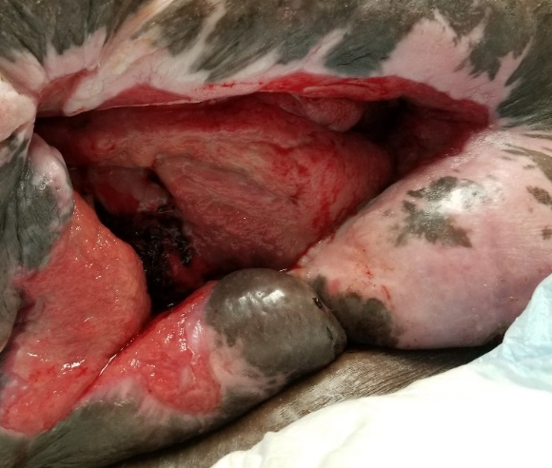
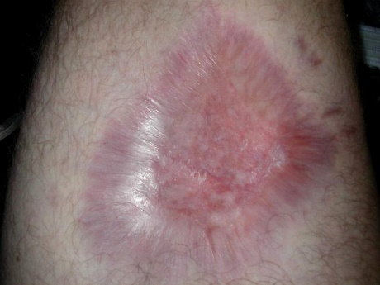
Common Tissue Types to Know
Granulation
Slough
Muscle
Eschar
Granulation
Eschar
Slough
Scar tissue
Adipose
Muscle
Bone, tendon, ligament
Scar tissue
Adipose
Tendon
Notes:
Done to here

Slide 7
Pressure Injuries
Occur on or near a boney prominence from prolonged or intense pressure, usually with some friction or shear element.
Define Friction; Define Shear
Medical device pressure injuries are staged just like above.
Mucous membrane pressure injuries are not staged like above.
Considerations
Like any wound, if you do not remove the cause, the wound will not heal.
Much easier to prevent these wounds in the first place!
*National Pressure Injury Advisory Panel
Notes:
PROLONGED pressure, with friction or shear ON OR NEAR a boney prominence is likely pressure injury.
Neuropathic ulcers are from MOBILE pressure. Not immobility pressure like pressure injuries.
Not called a decubitus anymore.
Seriously class, use that Braden. Calculate it carefully with the tool, put interventions into place based on the patient’s weak areas.
Ensure the CNAs know too, they are more likely than you to carry out the interventions.
Don’t just one and done the Braden to check a box. Trust me.

Slide 8
One page snapshot: Unique Features of Pressure Injury Stages
Stage 1: Skin is intact; Nonblanchable erythema.
You must touch to assess.
Stage 2: Epidermis is open/lost; Dermis is visible.
VERY shallow wound. NO depth. NO slough.
Stage 3: Epidermis is lost; Dermis is lost. Adipose now exposed (may look pink/granular). Minimal to moderate depth.
Possibly has slough, undermining, tunneling. NO bone, NO muscle, NO tendons.
Stage 4: Epidermis is lost; Dermis is lost; Past adipose; Muscle, Bone, Ligament, and/or Tendon visible.
Moderate to severe depth. Possibly has eschar and/or slough.
Unstageable: Too much eschar/slough is obscuring the wound bed to determine staging.
Unstageables are either a stage 3 or 4 pressure injury underneath.
Deep Tissue Injury: Pressure at the bone level is injuring tissue by constricting blood supply. The injury grows outwards to the epidermis and presents as a “bruise”.
Without intervention, wound will continue to enlarge under the surface, eventually may open at the epidermis, and can have an exposed wound bed down to the bone.
Notes:
Job aid. Each banner is the unique characteristics of each stage of pressure injury.
If you do not know if the wound is one stage, eliminate the others.

Slide 9
Pressure injury staging
The deepest level of tissue listed below that you can visualize in a wound bed is also the number stage next to it.
1. Epidermis ----------
2. Dermis ------------
3. Adipose ------------
4. Muscle, Bone, Ligament, and/or Tendon

Slide 10
Epidermis
Dermis
Muscle
Adipose (fat) that has red granulation tissue covering it.

Slide 11
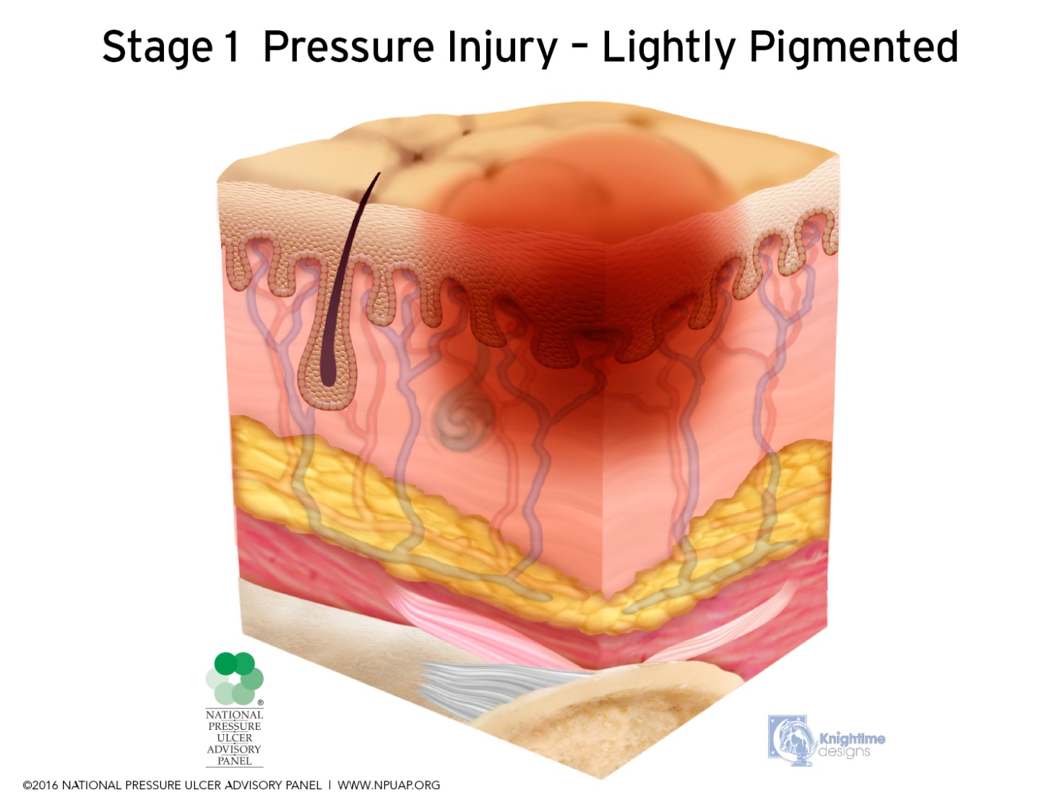
Stage 1: Epidermis (top layer of skin) is intact; Nonblanchable erythema.
You must touch to assess.
1. Epidermis ----------
2. Dermis -------------
3. Adipose ------------
4. Muscle, Bone, Ligament, and/or Tendon

Slide 12
Touch intact skin. If erythema lightens, then color returns, it is NOT a stage 1 (but is beginning to damage due to pressure)

Slide 13
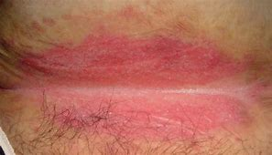
What’s going on here?
Intertrigo = Skin fold damage from moisture trapped in the fold
Notes:
Trick question. This is moisture in a skin fold that chaffs and rubs. A kissing wound is not a pressure injury. Wick that moisture out ot use powder. The pink dots outside the main pink are classic sign of fungus too.

Slide 14
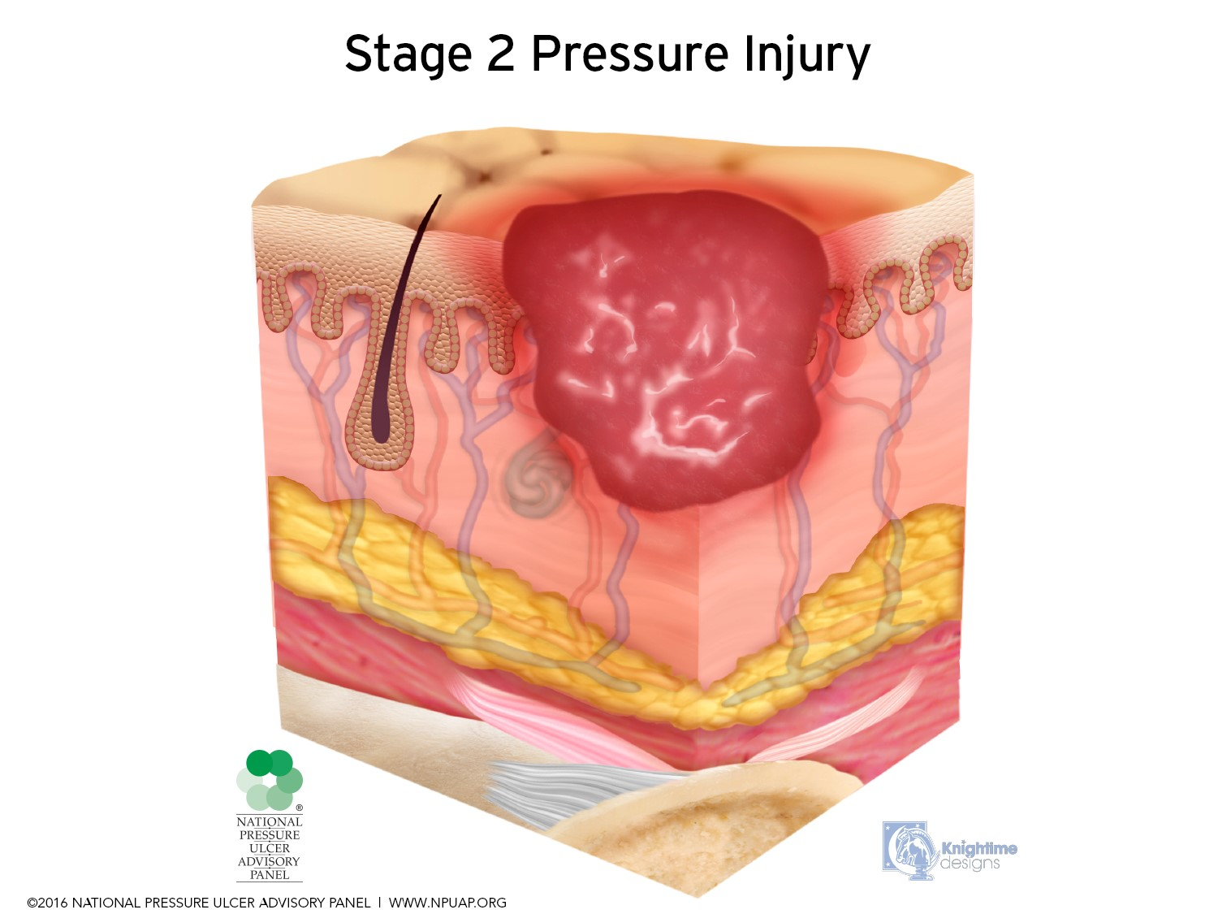
Stage 2: Epidermis is open/lost; Dermis is visible.
VERY shallow wound. NO depth. NO slough.
1. Epidermis ----------
2. Dermis ------------
3. Adipose ------------
4. Muscle, Bone, Ligament, and/or Tendon

Slide 15
Dermis Identification
Dermis is thin, just a little thinner than epidermis
From outside in, dermis is red, then pink, pale pink, super pale pink to white.
The rete ridges of the epidermis reach into the dermis like fingers.
When the epidermis is lost, the ends of those ridges are visible as little red dots
The little red dots are called ISLETS

Slide 16
Stage 2: Epidermis is open/lost; Dermis is visible.
VERY shallow wound. NO depth. NO slough.
Exceptions: Serum filled blisters on a boney prominence are stage 2 PIs
Exception to broken epidermis rule
Serum filled blister
Notes:
If the area is intact, is it a stage 2?
NO
Why class?
Stage 2’s are open
If there is fat or slough, is it a stage 2?
NO
Why class?
Stage 2’s do not have slough or fat.

Slide 17
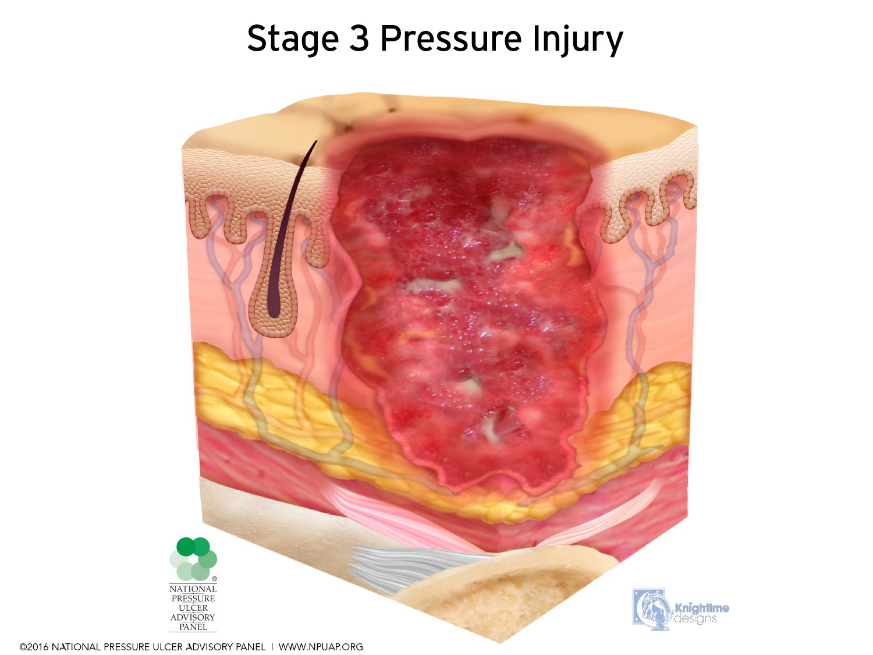
Stage 3: Epidermis is lost; Dermis is lost. Adipose now exposed (may look pink/red & granular). Minimal to moderate depth.
Possibly has slough, undermining, tunneling.
NO bone, NO muscle, NO tendons.
1. Epidermis ----------
2. Dermis -------------
3. Adipose ------------
4. Muscle, Bone, Ligament, and/or Tendon

Slide 18
Stage 3: Epidermis is lost; Dermis is lost. Adipose now exposed (may look pink/granular). Minimal to moderate depth.
Possibly has slough. NO bone, NO muscle, NO tendons yet.
Fat/Adipose
Dermis
Notes:
Is this a stage 2?
NO
Why class?
There is slough and granulation tissue
Partial thickness do not heal through granulation.

Slide 19
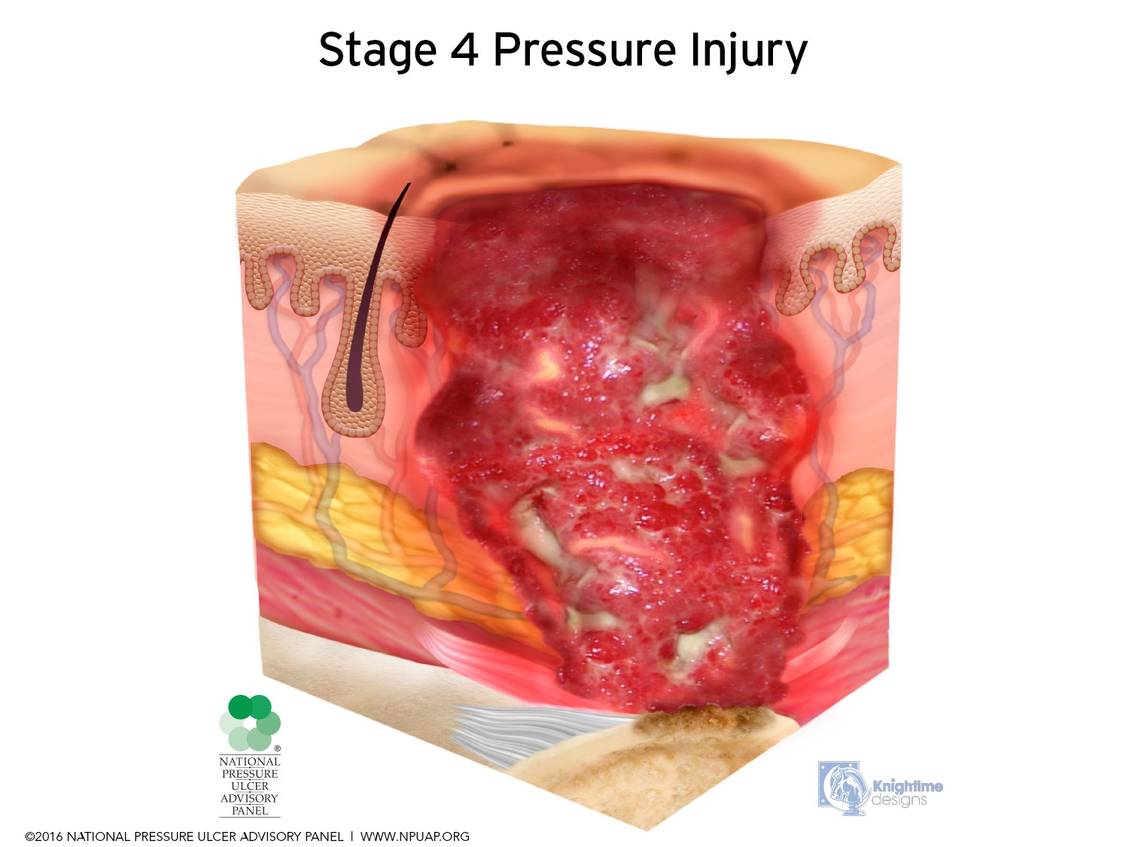
Stage 4: Epidermis is lost; Dermis is lost; Past adipose;
Muscle, Bone, Ligament, and/or Tendon visible.
Moderate to severe depth. Possibly has eschar and/or slough.
1. Epidermis ----------
2. Dermis -------------
3. Adipose ------------
4. Muscle, Bone, Ligament, and/or Tendon

Slide 20
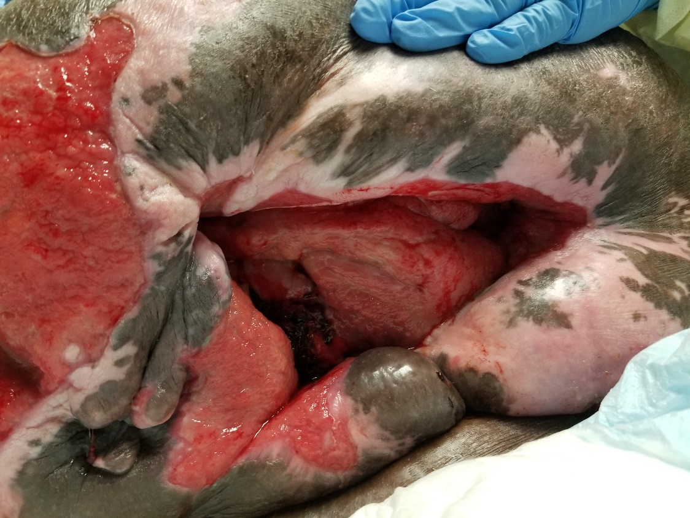
Stage 4: Epidermis is lost; Dermis is lost; Past adipose; Muscle, Bone, Ligament, and/or Tendon visible.
Moderate to severe depth. Possibly has eschar and/or slough.
Notes:
Is this a stage 3?
NO
Why class?
Muscle is visible

Slide 21
Indeterminate Stages
Sometimes you cannot stage a pressure injury right away as a stage 1,2,3 or 4 for two reasons:
UNSTAGEABLE: there is too much non-viable tissue on the wound bed (slough and/ or eschar) that is blocking the view of possible muscle/bone or ligament. This is called “unstageable”. Unstageable pressure injuries are a stage 3 or 4 underneath that slough or eschar, but we can not tell which one just now.

Slide 22
Unstageable: Too much eschar and/or slough is obscuring the wound bed to determine staging.
Unstageable pressure injuries are either stage 3 or 4 underneath but cannot tell which one right now.
1.Epidermis --------
2. Dermis -----------
3. Adipose ----------
4. Muscle, Bone, Ligament, and/or Tendon

Slide 23
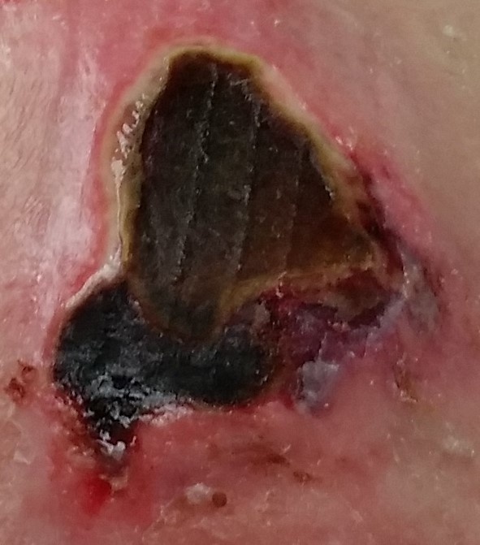
Unstageable: Too much eschar/slough is obscuring the wound bed to determine staging.
Unstageables are either a stage 3 or 4 pressure injury underneath.
If you can see bone, ligament, muscle, and/or tendon visible, it can be called a stage 4.
Notes:
Is this a stage 3 or a stage 4?
Don’t know. Because too much non-viable tissue (slough or eschar) is present.
So we call it unstageable until we can see more wound bed.
However, caveat. If you can see muscle, boom it is a stage 4.

Slide 24
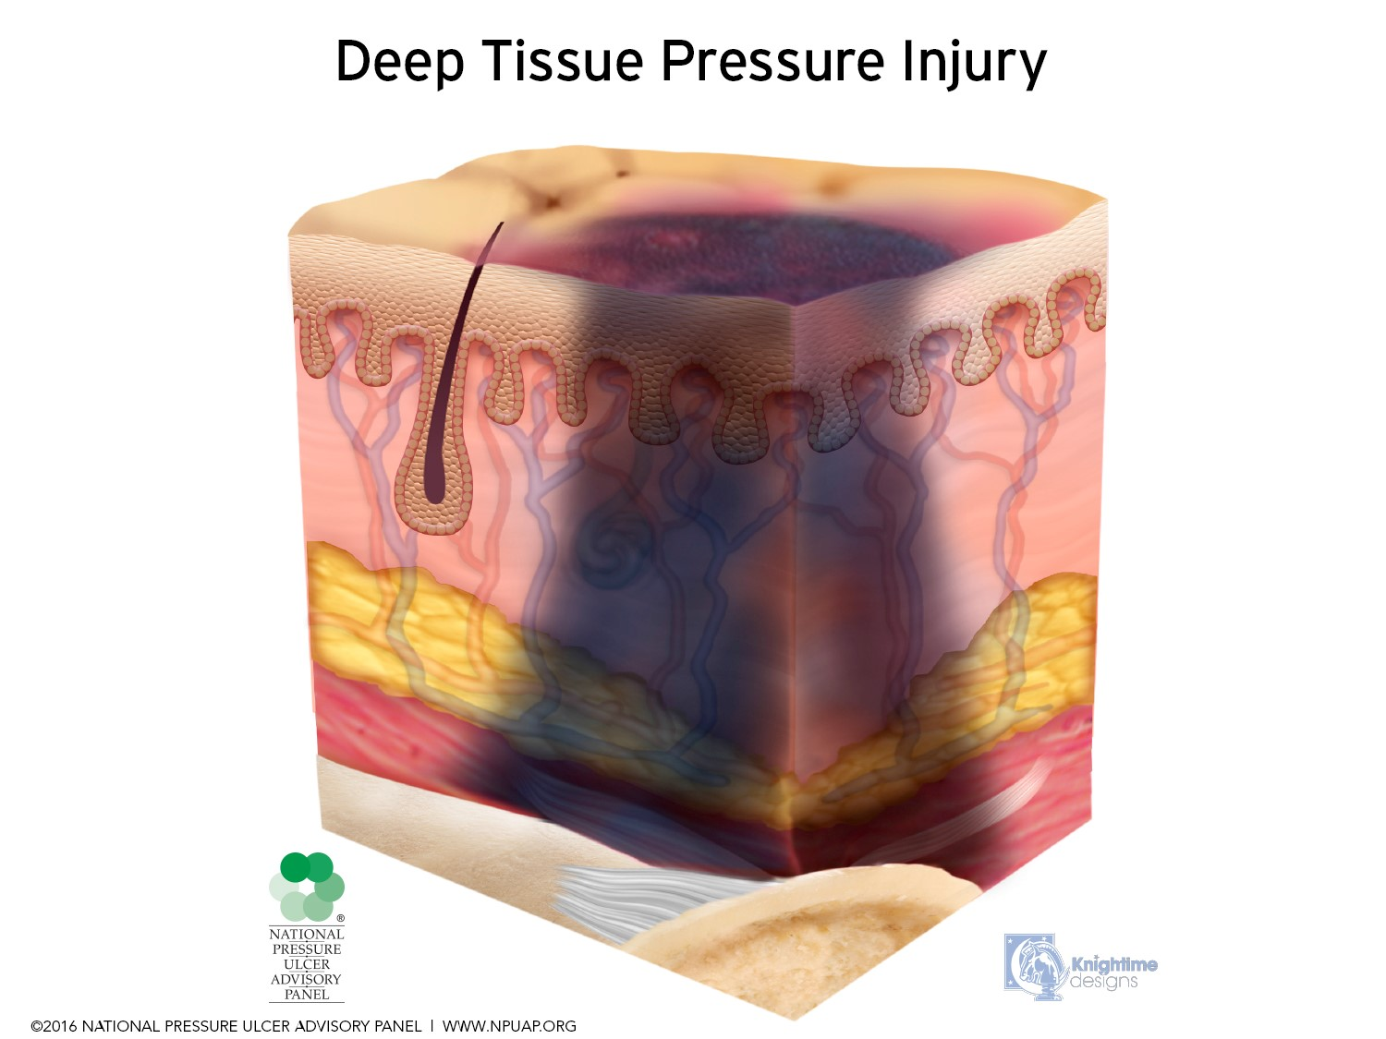
Indeterminate Stages
Deep Tissue Injury Pressure down near the bone is injuring the nearby tissue by constricting blood supply & physically crushing cells. The damage spreads out and up towards the surface. We detect bogginess upon palpation, then we visualize maroon, blue or purple discoloration of the skin.
With interventions, the wound should stop evolving worse and begin to stabilize towards a recognizable stage 1,2,3 or 4 pressure injury. Usually once the purple or maroon discoloration resolves, a stage can be determined.
1.Epidermis -----------
2. Dermis ---------------
3. Adipose ----------
4. Muscle, Bone, Ligament, and/or Tendon
Begins deep down

Slide 25
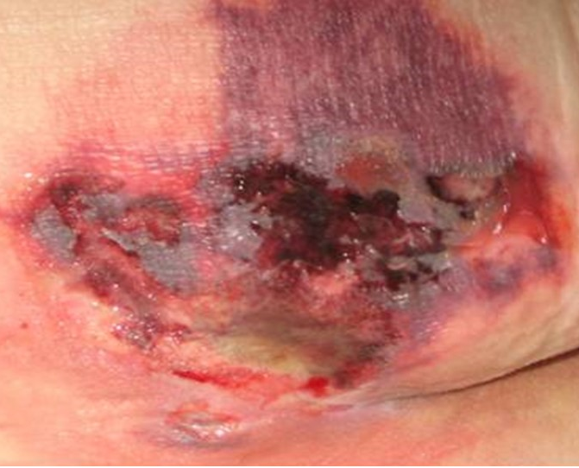
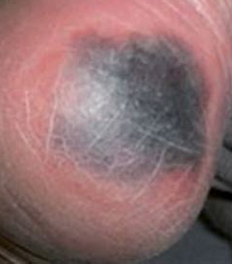
Deep Tissue Injury: Pressure at the bone level is injuring tissue by constricting blood supply. The injury grows outwards to the epidermis and presents as a “bruise”.
Without intervention, wound will continue to enlarge under the surface, eventually may open at the epidermis, and can have an exposed wound bed down to the bone.
Blood filled blisters on a boney prominence are DTPI
Notes:
DTPI can be confusing if you poison the well on learning. So don’t.
DTPIs will eventually be called a Stage 1, 2, 3 or 4. But not until all the purple, blue or maroon discoloration on the periwound is gone.
The wound bed is so bruised, beat up and battered from pressure damage below the surface that it is still deteriorating.
It may open more, go deeper to show you bruised dermis, and adipose, or even open all the way to the bone so quick your head spins.
This is because there was pressure damage happening underneath the skin for as much as 3 days before we can see discoloration on top the skin.
So we wait until it stops “evolving” worse to stage it. Ad then we stage it based on the deepest tissue visible.
https://www.slideshare.net/woundrounds/woundrounds-clinical-reimbursement-and-wound-care-webinar-slides

Slide 26
Stabilizing Deep Tissue Injury →
Stage 3 in this case:
Started off bruised looking in several spots, injury continued to occur underneath epidermis, evolved open, interventions helped the area calm down, so the bruising color eased up and the tissue stopped breaking down.

Slide 27
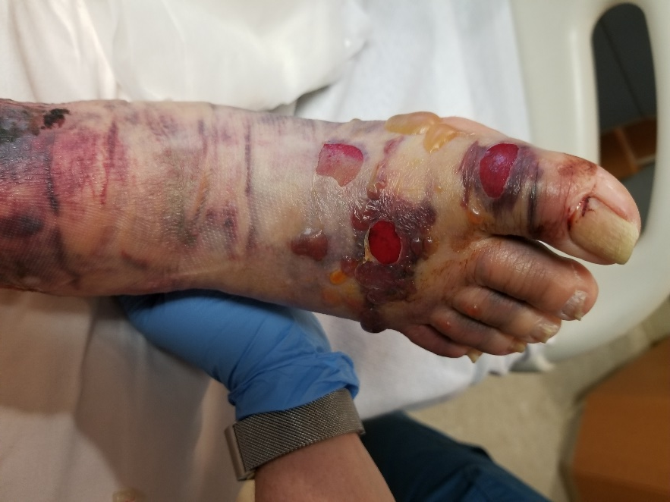
Mucous Membrane Pressure Injuries
Cam Walker Injury
Notes:
The tissue layers are not the 1,2,3,4 we keep talking about, so cannot use Stage 1,2,3,4. So just mucous membrane. They heal quickly once you remove the cause. Very vascular.

Slide 28
Mucous Membrane Pressure Injuries
Mucous membrane pressure injuries are caused by medial devices such as endotrach tubes in the mouth, nasogastric tubes inside the nose, and even indwelling urine and stool containing devices. No stage needed, just call it a “Mucous Membrane Pressure Injury”.
Notes:
The tissue layers are not the 1,2,3,4 we keep talking about, so cannot use Stage 1,2,3,4. So just mucous membrane. They heal quickly once you remove the cause. Very vascular.

Slide 29
How to start the Staging Process
Is it either of these?
Unstageable:
Too much eschar/slough is obscuring the wound bed to determine staging.
Unstageables are either a stage 3 or 4 pressure injury underneath.
Deep Tissue Pressure Injury:
Pressure at the bone level is injuring tissue by constricting blood supply and breaking cells. The injury grows outwards to the epidermis and presents as a “bruise”.
If it is one of the above, you are done staging. If not, go to the next page.

Slide 30
Rule it out: Stage 1,2, 4 or 3
If the wound is intact…
Pink/Red & No Blanching?
Stage 1
Pink/Red & Blanches?
Non-blanchable Erythema
If the wound is not intact
A
C
B
Flat, Red, pink or pale pink?
Stage 2
(NO SLOUGH)
Neither a 2 or 4?
Stage 3
(NO muscle, bone, tendon, ligament)
Bone, Muscle, Tendon, Ligament?
Stage 4

Slide 31
References Bryant & Nix (2012) Acute & chronic wounds: Current management concepts, fourth edition. Mosby Elsevier, St. Louis, MO. Edsberg, L. E., Black, J. M., Goldberg, M., McNichol, L., Moore, L., & Sieggreen, M. (2016). Revised national pressure ulcer advisory panel pressure injury staging system: Revised pressure injury staging system. Journal of Wound Ostomy Continence Nurs, 43(6), 585-597. doi:10.1097/won.0000000000000281 National Pressure Injury Advisory Panel (2016). Pressure Injury Staging. https://npiap.com/page/PressureInjuryStages Wound Ostomy Continence Nurse Society (2016) Wound treatment associate participant workbook. Wound Ostomy Continence Nurse Society Publishing.

