Slide 1
What is the Code of Ethics for Nurses?
Olympia Resol, RN, MPH, CRNI, CARN

Slide 2
Course Objectives
At the end of the course, the student should be able to:
Outline the history of the nursing code of ethics;
Identify the four (4) principles of ethics in the nursing profession;
Distinguish the nine (9) main provisions of the American Nurses Association (ANA) Code of Ethics for Nurses;
Lastly, the student should be able to understand how nurses use the ANA Code of Ethics.

Slide 3
Introduction
For almost two decades, nursing has been ranked number one by the Gallup Poll as the most honest and ethical profession. (Saad, 2020)

Slide 4
Introduction
In the latest version of the survey which was run on December 1-17, 2020 — wherein Americans were asked to rate the honesty and ethics of 15 different occupational groups as very high, high, average, low or very low — nurses obtained a record 89% very high/high score for their honesty and ethics.

Slide 5
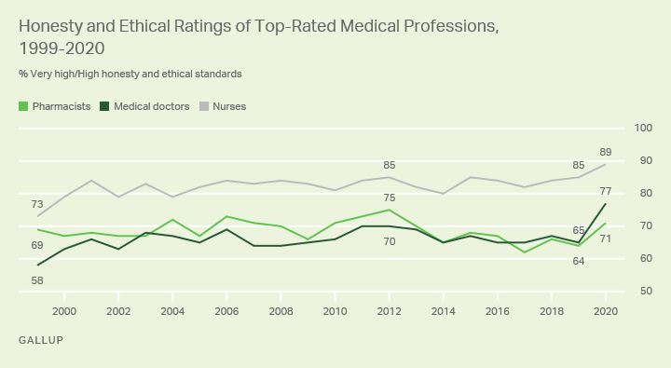
Introduction
The previously mentioned score is four percentage points greater than their previous high, last recorded in 2019.

Slide 6
Introduction
How are nurses able to hold their top position for this long? Our best bet is that it would be pinned on the standards set for them by the American Nurses Association (ANA) Code of Ethics for Nurses, which encapsulates the words that every nurse in the United States live by.

Slide 7
Introduction
According to the ANA (2015), the nursing code of ethics is a guide for “carrying out nursing responsibilities in a manner consistent with quality in nursing care and the ethical obligations of the profession.”

Slide 8
Introduction
In the general sense, ethics are the moral principles that dictate how people will conduct themselves. Ethical values are essential for ALL healthcare professionals, especially nurses.

Slide 9
Introduction
Nurses make up the largest proportion of workers in the healthcare industry with more than 100,000 active registered nurses in Michigan alone. Whether they are at the bedside or in the boardroom, nurses continue to advocate for their patients and policy reform at local, state or national levels. (Oakland University’s School of Nursing, 2021)

Slide 10
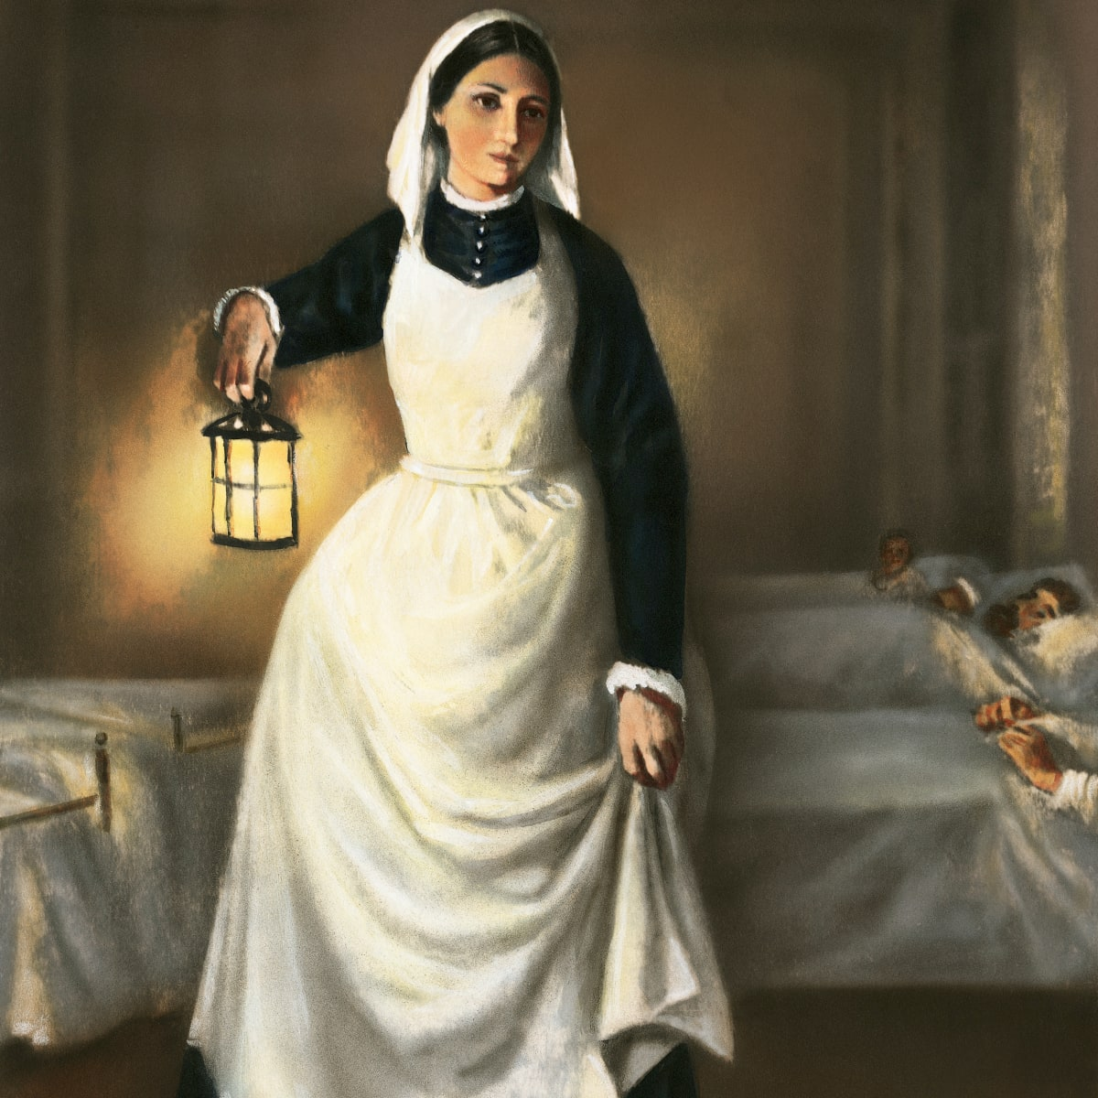
History of the Nursing Code of Ethics
The origins of the nursing code of ethics can be traced back to the “Nightingale Pledge,” which was named after Florence Nightingale, the founder of modern nursing.

Slide 11
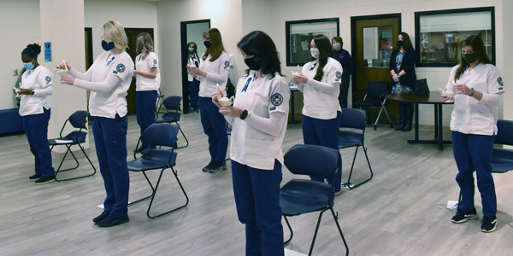
History of the Nursing Code of Ethics
As a modification of the Hippocratic Oath, taken by medical doctors, the Nightingale Pledge has been recited by nursing students at graduations with minimal changes since its inception in 1893.

Slide 12
History of the Nursing Code of Ethics
In the 1950s, the formal code of ethics was developed by the American Nurses Association (ANA) and has undergone numerous modifications since. The most significant recent change was in 2015. It was when nine (9) interpretative statements or provisions were added to the code of ethics in order to help guide nursing practice in a more definitive manner.

Slide 13
History of the Nursing Code of Ethics
Many states include the ANA’s nursing code of ethics in their practice statements.

Slide 14
History of the Nursing Code of Ethics
Even though the code of ethics is primarily ethics-related, it has legal implications as well. Given its importance to the nursing profession, revisions are made on a regular basis.

Slide 15
Four Principles of Ethics in the Nursing Profession
There are four (4) main principles that are part of the nursing code of ethics. They are the following:
Autonomy
Beneficence
Justice
Nonmaleficence

Slide 16
Four Principles of Ethics in the Nursing Profession
These principles are ideally what every nurse should be aware of in their daily nursing practice. While ethical principles are sometimes confusing and often taught briefly during undergraduate nursing – they should be constants in the nursing practice in order to provide the best, safest, and the most humane care possible to all patients.

Slide 17
1. Autonomy
Autonomy is recognizing each individual patient’s right to self-determination and decision-making. As patient advocates, it is imperative that nurses ensure that patients receive all medical information, education, and options in order to choose the option that is best for them. This includes all potential risks, benefits, and complications to make well-informed decisions.

Slide 18
1. Autonomy
Once the patient has all relevant information, the medical and nursing team can create a plan of care in compliance with the medical wishes of the patient.

Slide 19
1. Autonomy
It is important that nurses support the patient in their medical wishes and ensure that the medical team is remembering those wishes. Sometimes, nurses will need to continue to advocate for a patient despite the wishes being verbalized because the medical team might not agree in those wishes.

Slide 20
1. Autonomy
Many factors may influence a patient's acceptance or refusal of medical treatment, such as culture, age, gender, sexual orientation, general health, and social support system.

Slide 21
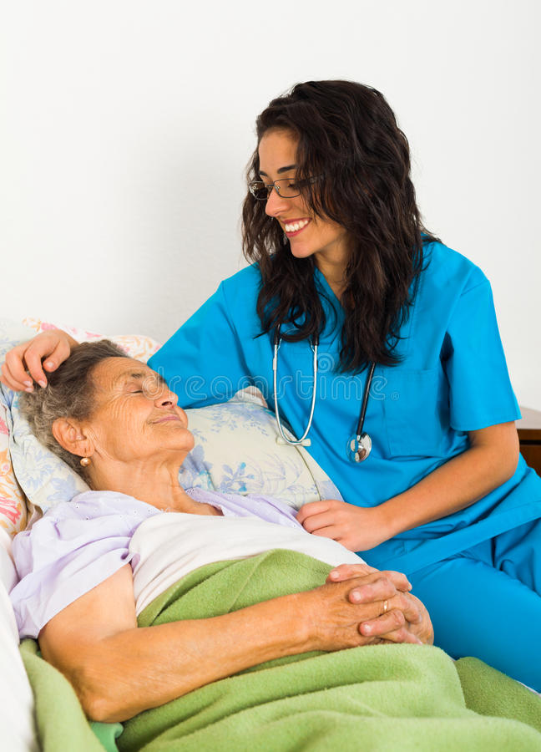
2. Beneficence
Beneficence is acting for the good and welfare of others and including such attributes as kindness and charity. The ANA defines this as “actions guided by compassion.”

Slide 22
3. Justice
Justice is that there should be an element of fairness in all medical and nursing decisions and care. Nurses must care for all patients with the same level of fairness despite the individual's financial abilities, race, religion, gender, and/or sexual orientation.

Slide 23
3. Justice
An example of this is when working at a free flu clinic or diabetes screening clinic. These are open to all individuals in the community regardless of the previously mentioned factors.

Slide 24
4. Nonmaleficence
Nonmaleficence is to do no harm. This is the most well known of the main principles of nursing ethics. More specifically, it is selecting interventions and care that will cause the least amount of harm to achieve a beneficial outcome.

Slide 25
4. Nonmaleficence
The principle of nonmaleficence ensures the safety of the patient and community in all care delivery. Nurses are also responsible to report treatment options that are causing significant harm to a patient which may include suicidal or homicidal ideations.

Slide 26
Nine Provisions of the ANA Code of Ethics
Revised in 2015 to include nine (9) provisions, the ANA Code of Ethics for Nurses now includes interpretative statements that can provide more specific guidance for nursing practice.

Slide 27
Nine Provisions of the ANA Code of Ethics
These provisions were implemented to help guide nurses in ethical decision-making throughout their practice.

Slide 28
Nine Provisions of the ANA Code of Ethics
1. The nurse practices with compassion and respect for the inherent dignity, worth, and unique attributes of every person.
1.1 Respect For Human Dignity
1.2 Relationships with Patients
1.3 The Nature of Health
1.4 The Right to Self-Determination
1.5 Relationships with Colleagues and Others

Slide 29
Nine Provisions of the ANA Code of Ethics
2. The nurse’s primary commitment is to the patient, whether an individual, family, group, community, or population.
2.1 Primacy of the Patient’s Interests
2.2 Conflict of Interest for Nurses
2.3 Collaboration
2.4 Professional Boundaries

Slide 30
Nine Provisions of the ANA Code of Ethics
3. The nurse promotes, advocates for, and protects the rights, health, and safety of the patient.
3.1 Protection of the Rights of Privacy and Confidentiality
3.2 Protection of Human Participants in Research
3.3 Performance Standards and Review Mechanisms
3.4 Professional Responsibility in Promoting a Culture of Safety
3.5 Protection of Patient Health and Safety by Acting on Questionable Practice
3.6 Patient Protection and Impaired Practice

Slide 31
Nine Provisions of the ANA Code of Ethics
4. The nurse has authority, accountability, and responsibility for nursing practice; makes decisions; and takes action consistent with the obligation to provide optimal patient care.
4.1 Authority, Accountability, and Responsibility
4.2 Accountability for Nursing Judgments, Decisions, and Actions
4.3 Responsibility for Nursing Judgments, Decisions, and Actions
4.4 Assignment and Delegation of Nursing Activities or Tasks

Slide 32
Nine Provisions of the ANA Code of Ethics
5. The nurse owes the same duties to self as to others, including the responsibility to promote health and safety, preserve wholeness of character and integrity, maintain competence, and continue personal and professional growth.
5.1 Duties to Self and Others
5.2 Promotion of Personal Health, Safety, and Well-Being
5.3 Preservation of Wholeness of Character
5.4 Preservation of Integrity
5.5 Maintenance of Competence and Continuation of Professional Growth
5.6 Continuation of Personal Growth

Slide 33
Nine Provisions of the ANA Code of Ethics
6. The nurse, through individual and collective effort, establishes, maintains, and improves the ethical environment of the work setting and conditions of employment that are conducive to safe, quality health care.
6.1 The Environment and Moral Virtue
6.2 The Environment and Ethical Obligation
6.3 Responsibility for the Healthcare Environment

Slide 34
Nine Provisions of the ANA Code of Ethics
7. The nurse, in all roles and settings, advances the profession through research and scholarly inquiry, professional standards development, and the generation of both nursing and health policy.
7.1 Contributions through Research and Scholarly Inquiry
7.2 Contributions through Developing, Maintaining, and Implementing Professional Practice Standards
7.3 Contributions through Nursing and Health Policy Development

Slide 35
Nine Provisions of the ANA Code of Ethics
8. The nurse collaborates with other health professionals and the public to protect human rights, promote health diplomacy, and reduce health disparities.
8.1 Health Is a Universal Right
8.2 Collaboration for Health, Human Rights, and Health Diplomacy
8.3 Obligation to Advance Health and Human Rights and Reduce Disparities
8.4 Collaboration for Human Rights in Complex, Extreme, or Extraordinary Practice Settings

Slide 36
Nine Provisions of the ANA Code of Ethics
9. The profession of nursing, collectively through its professional organization, must articulate nursing values, maintain the integrity of the profession, and integrate principles of social justice into nursing and health policy.
9.1 Articulation and Assertion of Values
9.2 Integrity of the Profession
9.3 Integrating Social Justice
9.4 Social Justice in Nursing and Health Policy

Slide 37
Ethical Decision-Making in the Nursing Practice
Unfortunately, nurses are often unable to make complex ethical decisions based solely on the four principles and nine provisions. In these instances, it is important to consult the ethics committee before making any major decisions. Often, other resources are needed when making major ethical decisions.

Slide 38
How Nurses Use the ANA Code of Ethics
Knowing the nursing code of ethics is essential for nurses because it will help guide everyday practice and navigate the daily complexities of the healthcare profession.

Slide 39
How Nurses Use the ANA Code of Ethics
Nurses often use the four major ethical principles throughout a shift, even if not fully aware of it.

Slide 40
How Nurses Use the ANA Code of Ethics
These instances may include the following:
Providing pain medication to a post-operative hip replacement
Holding the hand of a dying patient who is alone
Advocating for the patient that wants to end chemotherapy and enter hospice care

Slide 41
Conclusion
Nursing is consistently regarded as the most honest and ethical profession. Hence, practicing with the nursing code of ethics is essential to ensuring that patients and their families receive the care they have come to know and expect.

Slide 42
Conclusion
Utilizing the ethical codes of justice, nonmaleficence, autonomy, and beneficence day in, day out allows nurses to provide the safest and most compassionate care for their patients.

Slide 43
References
Saad, L. (2020, December 22). U.S. ethics ratings rise for medical workers and teachers. Gallup.com. Retrieved October 12, 2021, from https://news.gallup.com/poll/328136/ethics-ratings-rise-medical-workers-teachers.aspx.
American Nurses Association (ANA). (2015, January). Code of Ethics for Nurses with Interpretative Statements. Silver Spring, Maryland. Retrieved October 12, 2021, from https://www.nursingworld.org/practice-policy/nursing-excellence/ethics/code-of-ethics-for-nurses/coe-view-only/.
Oakland University's School of Nursing. (2021, January 22). Gallup Poll finds nursing is most honest, ethical profession. Oakland University Magazine. Retrieved October 12, 2021, from https://oakland.edu/oumagazine/news/nursing/2021/gallup-poll-finds-nursing-is-most-honest-ethical-profession.

