Slide 1
IV Therapy & Blood Withdrawal Theory Part 2 (for LVNs Only)

Slide 2
Why is the order of tubes important?

Slide 3
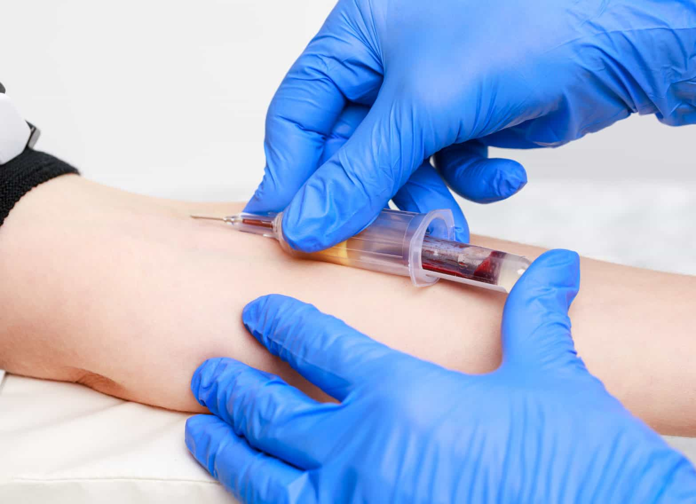
Why is the order of tubes important?
Blood collection is one of the most common nursing procedures, but it is not without risks.

Slide 4
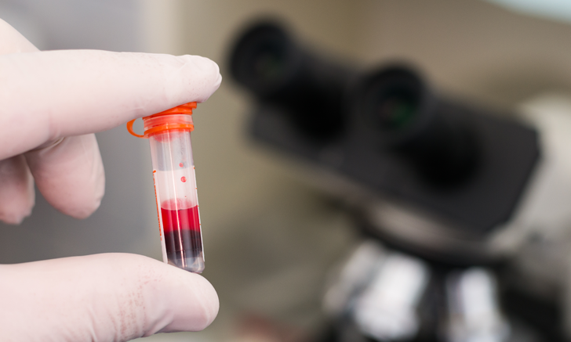
Why is the order of tubes important?
Several studies have shown that nearly 75% of all analytical mistakes happen during blood collection.

Slide 5

Why is the order of tubes important?
These errors range from wrong patient identification to filling an incorrect sample tube among other mistakes during the procedure.

Slide 6
Order of Blood Draw Tubes and Additives

Slide 7
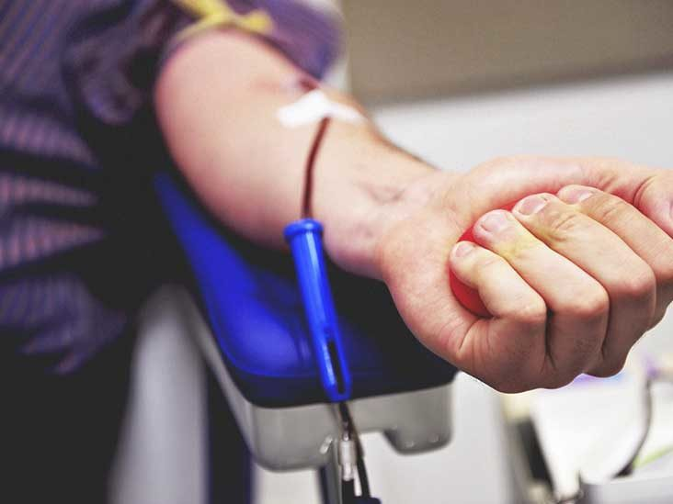
Order of Blood Draw Tubes and Additives
Blood samples must be drawn in a specific order to avoid cross-contamination of the sample by additives found in different collection tubes. Phlebotomy order of draw is the same for specimens collected by syringe, tube holder, or into tubes pre-evacuated at the time of collection.

Slide 8







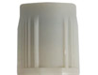
Order of Blood Draw Tubes and Additives
The correct order of draw follows:
Blood culture tube or bottle (ALWAYS drawn prior to other labs to reduce contamination)
Sodium citrate tube (e.g., blue closure)
Serum tubes, including those with clot activator and gels (e.g., red, red-speckled, gold closures)
Heparin tube with or without gel (e.g., dark green, light green, speckled green closures)
EDTA tube with or without gel separator (e.g., lavender, pearl, pink closures)
Sodium fluoride/potassium oxalate glycolytic inhibitor (e.g., gray closure)

Slide 9
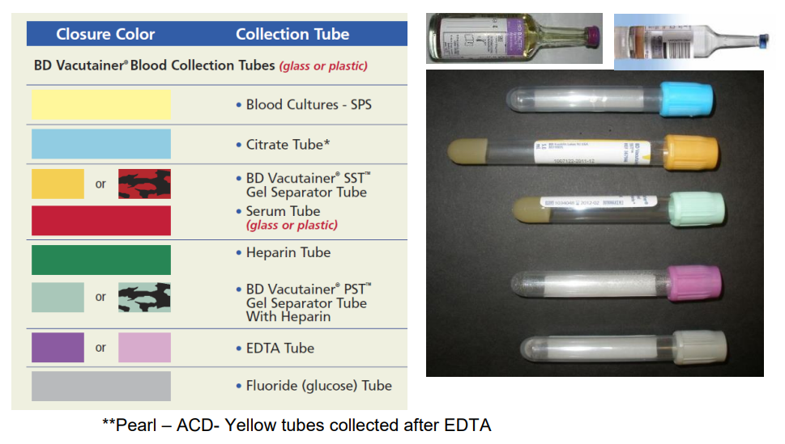
Order of Blood Draw Tubes and Additives
The most current Clinical and Laboratory Standards Institute (CLSI) guidelines recommends a single "Order of Draw", whether using a multi-sample, evacuated tube system or drawing with a syringe(s). The "Order of Draw" is designed to eliminate the possibility of cross contamination that may result in erroneous results.

Slide 10
Order of Blood Draw Tubes and Additives
More Caution:
The placement of tubes not listed here should take into consideration the potential for their additive to alter results obtained from the next tube if carryover were to occur.

Slide 11
Order of Blood Draw Tubes and Additives
Plastic serum tubes containing a clot activator may cause interference in coagulation testing.
Only blood culture tubes, glass nonadditive serum tubes, or plastic serum tubes without a clot activator may be collected before the coagulation tube.

Slide 12
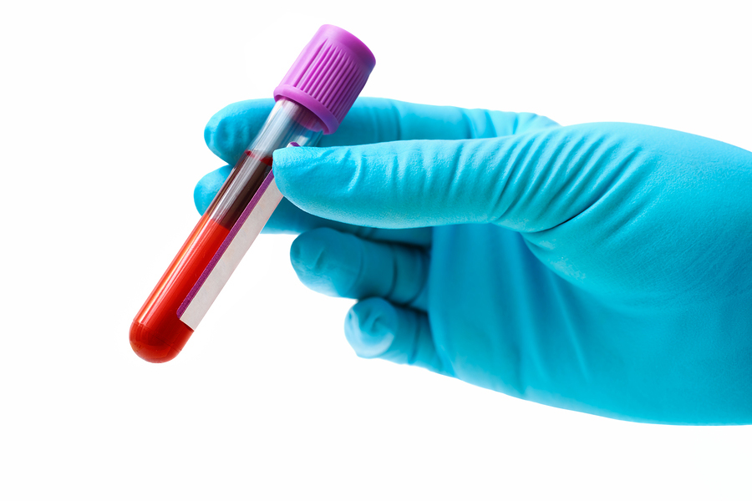
Order of Blood Draw Tubes and Additives
Numerous errors can occur during the collection and handling of blood specimens, which pose significant and avoidable risks to the patient and the phlebotomist. When global standards are not fully implemented, it is more likely that patients will be injured during the procedure, biologically representative specimens will not be obtained from patients, and test results will not be comparable from one facility to another.

Slide 13
Order of Blood Draw Tubes and Additives
CLSI’s GP41 —Collection of Diagnostic Venous Blood Specimens provides a descriptive, stepwise process and procedures reflecting the quality system essentials format for diagnostic venous blood specimen collection. Special considerations for collections from vascular access devices, blood culture collection, and collections in isolation environments are included, as well as how to handle emergency situations. An expanded appendix section provides helpful tips for collecting specimens from pediatric and other challenging patients.

Slide 14
A Fun Way to Memorize

Slide 15
A Fun Way to Memorize
The most current Clinical and Laboratory Standards Institute (CLSI) guidelines recommends a single "Order of Draw", whether using a multi-sample, evacuated tube system or drawing with a syringe(s):
Blood culture, Blue, Red/Gold, Green, Lavender/Pearl/Pink, and Gray.

Slide 16
A Fun Way to Memorize
A fun way to memorize this order is to remember the acronym Be Bold, Respectful, Gracious, Lighthearted, and Gentle.
Be – Blood culture
Bold – Blue
Respectful – Red/Gold
Gracious – Green
Lighthearted – Lavender/Pearl/Pink
Gentle – Gray

Slide 17
Activity for You

Slide 18
REQUIRED Theory Work
Note: The following are REQUIRED Theory Work after Skills by BVNPT:
Calculation Exam
Quiz (Multiple Choice Exam)
These are required to be submitted after the Skills portion of class, or by 9 p.m. the following day (Monday) after Skills.

Slide 19

Instructions
Head to the Study Guides section of the course page and download the PDF file that contains the Calculation Exam together with the Handout that you will need for this activity.

Slide 20
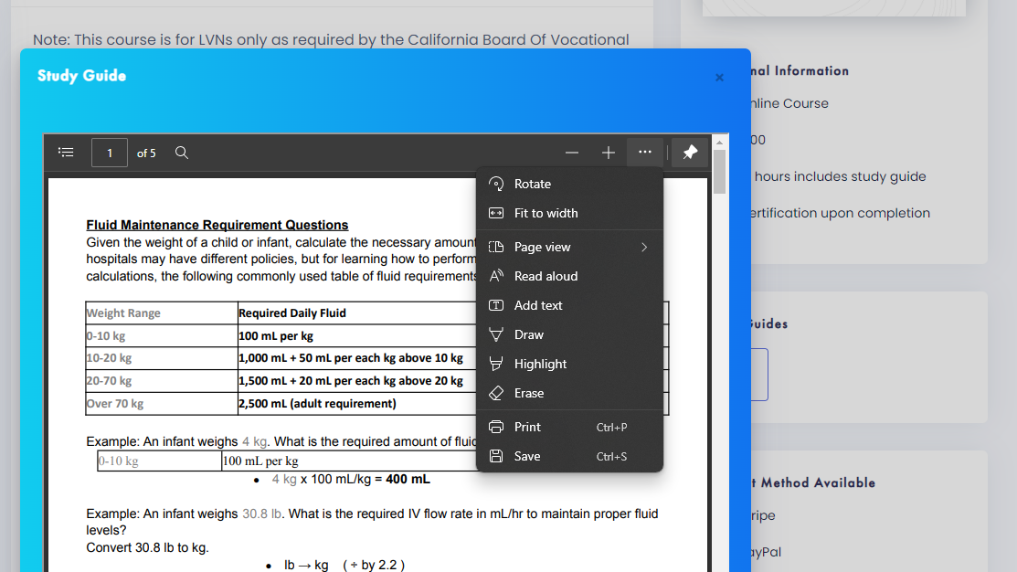
Instructions
You may download the PDF by clicking the “three little dots” on the top right corner and then clicking the Save or Print button.

Slide 21
Instructions
Take your time to study the Handout before answering the questions in the next pages.
You may choose to print out the PDF file and write your answers on the spaces provided. You may also write your answers on a blank sheet/s of paper.
Make sure to show your solutions.

Slide 22
Instructions
Submit your answers (with solutions) as an image or PDF attachment to the following email address:
es.instructor.care@gmail.com
Use the following subject heading:
IV Theory Part 2 – Your Full Name
For example:
IV Theory Part 2 – Jane Smith

Slide 23
Instructions
Important Note:
Even if you pass the Quiz part of this course, your certificate will NOT be acknowledged until you are able to submit your answers to the Calculation Exam.

Slide 24

Have you completed and submitted your answers to the Calculation Exam?
Good job! You are now ready to take the Quiz.

