Slide 1
Wound Healing, Topical Therapy, & Refractory Wounds
Catherine Koutroumpis, BSN, RN, CWOCN

Slide 2
Objectives
By the end of this module, participants will be able to:
Understand partial versus full thickness wound healing
Understand acute versus chronic wound healing
Recognize common wound care categories
Choose topical wound therapy based upon assessment
List some atypical or less common wounds
Recognize barriers to wound healing

Slide 3
Partial Thickness Wounds
Skin = Epidermis and dermis
Partial thickness wounds refer to injuries to the epidermis and/or dermis
But no so far in that adipose is exposed.
For instance, a skin tear is a partial thickness wound
Another example is a stage 2 pressure injury
These wounds heal by regeneration.
The body creates more dermis and epidermis tissue to cover the injury.
These wounds do not scar.

Slide 4
Full Thickness Wounds
Full thickness wounds are injuries that go into the adipose layer and deeper
For example, a stage 3 or 4 pressure injury is a full thickness wound.
These wounds heal by slowly filling with granulation tissue.
This surgical wound in the photo went down into the
adipose layer and is now granulating.
The body is creating new capillaries as it fills in the wound,
giving the tissue texture.
These wounds will scar in most cases.

Slide 5
Healing Cascade (Full Thickness Wounds)
Hemostasis & Inflammation
3-5 days
Hemostasis, then clean the site up with WBCs, macrophages, MMPs
Proliferation
2-4 weeks
Repair the injury through granulation
Maturation
Up to a year
Resurface, strengthen collagen, elastin

Slide 6
Acute Wounds
Acute wounds occur suddenly, like in surgery or an unexpected trauma.
Repair and closure is rapid in a relatively healthy person.

Slide 7
Chronic Wounds
Chronic wounds are those injuries that fail to heal due to underlying causes:
The reason the wound occurred has not been addressed. For example, someone with a diabetic foot ulcer that does not have blood glucose levels within healthy range.
The inflammatory phase has prolonged and so the next phase (proliferation) cannot begin.
There may be critical colonization or infection.
Denervation at the wound site can also delay healing.

Slide 8
Healing Chronic Wounds
The possibilities are endless when trying to troubleshoot a chronic wound. Here are some examples:
Arterial wounds may need revascularization procedure to increase blood flow to the lower extremities
Neuropathic wounds, including diabetic foot ulcers, require offloading of pressure to the ulcer(s). Gold standard of treatment is a contact boot.
Diabetic foot ulcers require rotary debridement and glucose levels between 80-100

Slide 9
Healing Chronic WoundS
The possibilities are endless when trying to troubleshoot a chronic wound. Here are some examples:
Venous ulcers require therapeutic compression to move fluid from the lower extremities up
Pressure injuries require removal of part or all of the pressure, as well as avoidance of friction and shear injury
Patients on steroids may require topical vitamin A in the wound during dressing changes, or cut back on steroids if possible.
Critical colonization (infection at the wound bed) and systemic infection require attention to resolve the issue and promote healing.

Slide 10
Topical Therapy
Alginate - absorbs heavy drainage; seaweed ingredient helps bloody wounds.
Hydrofiber - absorbs heavy drainage. Needs a cover dressing. (i.e. Aquacel)
Tip: Hydrofiber and alginate dressings are used in very similar conditions.
Foam - absorbs mild to moderate drainage. May need a cover dressing, may have that feature built in. Depends on the brand.(i.e. Mepilex, Allevyn)
Bordered Foam – just a foam that also has an adhesive edge around for securement. (i.e. Mepilex bordered, Allevyn bordered)
Hydrogel - the wound is too dry, so applying hydrogel to wound bed or a dressing
Common Generic Categories of Topical Wound Care…

Slide 11
Topical Therapy
Alginate - absorbs heavy drainage; seaweed ingredient helps bloody wounds.
Hydrofiber - absorbs heavy drainage. Needs a cover dressing. (i.e. Aquacel)
Tip: Hydrofiber and alginate dressings are used in very similar conditions.
Foam - absorbs mild to moderate drainage. May need a cover dressing, may have that feature built in. Depends on the brand.(i.e. Mepilex, Allevyn)
Bordered Foam – just a foam that also has an adhesive edge around for securement. (i.e. Mepilex bordered, Allevyn bordered)
Hydrogel - the wound is too dry, so applying hydrogel to wound bed or a dressing (i.e. Intrasite gel, Restagel)
Common Generic Categories of Topical Wound Care…

Slide 12
Topical Therapy
Hydrocolloid - for SHALLOW wounds with MINIMAL drainage or less. (i.e. Duoderm). NOT for infected wounds.
Transparent film - can secure other dressings like gauze, or can cover a dry, devitalized wound to produce that greenhouse effect to jump-start the wound bed in the healing direction again. (i.e. Tegaderm, Optsite)
Sodium hypochlorite acid (Dakin’s) solution - for infected wounds, especially with slough or eschar (which bacteria love to live in and under). Fun fact: Dakin’s is diluted household bleach ☺ Fights infection, but is very hard on healthy tissue though. Becoming obsolete due to new products on the market such as Vashe, Anicept, etc which do not harm good tissue.
Contact layers - a layer that covers the wound in order to protect it from the dressings needed to treat depth and drainage. For instance, petroleum gauze over a skin tear to protect that fragile skin flap from being torn away when you remove the primary dressing (gauze, hydrofiber) you may have been using to absorb drainage. (i.e. Mepitel, Adaptic, Petroleum gauze)
Common Generic Categories of Topical Wound Care…

Slide 13
Topical Therapy
When choosing topical wound care products (dressings and ointments), sometimes one is enough and sometimes a combination of multiple types is required. It will always depend on your wound assessment:
How deep or shallow is the wound?
How wet or dry is the wound?
Is there critical colonization (infection) in the wound bed?
Remember what goes down, must come up (so think ahead to avoid trauma).
Choosing a dressing…

Slide 14
Topical Therapy
How Deep or Shallow is the Wound?
Wounds without depth do not need a filler.
Wounds with depth do need a filler. Some examples of filler dressings are:
Dry gauze
Normal saline moist gauze
Hydrofiber/Aginate
Packing strips
Wound vac dressing
Wound Depth

Slide 15
Topical Therapy
How Wet or Dry is the Wound?
If the wound bed is moist, and has some drainage on the dressing, no need to add more moisture.
If a wound bed is dry, it requires moisture.
Some examples are:
Normal Saline moistened gauze
Hydrogel
If the wound is overly wet from drainage, a wicking product is needed. Some examples are:
Dry gauze
Hydrofiber/Alginate
Absorbent packing strips
Wound vac dressing
Wound Drainage

Slide 16
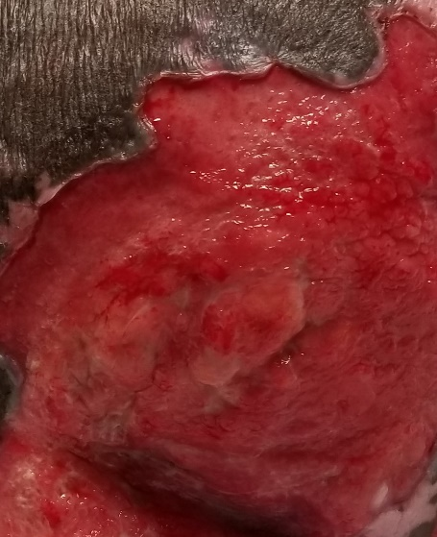
Drainage Amount
NONE
SCANT
SMALL
MODERATE
COPIOUS
Dry wound bed
Moist wound bed
Wet, possibly overflowing wound bed
No drainage on dressing
No measurable drainage on dressing
Less than 25% of dressing has drainage
26-75% of dressing has drainage
More than 75% of dressing has drainage
Notes:
Done to here

Slide 17
Drainage Amount
NONE
SCANT
SMALL
MODERATE
COPIOUS
Add Moisture
Dry wound bed
Moist wound bed
Wet, possibly overflowing wound bed
No drainage on dressing
No measurable drainage on dressing
Less than 25% of dressing has drainage
26-75% of dressing has drainage
More than 75% of dressing has drainage
Notes:
Done to here

Slide 18
Drainage Amount
NONE
SCANT
SMALL
MODERATE
COPIOUS
Absorb moisture
Dry wound bed
Moist wound bed
Wet, possibly overflowing wound bed
No drainage on dressing
No measurable drainage on dressing
Less than 25% of dressing has drainage
26-75% of dressing has drainage
More than 75% of dressing has drainage
Notes:
Done to here

Slide 19
Topical Therapy
Contamination – microbes are in the wound bed, not reproducing, not interfering with wound healing
Colonization – microbes in the wound bed, reproducing but not interfering with wound healing
Critical colonization- microbes in the wound bed, reproducing and they are interfering with wound healing
Infection – microbes in the wound bed, reproducing, interfering with wound healing and invaded systemically
Microbes & Wounds…

Slide 20
Topical Therapy
Critical colonization and infection warrant anti-microbial protection of the wound bed.
Some examples are:
Dakin’s Solution (diluted bleach)
Silver
Antibiotic ointments
Systemic infection will also require oral or intravenous antibiotics. Wound culture results are needed to determine what antibiotic is appropriate. So get that culture before beginning broad spectrum antibiotics.
Microbes and Wounds…

Slide 21
Topical Therapy
So…
If it is deep, it needs a filler. If it is shallow, it does not need a filler.
If it is wet, it needs absorption. If it is very wet, it needs high absorption. Might need to layer absorptive dressings.
If it is dry, moisture needs to be added.
If there is infection or critical colonization, antimicrobial is needed at the site
If the wound bed or peri-wound is fragile, protection from future dressing removal should be considered.
Putting it all together…

Slide 22
Barriers to Wound Healing
Nutrition: Patients with a wound require protein and calories to heal.
Protein requirement is 1.25 grams per kg per day
Caloric requirement is 30-35 calories per kg per day
Comorbidities: Any disease that affects circulation, perfusion and mobility
Blood glucose: Goal blood glucose readings for a patient with diabetes and a wound is 80-130
Steroids: Topical vitamin A applied to the wound counters the negative affects on wound healing
Immobility: Unable to move well increases chances for pressure injuries and moisture associated skin breakdown (MASD)
Non-compliance: Patient may choose consciously or unconsciously to follow healthcare guidelines.

Slide 23
Obtaining a wound culture
You will need:
Normal saline
Gauze
Blue top culture tube
White/Clear top culture tube
Lab baggie
Pen/Marker
Patient labels

Slide 24
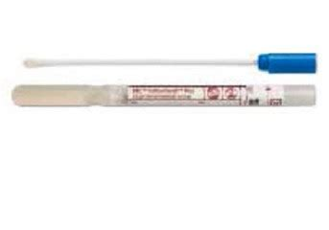
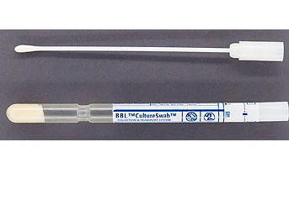
Obtaining a Wound Culture
Tube with gel in bottom: Anaerobic (Bottom is filled with gel to keep sample in oxygen-free environment for transport
Tube with moist foam in bottom: Aerobic (Bottom is filled with moist foam to keep sample from drying out during transport

Slide 25
Collection method:
CLEAN the wound with normal saline and gauze.
Remove one swab from culture package
Press swab into VIABLE tissue in the wound bed and roll the swab. Continue to press and roll in 3-4 areas.
Pop top of collection tube off and place sample swab down into tube.
Label with patient label, your initials, collection date and time and SITE.
Repeat steps 2-5 for other color culture tube.
**Swabbing eschar or slough will likely not provide an accurate result.

Slide 26
Timeline in Microbiology
Gram stain of specimen to see what broad category of organism is present (i.e. Gram negative rods, gram positive cocci). Results same day as collection.
Inoculate nutrient rich plates with specimen to coax the bacteria to grow. Isolate bacteria and identify it (i.e. MRSA, E. Coli, Pseudomonas). Results 2-3 days minimum.
Test the isolated bacteria against a battery of antibiotics to determine resistant or susceptible options. Results usually within a day of #2 above.

Slide 27
Lower Leg Wounds
Neuropathic | Venous (“Too Much”) | Arterial (”Wasteland”)
Shallow or deep, usually involves callus covering or periwound | Irregular wound borders; Flaky crusty surrounding skin | Well defined, punched out borders;
Exudate: Can be dry or draining; | Tend to weep Red tissue, sometimes necrotic tissue. | Tend to be dry Pale pink tissue, sometimes necrotic tissue.
Neuropathy present to varying degree. | Pain typical of regular wounds | Tend to be very painful, at times excruciating
Locations: Bottom and sides of feet; Malformed feet or toes common. | Lower leg gaiter (below knee, above ankle, on medial malleolus) | On lateral malleolus, tips and tops of toes and feet common.
“Diabetic” neuropathic ulcer only accurate if patient diabetic. | Lower leg edema, hemosiderin staining signs of venous insufficiency | Signs of arterial insufficiency: Shiny, hairless legs; Cool to touch; Cyanotic; Thickened toenails; Dependent pain; Smoker

Slide 28
Neuropathic wounds
On bottom and sides of feet; Usually surrounded by callus; foot deformities are common (i.e. charcot foot); Tend to not hurt because of neuropathy.
Daily feet inspection
Nail care by a trained healthcare worker (not a pedicurist)
Properly footed footwear → Podiatrist
Rotary debridement of the callus around the wound
Wear shoes at all time when not in bed or chair
Wear white socks so if a new wound appears or an old one is worsening, the white sock will show drainage that may have been missed upon inspection.

Slide 29
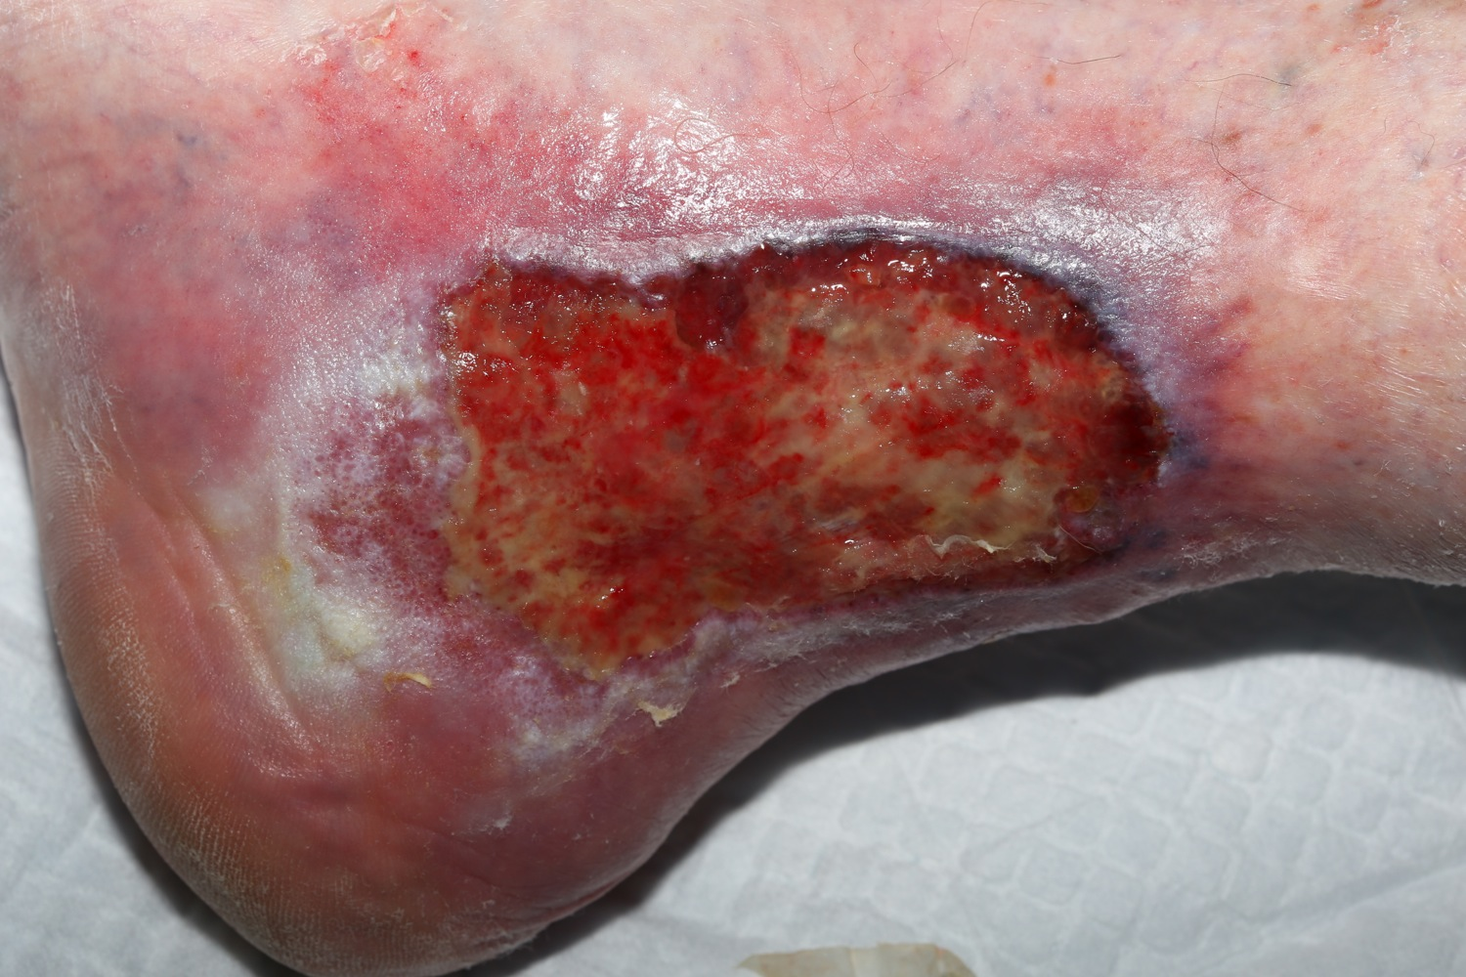
Venous wounds
Lower leg edema
Hemosiderin staining
Lipodermatosclerosis
Wounds occur in the gaiter area and medial malleolus
Wounds have irregular borders, tend to weep, have pink, red or beige-yellow slough tissue.
The skin on the lower leg can be dry, and flaky.
More common in patients with obesity, pregnancy, jobs with sitting or standing for long periods

Slide 30
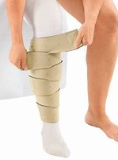
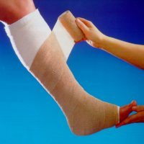
Lymphedema & Venous Insufficiency
Therapeutic Compression (30-40 mm HG) is GOLD STANDARD for treating venous insufficiency and related wounds

Slide 31
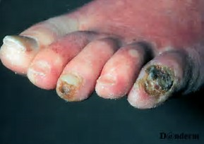
Arterial wounds
Arterial wounds result from increasingly poor blood flow down through the arteries
Biggest factor for developing arterial wounds is smoking.
Wounds are frequently black eschar covered or is open, very dry wound bed with punched out edges and little to no drainage.
Signs of arterial insufficiency include: Shiny skin and hairlessness of the lower legs, thickened toenails, cold and sometimes blue-red extremity, faint or absent pulse upon palpation. Claudication is sudden pain with activity that resolves upon rest.
Arterial ultrasound (u/s) or Ankle-Brachial Index (ABI) tell us if arterial disease is present, and in the case of an arterial u/s the degree of stenosis.

Slide 32
Pressure injury treatment
No matter the stage of pressure injury, repositioning patients, addressing incontinence ASAP, and avoiding friction and shear are all necessary for pressure injury avoidance and treatment.
Stage 1: Skin is intact; Nonblanchable erythema.
You must touch to assess.
Reposition; Use protective ointment or prophylactic foam.
Stage 2: Epidermis is open/lost; Dermis is visible.
VERY shallow wound. NO depth. NO slough.
Reposition; Use barrier cream.
Stage 3: Epidermis is lost; Dermis is lost. Adipose now exposed (may look pink/granular). Minimal to moderate depth.
Possibly has slough, undermining, tunneling. NO bone, NO muscle, NO tendons.
Reposition; Filler dressing if wound has depth; Cover dressing.
Stage 4: Epidermis is lost; Dermis is lost; Past adipose; Muscle, Bone, Ligament, and/or Tendon visible.
Moderate to severe depth. Possibly has eschar and/or slough.
Reposition; Filler dressing then cover dressing.
Always clean the wound before applying treatment. Frequency of changes depend on the severity of the wound in depth and drainage
Notes:
Job aid. Each banner is the unique characteristics of each stage of pressure injury.
If you do not know if the wound is one stage, eliminate the others.

Slide 33
Pressure injury treatment
Unstageable: Too much eschar/slough is obscuring the wound bed to determine staging.
Unstageables are either a stage 3 or 4 pressure injury underneath.
Reposition; Topical care for depth & drainage; Possible enzymatic or surgical debridement; However, if the eschar is stable (no openings, no drainage, no signs of infection) leave it be.
Deep Tissue Injury: Pressure at the bone level is injuring tissue by constricting blood supply. The injury grows outwards to the epidermis and presents as a “bruise”.
Without intervention, wound will continue to enlarge under the surface, eventually may open at the epidermis, and can have an exposed wound bed down to the bone.
Reposition; Advocate for NPO patients to receive a diet. Wound care depends on the assessment. Open wounds require cover dressing or barrier cream. Closed wounds benefit from protective ointment or a fom dressing.
Notes:
Job aid. Each banner is the unique characteristics of each stage of pressure injury.
If you do not know if the wound is one stage, eliminate the others.

Slide 34
Arterial wounds
Treatment for arterial ulcers include:
Cardiopulmonary rehab if the patient is ambulatory and experiencing claudication
Revascularization
Plaque fighting medication
STOP SMOKING

Slide 35
Atypical wounds
Calciphylaxis
A rare but excruciating wound that occurs in patients with chronic kidney disease, frequently on dialysis. Pathology report can differentiate calciphylaxis from other arterial wounds. Visual identifiers include a violet discoloration surrounding the wound bed.
Aggressive debridement is appropriate when infection is a concern, and skin grafts have had some success in treating the wound. Treatment is topical wound care and aiding the patient to reach the best level of control possible with regards to their kidney health.

Slide 36
Atypical wounds
Pyoderma Gangrenosum (PG)
Wound is thought to be an unhealthy immune response to an unidentified antigen. They can be mistaken for other lower leg ulcers, and therefore can be diagnosed by biopsy.
Those with ulcerative colitis (U.C.) and Cohn’s disease are more likely to develop PG. Many instances of PG are preceded by a trauma and therefore excellent history rcording is important for diagnosis.
The wound will require topical therapy and systemic treatment, typically steroids in the case of U.C. and Crohn’s.

Slide 37
Atypical wounds
Necrotizing fasciitis
A serious infection typically caused by group A strep and staph aureus, necrotizing fasciitis (nf) attack the muscle fascia. This infection is initially seen on the surface as erythema, which leads clinicians to think of cellulitis. Eventually the tissue begins to discolor purple or blue-grey, before it ulcerates and opens towards the initial sub-cutaneous infection. It is very painful, much more so than what an observer would imagine for the appearance of the wound.
The infection spreads so quickly along the sub-cutaneous tissues, surgical debridement frequently requires enlarging the original injury to ensure all the NF has been debrided. Topical wound care is decided upon just like most wounds, based on depth and drainage.
Fournier’s Gangrene
Necrotizing fasciitis of the perineum.

Slide 38
Atypical wounds
Strep B infection
The beta strep organism secretes enzymes that break down the epidermis. A significant infection of the skin leads to the outer tissue becoming weepy and then sloughing away over a few days (for the patient on anti-biotics). Reassure the patient that while the injury looks extremely concerning, as the epidermis is sloughing away, more epidermis is being created underneath. The weeping, sloughing tissue will finish its shed and expose new skin. However, complications of this can lead to a wound in the immunocompromised patient or even just a very ill patient.

Slide 39
Atypical wounds
Fungating wounds
Malignancy in the body that travels through the lymph or blood system can metastasize into the skin creating a simple pink or red bump that eventually ulcerates open and has unique characteristics. Skin cancers left untreated can also develop into a fungating wound.
The wound can be painful, have drainage, and often contain non-viable tissue.
Anaerobic organisms thrive on necrotic tissue and those microbes cause an
offensive odor that completely affects whether the patient will even leave their
home.
Treatment is topical wound care based on assessment, including a contact layer
to ease the discomfort of removing the primary dressing. The internal cause
of the malignancy will need to be treated with radiation, chemotherapy or other
oncological means. Debridement is not recommended for fungating wounds.

Slide 40
Atypical wounds
Epidermolysis Bullosa
An inflammatory condition that is most often hereditary, E.B. causes blisters and ulcers to form, frequently after minor trauma. The condition does not only affect the external skin, but anywhere epithelial cells exist (i.e. cornea, bowels, gums, et). A large complication is eating, as trauma to the esophagus can occur, blisters will form, rupture, then lead to scarring. People with this condition suffer anemia, infection related to non-intact skin (barrier to bacteria is lost), and skin cancer is likely.
Wound care should involve no adhesives when possible, and if adhesives are required, allow them to fall away on their own to prevent trauma with removal. Bullae should be lanced and drained by a trained individual to avoid larger tearing of the blister flaps and hence more lost epidermis.

Slide 41
Atypical wounds
Extravasation injury
When non-vesicants or irritants leak outside the intravenous site, erythema and edema may occur with no lasting damage. If a vesicant leaks, the result could be erythema, edema, inflammatory attack all the way to necrotic tissue formation.
Many chemotherapeutic medications have a process to follow just after extravasation occurs with intent to lessen the damage. It is wound care afterwards that a wound nurse would be asked to recommend. Again, topical wound care will depend on depth, drainage, and avoiding further trauma with removal of said dressing.

Slide 42
Atypical wounds
Toxic Epidermal Necrolysis (TEN)
Similar to Epidermolysis Bullosa, TEN leads to the blistering and sloughing of the epidermis. Steven-Johnsons-Syndrome (SJS) falls under the TEN umbrella. SJS and other types of TEN are caused mainly by drug reactions, although hepatitis A and bone marrow transplants also run the risk. Fever and lack of energy occur a few days before blistering is noted. The upper respiratory tract, anus, mouth, and vagina can all be affected as well.
Immediate cessation of the drug in questions occurs, and a punch biopsy may be taken to confirm SJS or TEN. The patient is best managed at a burn center.

Slide 43
REFERENCES
Bryant & Nix (2012) Acute & chronic wounds: Current management concepts, fourth edition. Mosby Elsevier, St. Louis, MO.
Wound Ostomy Continence Nurse Society (2016) Wound treatment associate participant workbook. Wound Ostomy Continence Nurse Society Publishing.

