Slide 1
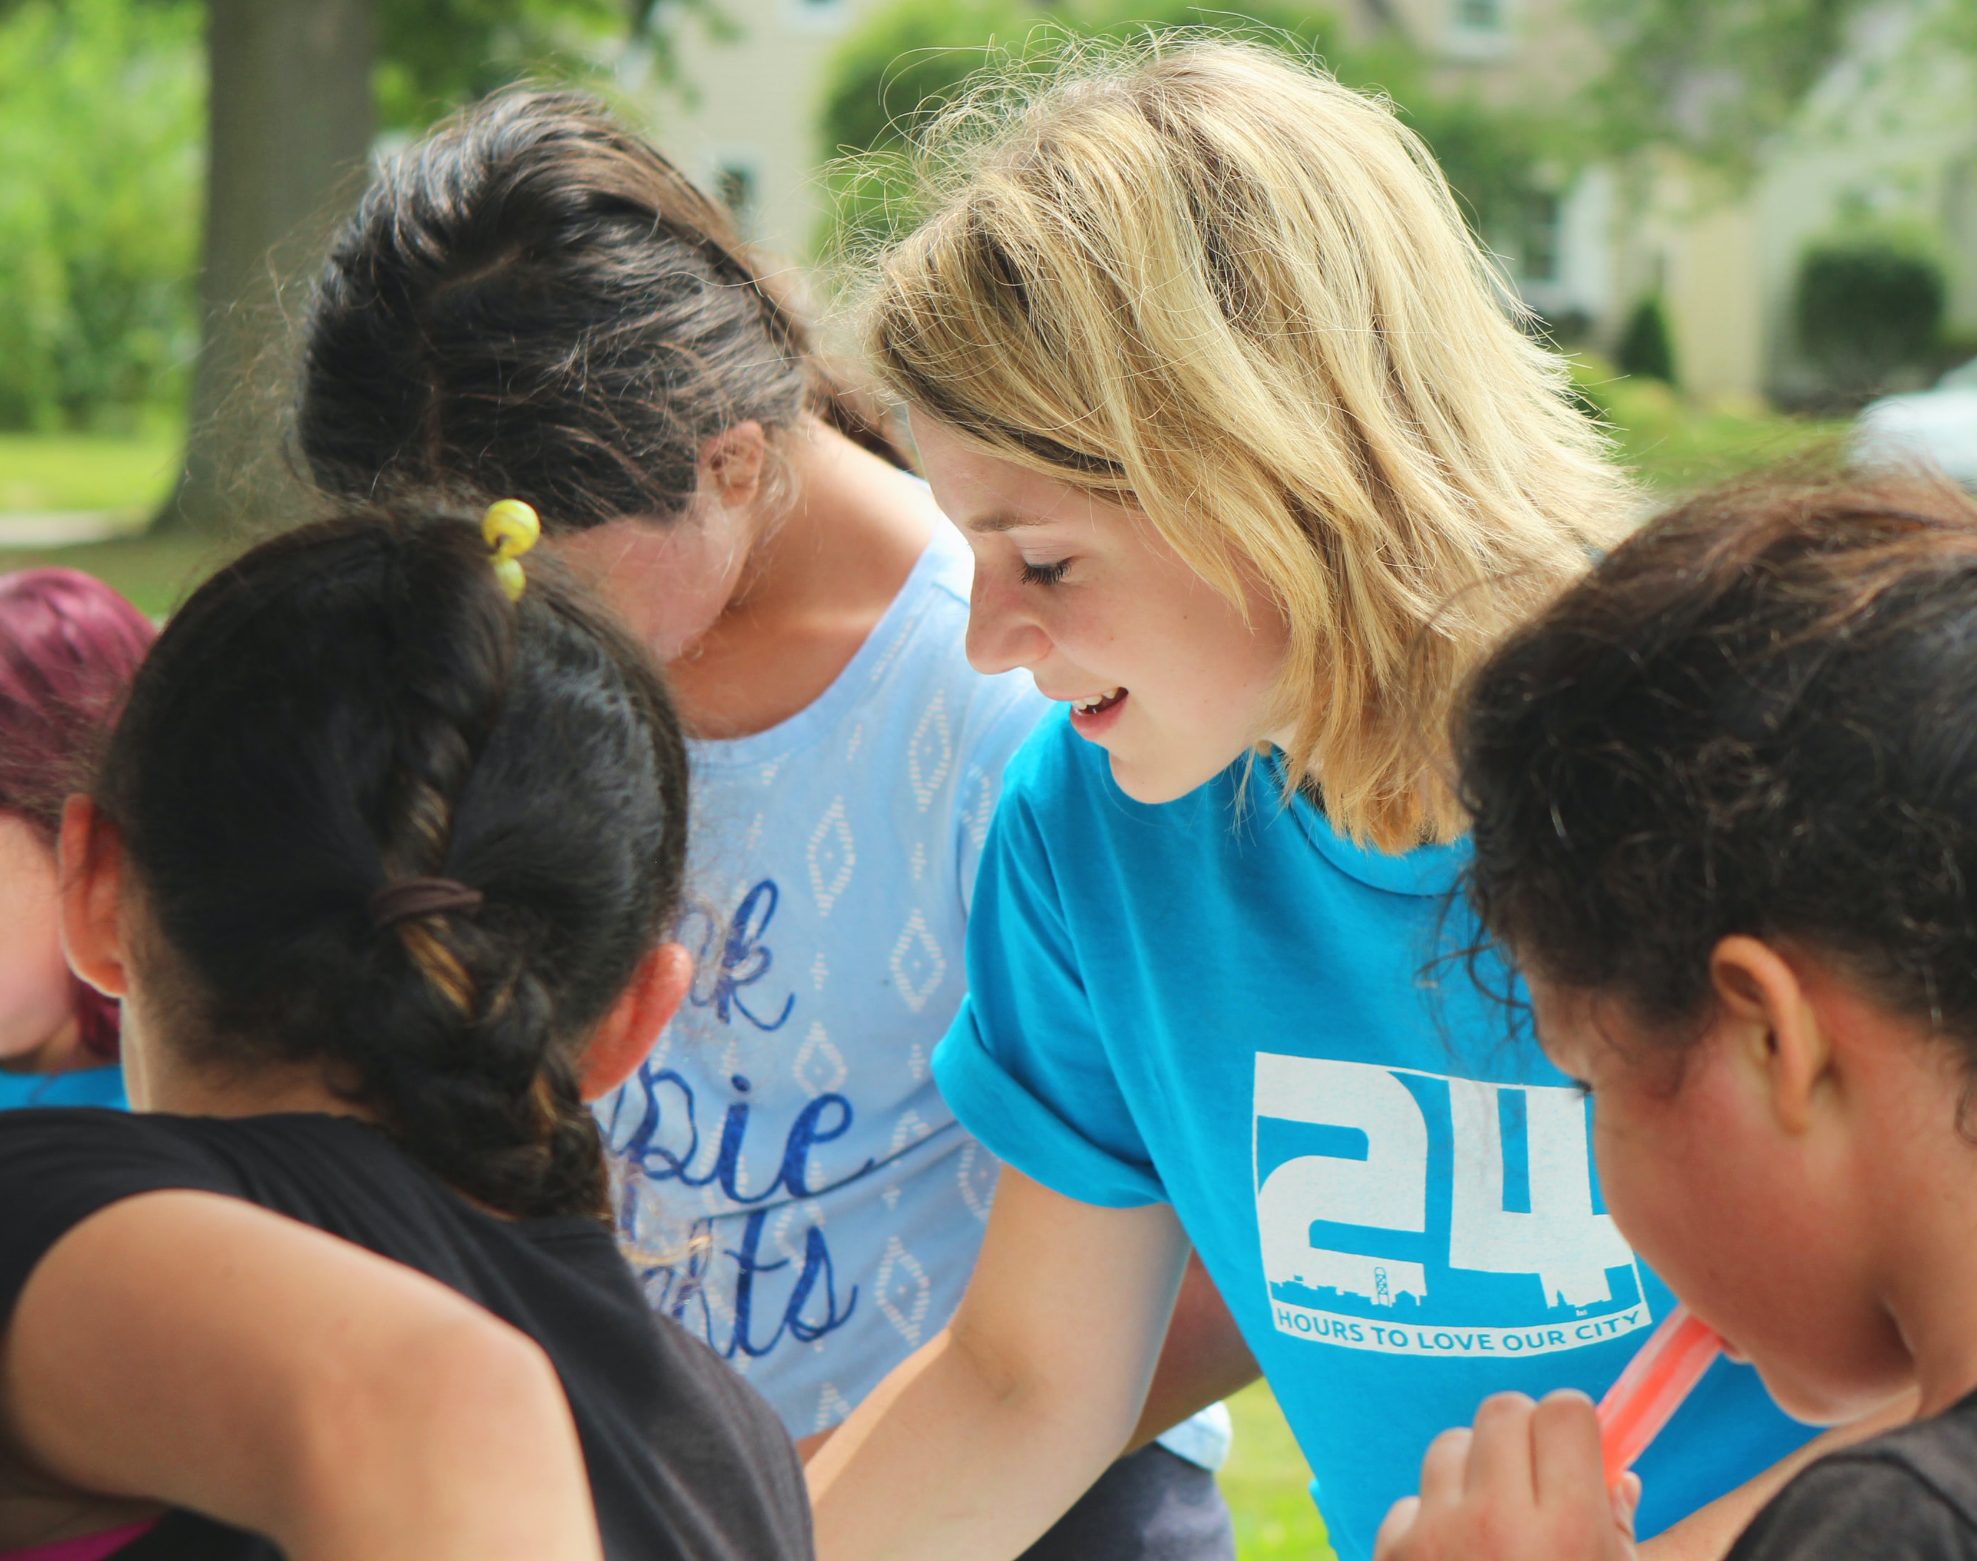
Voluntourism: The Beginner’s Guide to International Volunteering
Olympia Resol, RN, MPH

Slide 2
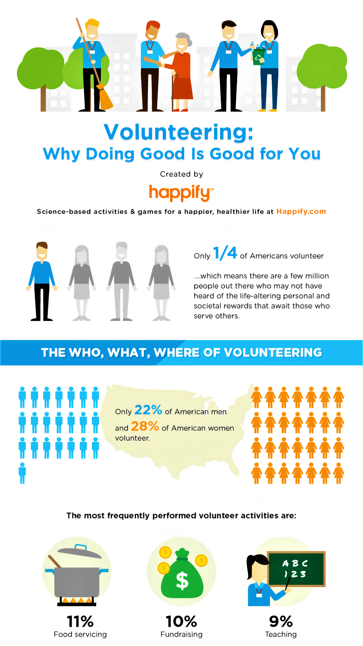

Slide 3
You Can Start Any Time
Being involved in philanthropic activities at a young age can pay dividends in personal growth, social responsibility and well‑being throughout life, points out Tara Jones, chief revenue officer for Girl Scouts of Western Washington. “Former Girl Scouts are more active in community service and volunteer work than non-Girl Scouts,” she notes.
But don’t worry if you missed out on the merit badges. Studies show volunteering at an older age has a significant positive effect on self-worth and purpose, which can help prolong a happier, healthier life.

Slide 4
Money Can Buy Happiness
It may seem as if the only way to feel fulfilled while volunteering is by being on the ground: planting trees, working phone banks. But giving cash—in the right way—can also boost your spirits. One 2013 study found that intentionally spending as little as $5 to help others, called prosocial spending, led to a measurable increase in happiness.
Turns out, it’s the act of giving and not the amount that’s key. Another study found that people with disposable income are happier when that extra money is put toward doing good for others rather than spending it on personal indulgences.

Slide 6
Giving Reduces Loneliness
When Maryellen Gordon, a longtime New York City resident, moved to St. Petersburg, Florida, she found herself facing several life changes. Her journalistic skills were less in demand than she had expected they’d be in the smaller community, and her friend base shrank dramatically with the move. “I faced a real struggle getting used to a whole new life,” she recalls. “I’m someone who needs structure and organization.”
After searching for a way to keep herself occupied and to get more involved in her new community, Gordon volunteered with the League of Women Voters, a nonpartisan organization that focuses on voter registration, particularly in underserved communities.

Slide 7
Giving Reduces Loneliness
“I love that it allows me to do a lot of what I did as a journalist,” she says. “I get out in the community, I talk to people, I learn.” And because the organization partners with a variety of groups across the city, Gordon found that she was also rebuilding the ethnically and economically diverse social base she was missing since leaving New York City.
“I’ve formed friendships with all sorts of people around the city, and it’s provided insights I wouldn’t have had otherwise,” she says.

Slide 8
Sometimes, It’s Good to Be Selfish
We’re not all Mother Teresa’s. Sometimes, the motivation behind doing for others has selfish elements—the opportunity to network, score auctioned items at a gala, or meet personal-fitness goals.
The Texas study found that while volunteering that focused on others, like reading to kids at the local library or putting together food kits at a shelter, resulted in greater health benefits, the health benefits to volunteers who were self-focused (on gaining resumé experience or supporting a political position) were almost as significant.

Slide 10
Leaning into Your Passions Can Give You Purpose
Sometimes, it’s easy to figure out how to help others via an activity that brings you joy. If you love animals, working at a rescue shelter may be perfect. But your hobbies and side skills may come into play in unexpected ways. For me, making masks was a natural extension of my penchant for creating costumes for Comic-Con.
Pauline Nguyen, a chief of staff for Digital Consumer Solutions at Mastercard in New York City, turned her passion for healthy food into a volunteer gig with City Harvest, which rescues surplus food to help feed hungry New Yorkers. “I found I could use my food-prep experience in a meaningful way,” she says. Nguyen began leading cooking demonstrations to teach food recipients how to use the produce and ingredients they were handing out. To date, she’s donated more than 150 hours to the program.

Slide 11
Leaning into Your Passions Can Give You Purpose
Of course, helping others—whether it’s a one-off act of getting someone across the street, or a lifetime spent rescuing wildlife—isn’t a magic wand for happiness and peace of mind. Still, says Jones, “In times like these, our willingness to step outside of ourselves and act as our brother’s keeper can be empowering and enriching.”

Slide 13
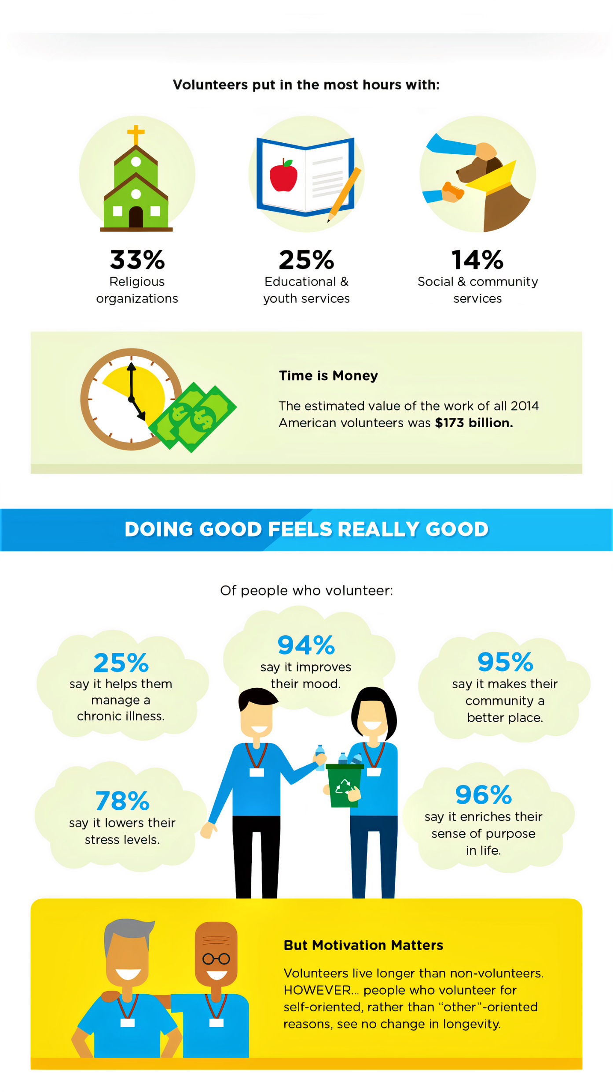

Slide 14
Everyone Has a Story
When volunteering for a community in need, you come to realize that every person has a story - a story of who they are and how they came to be where they are. While it’s important to remember that each person has their own unique narrative, it’s just as important to respect, appreciate, and take the time to understand this narrative.
Whether volunteering at a nursing home, soup kitchen, or homeless shelter, acknowledging everyone’s individual circumstances and stories makes for a more complete and fulfilling volunteer experience.

Slide 15
Small Changes Can Have a Big Impact
Okay, so painting a mural, pulling weeds, or donating clothes may not seem like much, but with the right mindset, these small actions can be seen to have far-reaching implications.
Think of it like this: painting a mural and pulling weeds contributes to the overall beautification of a community, while donating clothes might mean keeping someone warm for the winter. As a volunteer, you understand that simple actions can have a big impact.

Slide 17
Smiles Are Universal
If you’ve volunteered abroad or within a community unlike your own, you’ve probably figured out that smiling is part of a universal language. A simple smile can permeate language, cultural, economic, or other barriers and can relay the message that you care. When in doubt, flash those pearly whites.

Slide 18
Gratitude
Volunteering brings with it a deep appreciation of all that you have in life and helping those in need is a firm reminder of what really matters - like family, friends, and health. It’s not uncommon for volunteers to see their own lives in a different light, perhaps taking notice of the small things or moments that bring them joy.

Slide 19
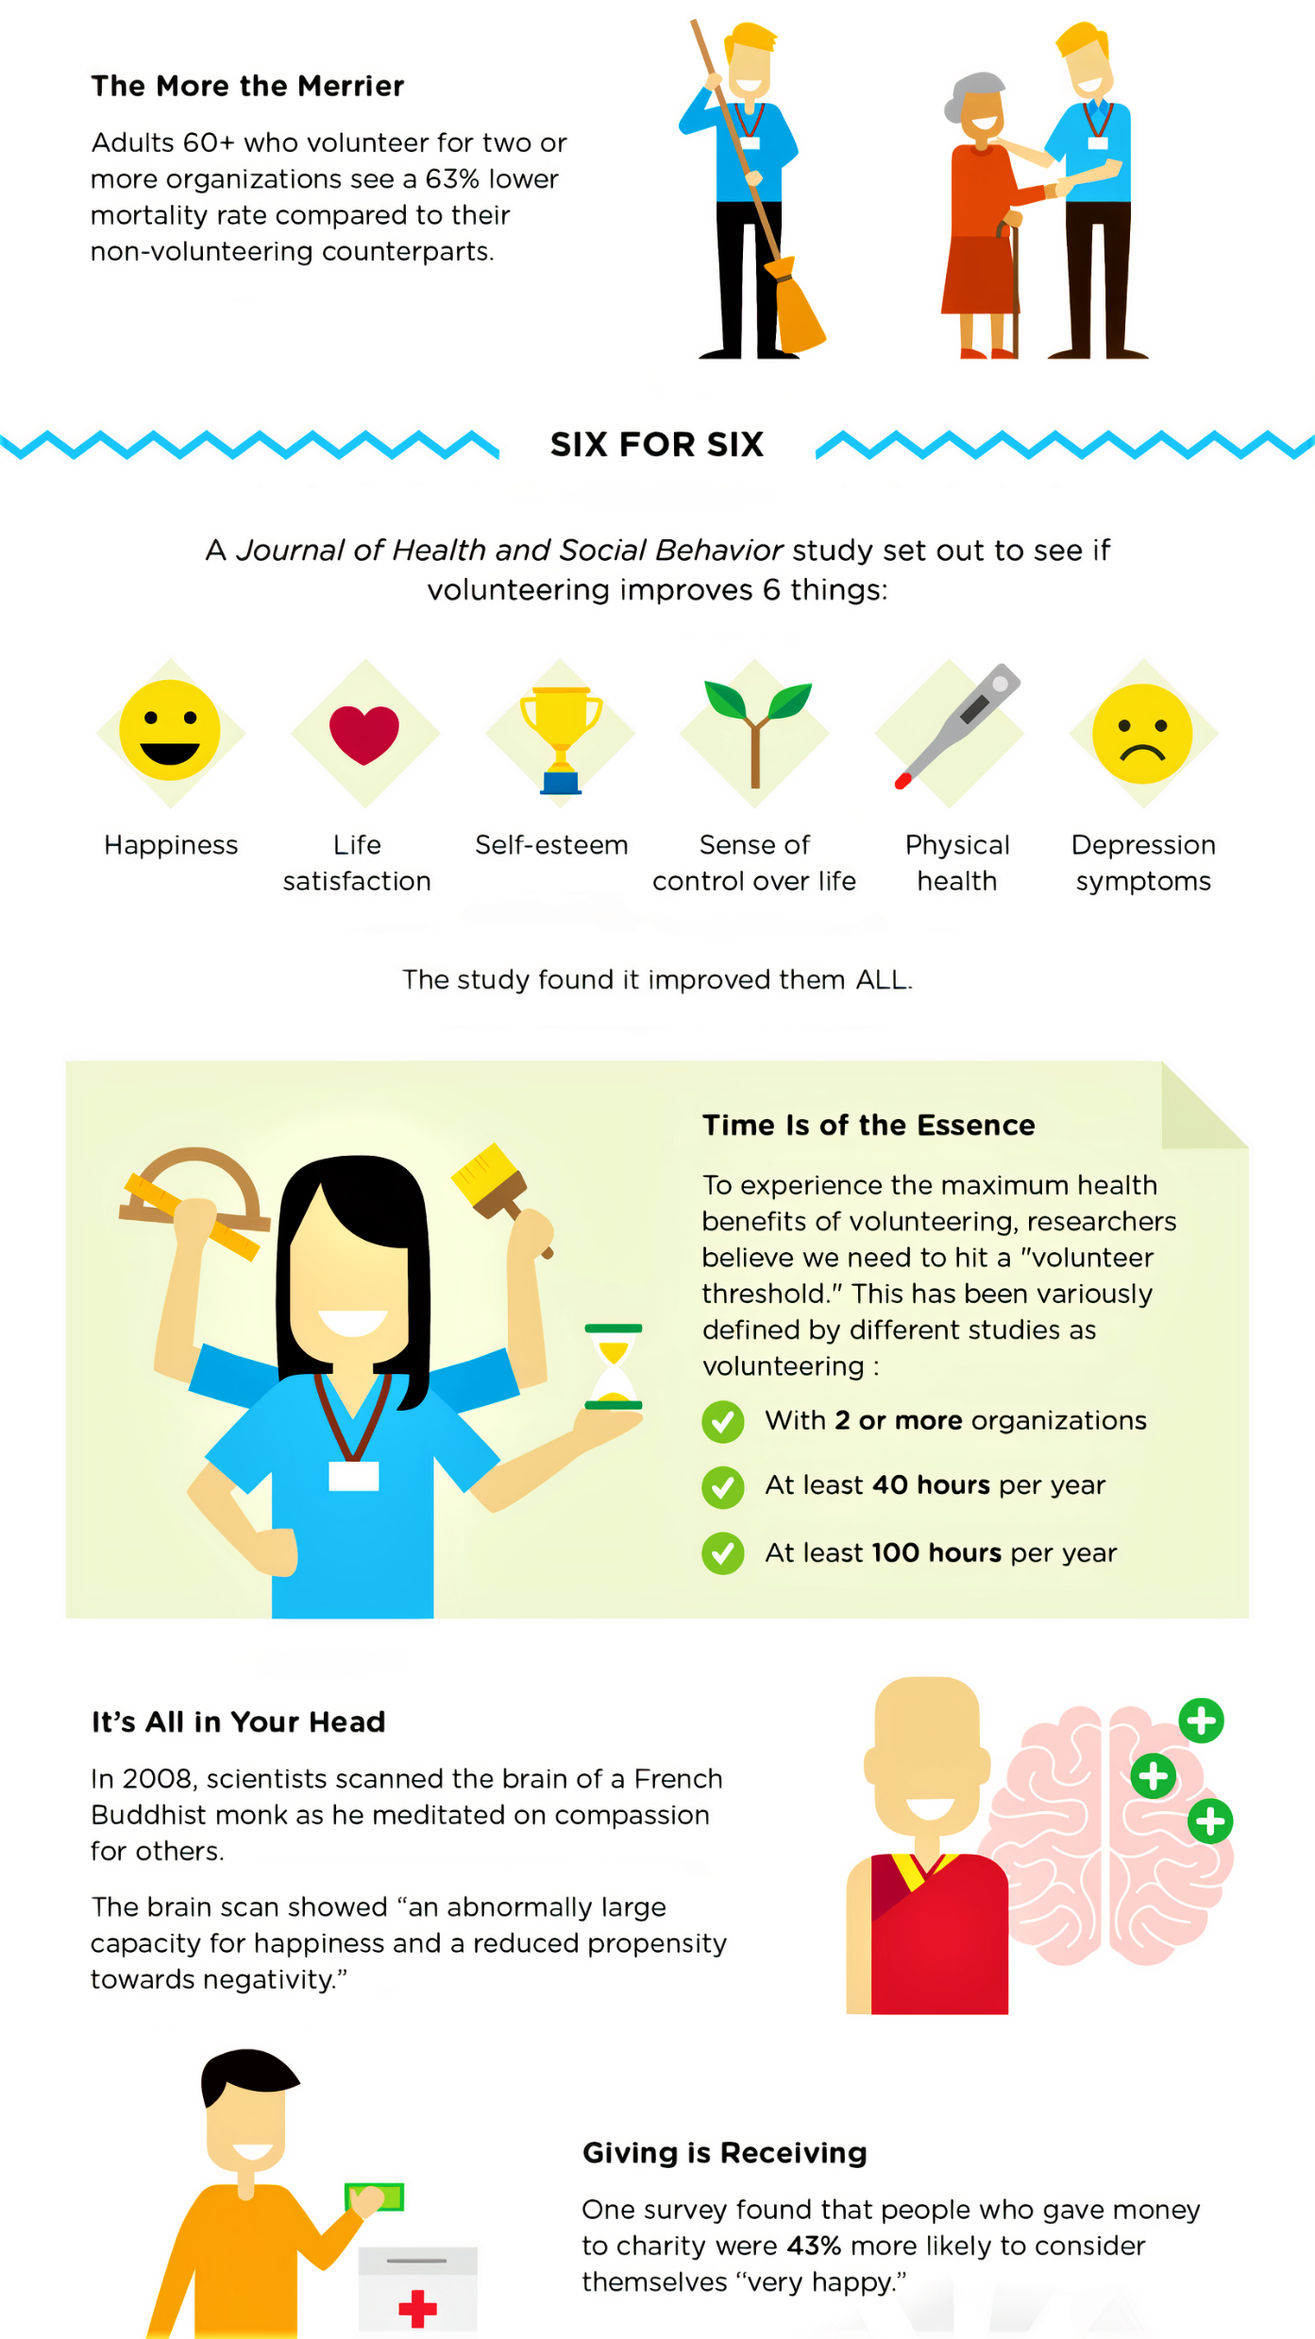

Slide 22
Volunteering Is a Learning Experience
As a volunteer, you never stop learning. Developing new skills, discovering new passions, gaining new insights about yourself and the world around you - volunteering covers it all. Volunteering can mean learning about different communities, organizations, and fields, as well as learning more about yourself.

Slide 23
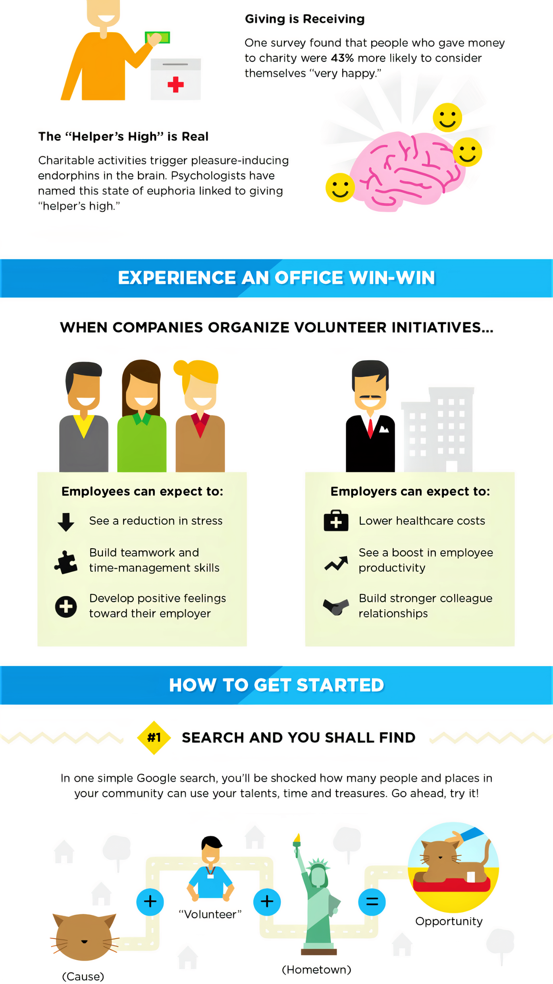

Slide 25
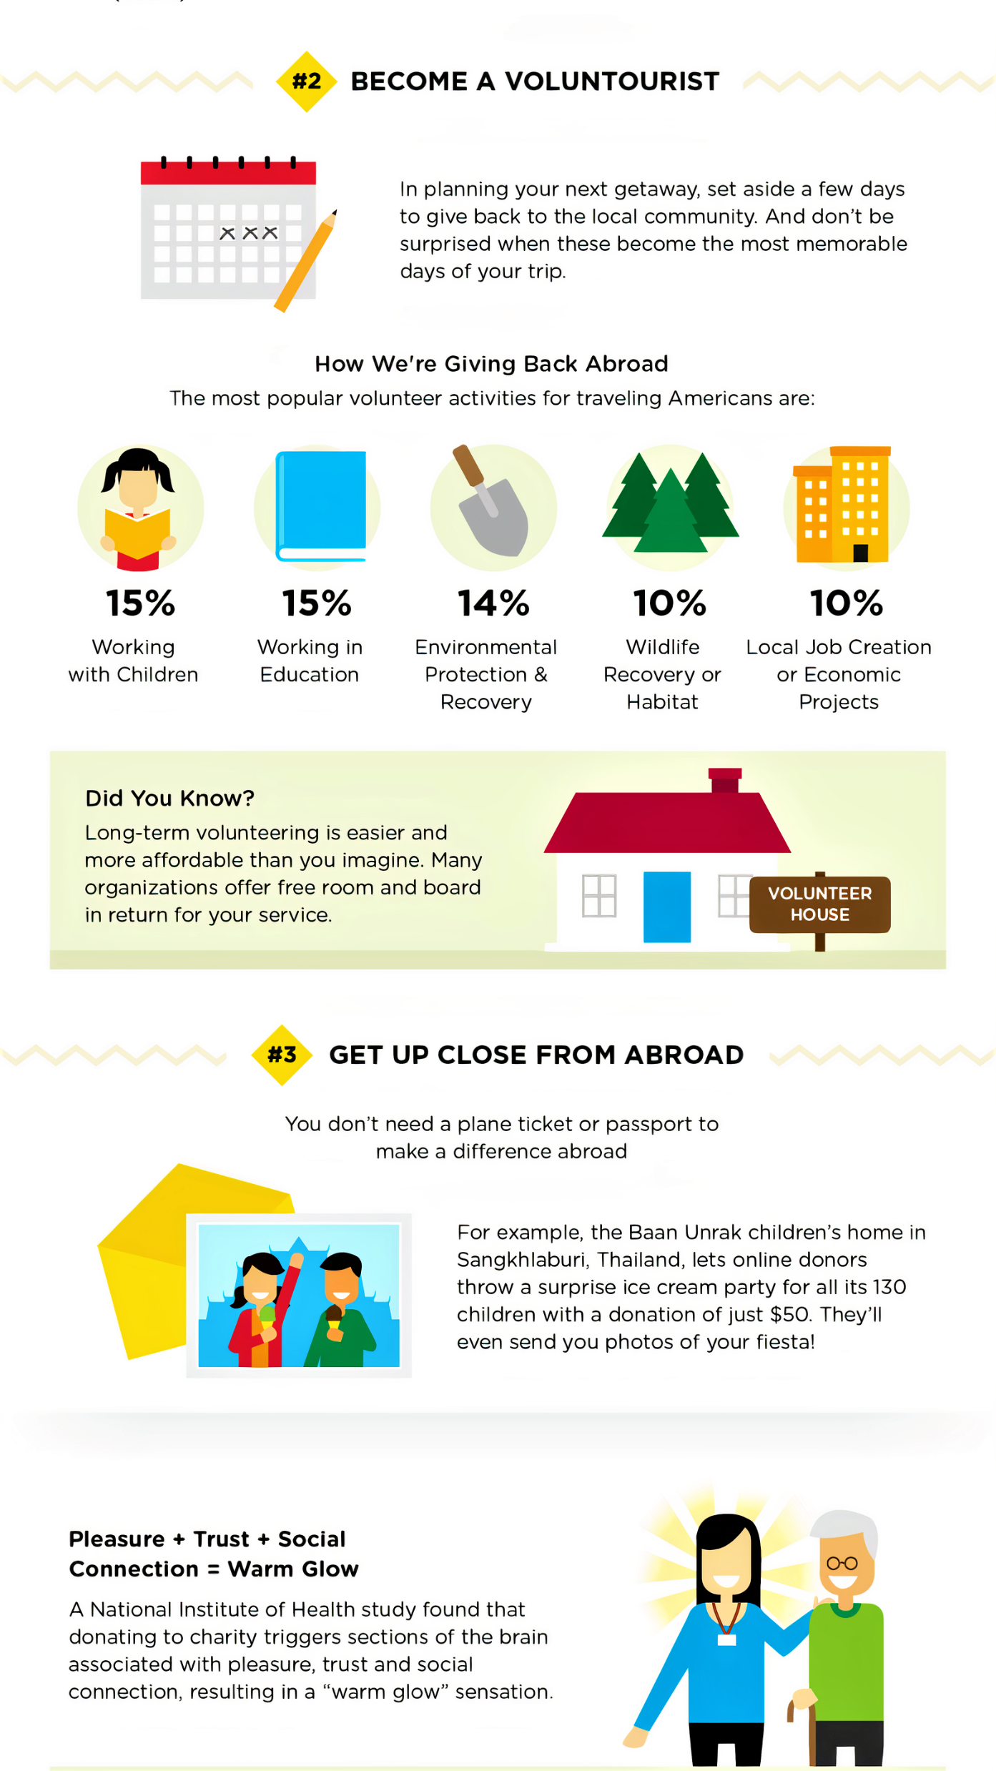

Slide 27
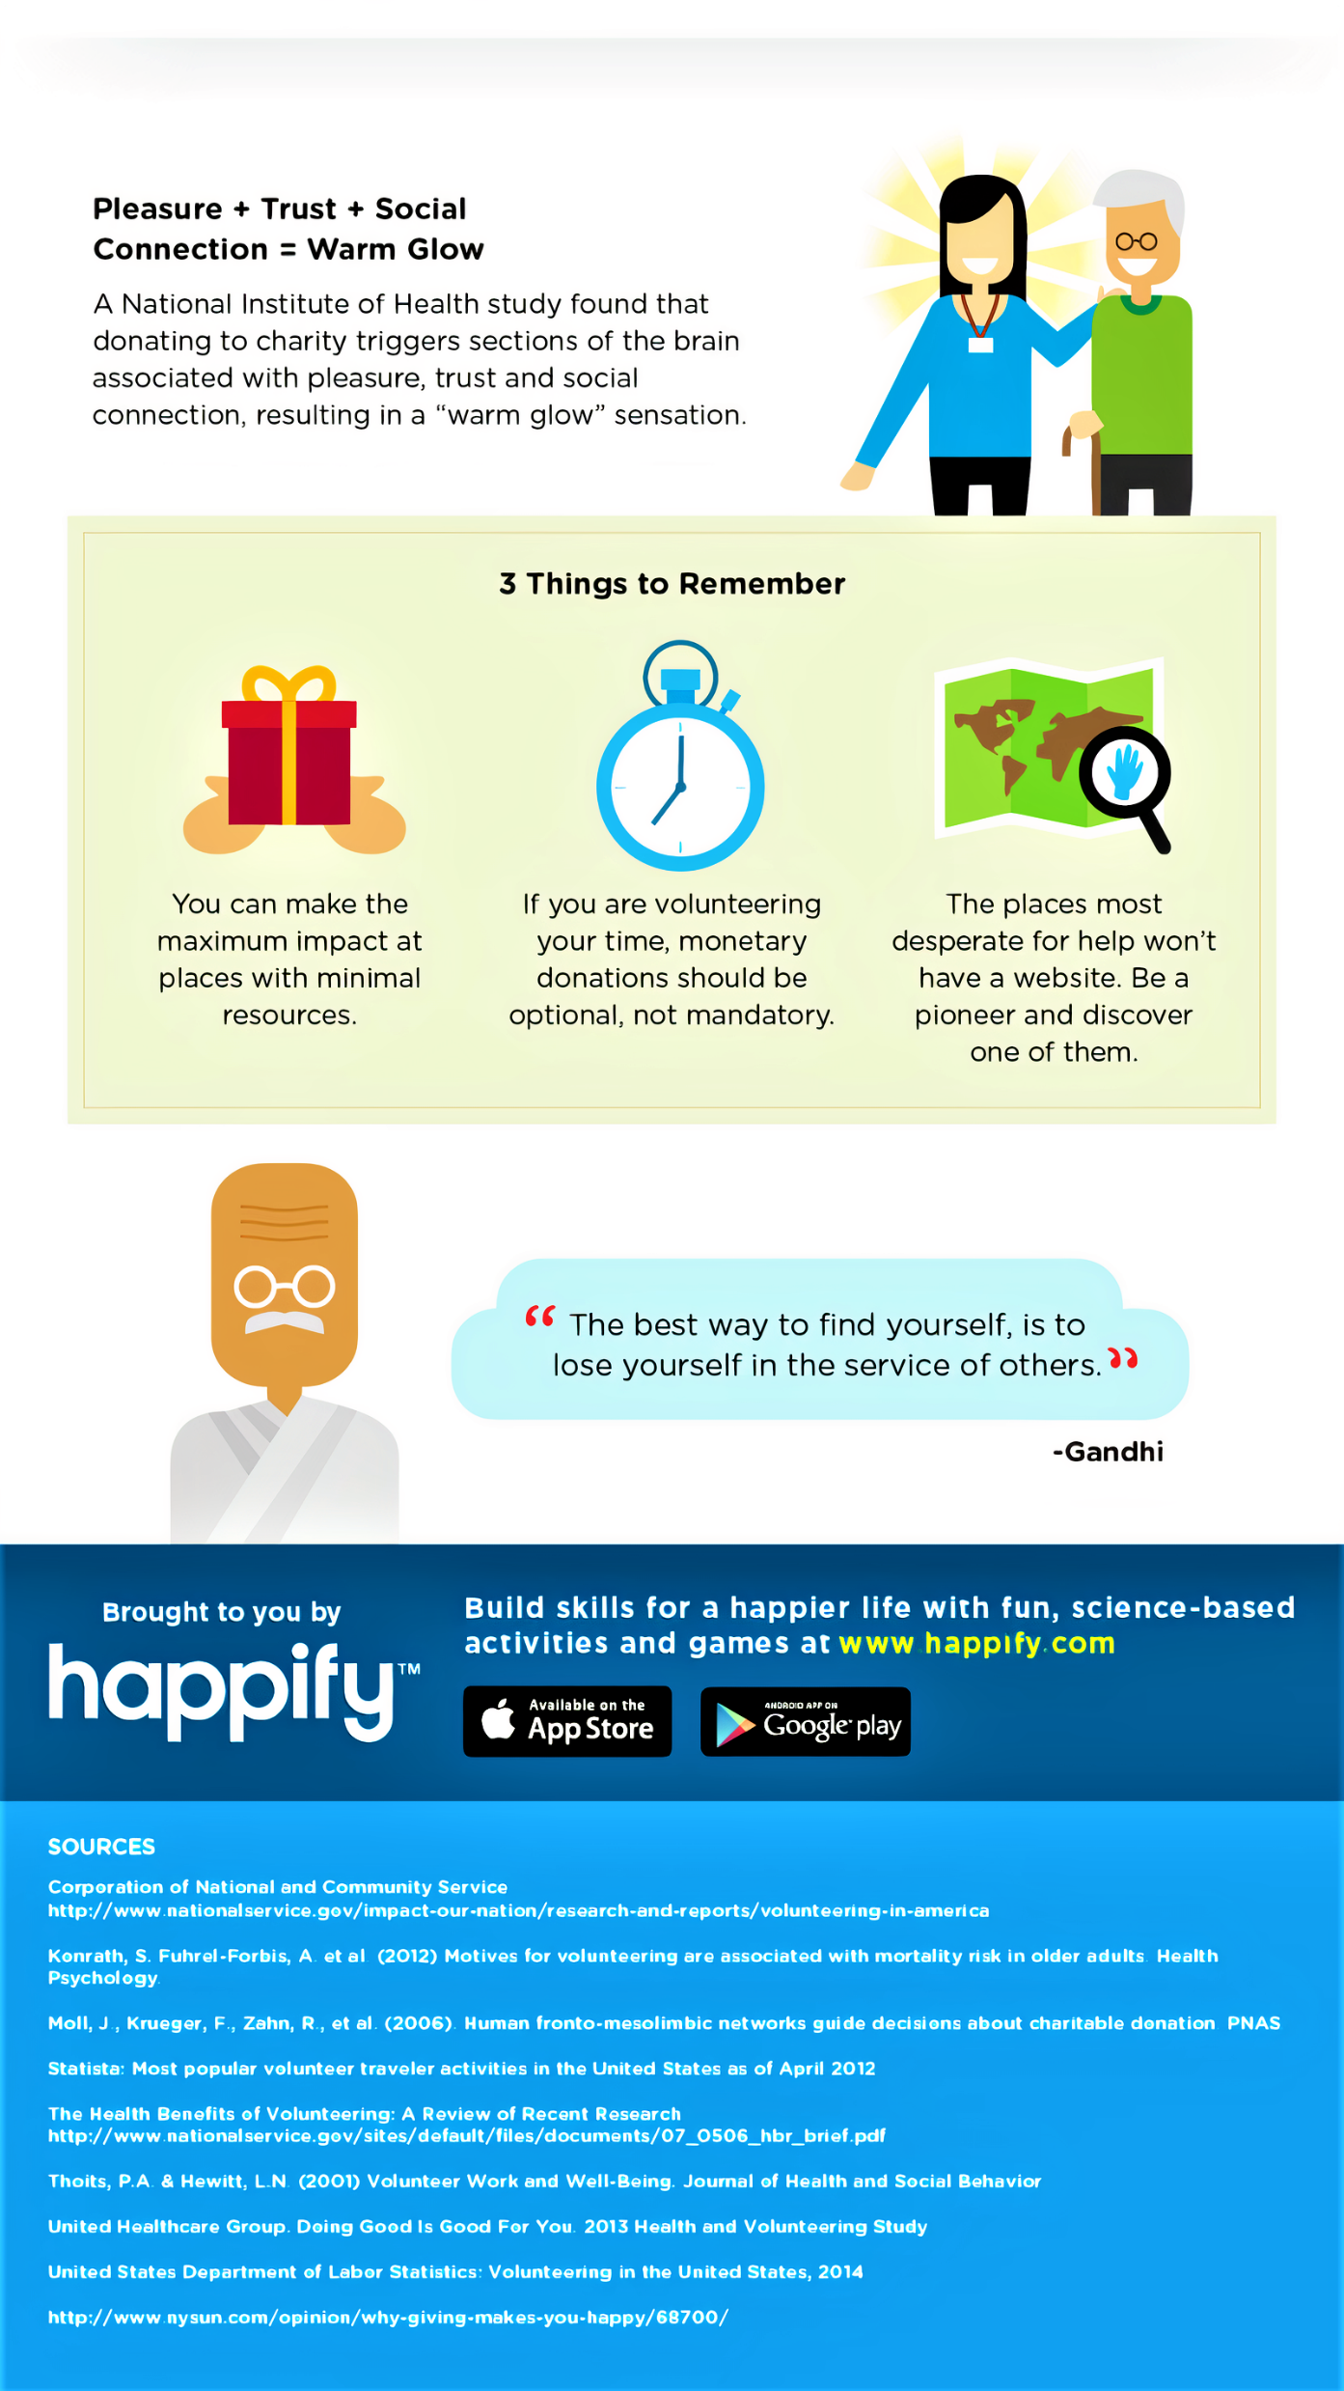

Slide 28
Once a Volunteer, Always a Volunteer
Putting aside the fact that doing good is scientifically proven to lead to more good deeds, volunteering is an experience that stays with you forever.
The fulfillment that comes with helping another human being, the satisfaction from knowing you’ve made a difference, and the good old fun factor, are just a few reasons once is never enough.

