Slide 1
Specialty Support Surfaces
Catherine Koutroumpis, MSN, RN, CWOCN

Slide 2
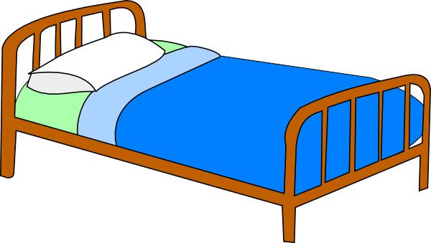
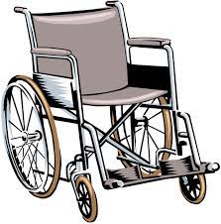
Support Surfaces
Support Surface = Mattresses, Chair cushions, Wheelchair cushions, etc.

Slide 3
Support Surfaces
Types of bed surfaces can be a confusing topic to learn. It is actually an area many wound specialists find difficult to teach in a clear manner. Some even struggle to understand themselves! So the focus here is to describe the features to look for in a bed or chair surface so you can ensure your patient is on a specialty surface if appropriate (and document this intervention as well).

Slide 4
What to Look For in a Support Surface
The three characteristics to a support surface that land them in a higher category of protection over another are:
Surface cover material
How is pressure redistributed?
Microclimate Management
Surfaces may have the best of all three features or maybe only one.
Frequently total cost can influence decisions. Most specialists will agree, the future savings from improved outcomes far outweighs the initial investment. However, one cannot invest with money that may not exist.

Slide 5
Surface Cover Material
The material should be “Low-friction, Low-shear”.
Definitions
Friction: The physical rubbing on the outer side of the skin.
Leads to breakdown of skin from outside in.
Shear: The negative affect of moving the patient in a way that the skin lags behind when the body is pulled in a direction (i.e. boosting in bed, transferring from stretcher to bed).
Leads to undermining of wounds.

Slide 6
Surface Cover Material
Many hospital beds are equipped standard with this feature as are many of the overlays you can place on top a standard bed to make it a better surface. Some chair cushions are now covered in this material as well.
Without this feature, significant friction and shear injury will occur for patients that require assistance with boosting, transfers, and turning.
If you have ever tried to boost a patient over an “egg crate” looking material, you are aware of the resistance that occurs, pulling the body in one direction while leaving the epidermis to lag behind.

Slide 7
Pressure Redistribution
When a person sits on a support surface, the pressure from their weight pressing down on and around boney prominences needs to be off set so that part of the body is not experiencing intense prolonged pressure.
The four main ways this can occur via a specialty support surface are covered next. They are listed in order of lowest to highest therapeutic effect with regards to pressure redistribution:
Static (non-powered) Reactive (i.e. Gel, Foam)
Static (non-powered) Reactive Air (i.e. Communicating air bladders)
Non-Reactive Powered Air (i.e. “Alternating Air” pump)
Powered Reactive Air
Air Fluidized (i.e. “Sand bed” – common but inaccurate nickname)

Slide 8
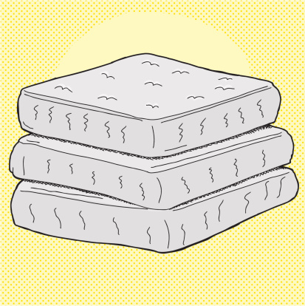
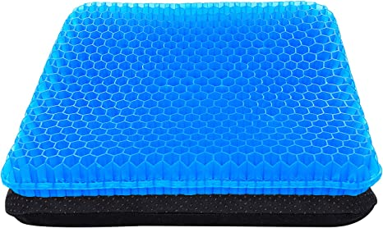
Static (Non-Powered) Reactive
Non-powered surface
The material absorbs and spreads out the impact of pressure to ease the stress on the boney prominences (i.e. Gel, Foam material).
Foam versions resists deformation and gel versions can range from soft to hard.
Both foam and gel does not allow air to pass through the layer.
National Pressure Injury Advisory Panel (2019)

Slide 9
Static (Non-Powered) Reactive Air
1. Patient sits down…
Air moves via resistance from a bladder or cell under or near the patient’s boney prominences to another in order to off set those higher pressures. (i.e. communicating air bladders).
2. Air moves out to neighboring cells

Slide 10
Powered Non-Reactive Air
This powered surface has air cells that inflate and deflate on a timed sequence. The cells are alternated into two groups. Group “A” cells inflate, while group “B” cells deflate, then they hold positions for a certain time before switching roles (i.e. Alternating air surface).
This surface is on a timed sequence. It does not change based on where the patient sits on the surface.
A
B
A
B
A
B
A
B
A
B
A
B
A
B
A
B

Slide 11
Powered Non-Reactive Air Mechanism
Non-Reactive Air (Continued…)
This surface with the alternating “A” and “B” cells is called “non-reactive” because the surface does not respond to the patient’s weight sinking into the surface, or the patient moving and changing levels of pressure in different areas. It simply changes the amount of pressure in each group on a timed schedule.

Slide 12
Powered Non-Reactive Air Mechanism
SINGLE-STEP → “A” cells goes up while “B” cells go down over a short timeframe.
MULTI-STEP → “A” cells go up some, “B” cells go down some, and hold. “A” cells go up more, “B” cells go down more, and hold. This continues until each cell reaches the lowest or highest threshold and then switch roles.
Between single and multi step alternating air, multi step has evidence based support as the better of the two options.

Slide 13
FYI
Non-powered Reactive Air and Alternating Pressure
are in the same level of therapy because based on a large literature review, there was not evidence enough to say the “Non-Reactive Air” is comparable to the “Alternating Air” surface in the next therapy level. Individual expert opinions will fall on either side of that argument though.

Slide 14
Powered Reactive Air
1. Patient sits down…
Air moves out from under or near the patient’s boney prominences because the advanced technology of the mattress can detect the increased pressure from the patient’s body weight. In response, the mattress pump moves air away from that area to another in order to alleviate pressure.
2. Bladders deflate some to lessen pressure
A
B
A
B
A
B
A
B

Slide 15
Air Fluidized
Millions of tiny microbeads circulate inside the surface at such a high rate that no one area of pressure is much higher than another. This therapy allows for the greatest immersion of the patient into the surface, and is the highest level of pressure redistribution available. i.e. Incorrectly, but commonly called the “sand” bed.
https://youtu.be/AiuOXfQP5-I
View what an air fluidized surface looks like with the surface cover pulled back.
Very cool!

Slide 16
Microclimate Management
What is “Skin Microclimate”?
It is the temperature and moisture levels at the skin’s surface. Our body naturally controls our skin microclimate by heat and moisture leaving through our skin into the environment around us.
When we lay on a bed, the areas that are blocked from this free flow of heat and moisture into the air become warmer (requiring more bloodflow and nutrients to stay healthy) and wetter (risking maceration injury).
Surfaces that have a microclimate management (i.e. Low Air Loss, Air Fluidized) feature a flow a steady stream of air over these body parts, protecting the patient from skin breakdown when compared with a surface without microclimate control

Slide 17
Specialty Surfaces
WARNING!
Too often caregivers will not offload heels or reposition patients because they are on a specialty surface. NO SURFACE EXISTS that can take the place of floating heels and repositioning. Continue these interventions for everyone at risk for skin breakdown.

Slide 18
References
McNichol, L., Watts, C., Mackey, D., Beitz, J., & Gray, M. (2015). Identifying the right surface for the right patient at the right time. Journal of Wound, Ostomy and Continence Nursing, 42(1) pages 19-37. Doi: 10.1097/WON.0000000000000103
National PI Advisory Panel (2019) Support surface standards initiative. https://cdn.ymaws.com/npiap.com/resource/resmgr/terms_and_defs_nov_21_2019_u.pdf
Wound Ostomy Continence Nurse Society (2016) Wound treatment associate participant workbook. Wound Ostomy Continence Nurse Society Publishing.

