Slide 1


Jax Tyres & Auto
STORE REVIEW

Slide 2

INTRODUCTION

Slide 3
Jax Tyres – High Level Observations / Questions
LayerCake are a certified Optimizely Partner and have been working with Jax since 2021.
What are the key strategic outcomes Jax Tyres is looking to drive, JAX need to document these key outcomes and track performance against these
What are the key user journeys and associated Call to Actions on the sites
Revenue goals and key revenue opportunities need to be defined e.g. where is the most revenue opportunity for Jax, this should be based in growth and repeat revenue
The customer needs to be key to Jax, and they should be redeveloping MyJAX with an advanced CRM and Data servicing customer key goals e.g. returning customer being able to repeat a purchase with ease
Automated email and comms to customers will allow them to connect directly to a store for a repeat service e.g. book in my service at the required time
Promotion throughout the site and in store needs to be updated to optimise this and help communicate this through customer comms and marketing
What is the relationship model between Jax and stores
How is the store inventory managed, if this centrally controlled. Need to better understand this and where opportunities exists to optimise this

Slide 4

JAX STORE
REVIEW

Slide 5
KEY FINDINGS STORE PAGES
Currently Store pages are very low traffic pages, since Jan 2023 only 8.71 % of site content was store pages. Of this only 11.6% of the traffic is for the Store Locator page.
We believe the core foundation of Stores does exists on the site but this can and should be improved upon.
Find My Store is prominent on the site and in the journeys, however, we feel key user journeys are not well mapped out to maximise potential for Jax
Google Analytics for insights and reporting is not optimised, affecting Jax's ability to track the overall site performance and the ability to trend/monitor site improvements over time
If there are staff available in the relevant Store who can answer customer questions (help improve conversion) consider ways to make them directly available to the customer to help move a customer to a purchase
Review the response times from the customer notifications to the Store, where is this data stored and how efficient are these requests processed
Consider adding advanced chat service e.g. Kore.ai could be used to help convert the customer sale
Need to review the order of information on the Store pages based on priority e.g. is the map the most important piece of information
There are no Call to actions for the store page, these need to exists to help better direct customer for example Book a Service
The MyJax (or a customer profile) important to be integrated to Store to – maximise retention, sales. Currently it's confusing.

Slide 6
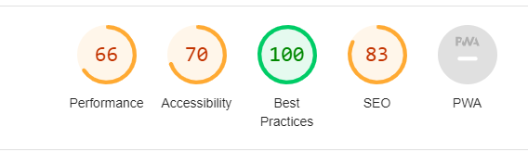
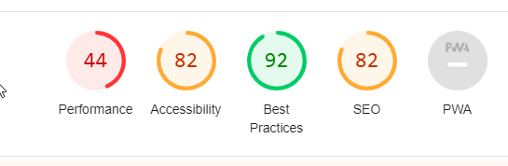
KEY FINDINGS STORE PAGES
It is critical Jax review the overall website performance, this is critical in both Revenue, SEO and User Experience. People have become accustomed to immediacy, if your website is not providing an efficient user experience you will lose users who become frustrated with not achieving their desired goals in a reasonable timeframe. Example below is from https://www.jaxtyres.com.au/tyre-stores/nsw/artarmon
Desktop Performance
Since Jan 2023 68% of traffic is on mobile devices, 29% on Desktop and 3% on Tablet
Unclear user journey e.g. click to search tryres by rego on store pages takes the user out of this page, this should load the popup at the bottom of the page
Optimised keywords should be built up for each store page to ensure SEO is enhanced
There is a lot of noise on the website for example 1: Feedback form, 2: Customer ratings, 3: Free inspection, 4: Chat bot service all these could be interrupting key user journeys (a sale)
Need to order the information on the store pages based on priority and track this with Hotjar
Mobile Performance

Slide 7
KEY FINDINGS STORE PAGES
Bring the Stores closer to the customer, highlight their stories and the service they provide https://franchisebusiness.com.au/breaking-the-mould-why-this-jax-tyres-franchisee-is-throwing-stereotypes-for-a-spin/
Does the "Send us a message" on the Store details go to the store? I would suggest this goes direct to them if it doesn't already, as well as being logged in a central CRM to log the contact point
This messaging component could be expanded to enable a direct communication with the store. Obviously the store would need to have staff to support this by responding to customer messages
Know Your Customer needs to be a key component of the future strategy for Jax, identifying all the data points collected in the store and online are keep to starting and growing this relationship
The map on the Store page is too big impacting the access to other key information about the store. Consider swapping this around to get the customer to provide their contact information and avail of other call to actions quicker/easier. Exact location on the map is secondary to this as the customer already knows the rough location based on the Suburb/Store name, focus on the sale and customer to convert to a sale.
Google/search store indexing is not a major issue. Small tweaks can be made here but I don't think there are low hanging fruits here. What I would suggest is exploring adding in a Jax knowledge panel for certain verified searches such as "Jax" "Jax Stores" etc.

Slide 8
KEY FINDINGS STORE PAGES
Hotjar (or similar) needs to play a bigger role in the overall site content and layout, this tool provide key learning to JAX from real customers
Review the event level tracking on JAX journeys to ensure that they can be reported on, the integration with GA was once a key element of the site but this has not been progressed and this is now regressed/broken
Consider adding experimentation to the platform, the time to deliver capabilities such as AB testing in the CMS limits this feature, there are many third-party services that can be easily integrated with the site to provide these services
Improve Content on the website, throughout the website there is limited content. Propose JAX built out a site taxonomy to drive their key site sections and verticals and engage a content resource to help deliver and operate this throughout the site
JAX need to better map out the key user journeys throughout their business to best attract, convert and retain customers
User journeys on the site are fragmented, there is also a lot is noise and alternative paths in these journeys that need to be reviewed – these can confuse users who come to the website to do a specific action (book as service, purchase tyres etc)
Customer testimonials on the store pages will help drive customer trust on the services and recourses in store.
JAX key devoice is mobile however the site is not optimised for mobile users.

Slide 9
KEY FINDINGS YOUR CUSTOMER
  Know your Customer
  Build a customer strategy, Jax is moving to Microsoft Dynamics this is a great decision as this will allow Jax to access to a loading CRM solution
  Drive revenue, for example with a light login (email & password) we can track a customer looking to purchase tyres ideally for their vehicle. Even if they don’t purchase we can communicate to the customer now and in the future e.g. next time the tyres are due for replacement
  Mapping customer to data, when a customer enters their rego, Jax need to search for the customer in Jax rich data to check if this rego exists
  Identify key customer information throughout the Jax eco-system and store this against your customer record
  Direct marketing automated through to the website to help move customer efficiently into and down the sales funnel
  Passively track your customer web visits while driving them into marketing journeys.
  They are not your customers if you DON’T OWN THEM
JAX data strategy
Alignment with Business Objectives: A data strategy can help you align your data management and usage practices with business strategy.
Improved Data Quality: A data strategy can help you establish standards for data quality. Better data results in better business outcomes.
Better Decision-Making: A data strategy supports informed decision-making. By using known related data to gain insights into your customers, markets, and operations, you can make more informed decisions that drive business success.
Regulatory Compliance: A data strategy can help you ensure that your organization is complying with relevant data privacy and security regulations. You can also ensure you are only storing and using information that is key to your business operations.
Data is a key tool in modern business, however it comes at a cost and needs to be managed to ensure it is driving the most business value is not a business risk.

Slide 10
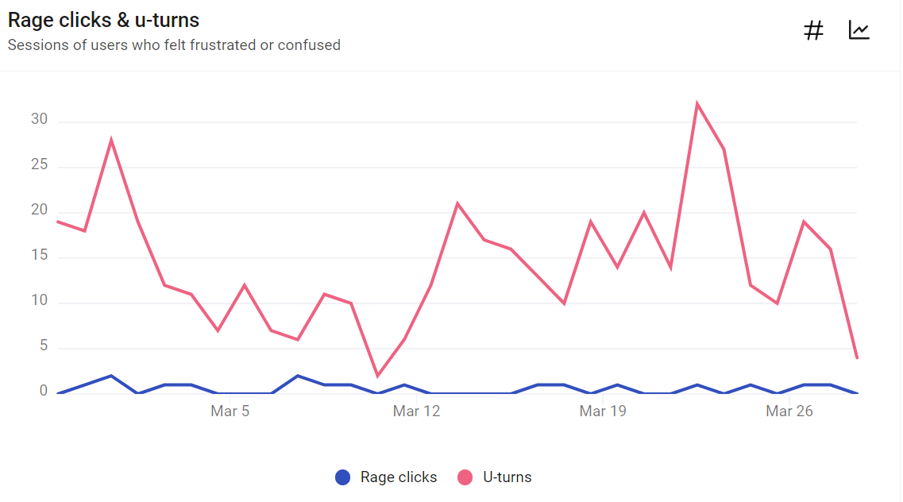
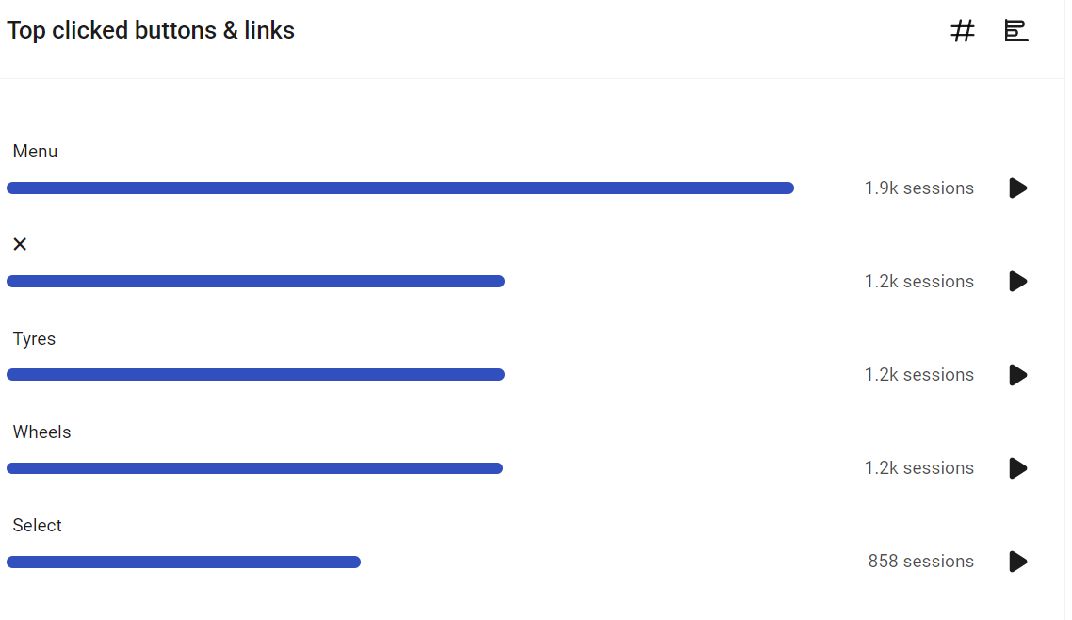
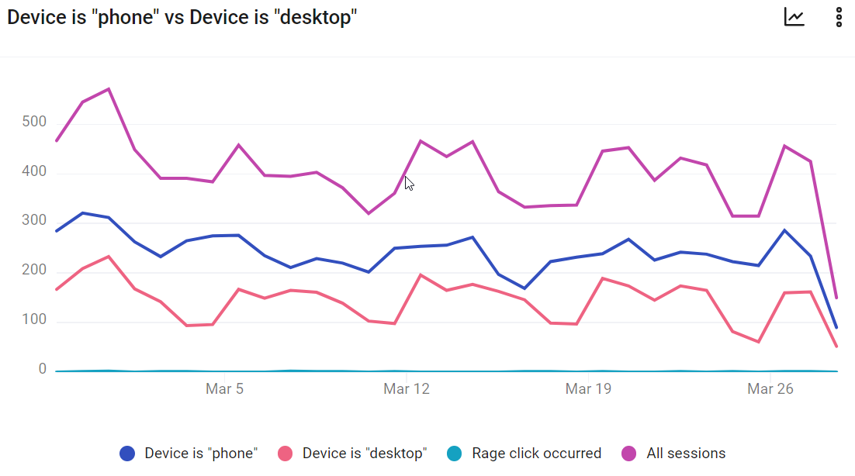
KEY FINDINGS FROM HOTJAR
Stats from Store Pages from Hotjar
On Mobile
40% of customer view 50% of the store page
22% of customer view the bottom 25%
On Desktop
35% of customer view 50% of the store page
25% of customer view the bottom 25% (lost

Slide 11

THANK YOU
We are proud of our longstanding partnership with the Jax Tyres and Auto. We look forward to continuing to build on this strong foundation and are committed to driving incredible quality and value for the Jax.

