Slide 1
Wound Assessments
Catherine Koutroumpis, BSN, RN, CWOCN

Slide 2
objectives
By the end of this course participants will be able to:
Identify the parameters of a wound assessment
Name anatomical locations correctly
Deduce wound etiology
Stage Pressure Injuries
Properly measure wounds
Identify types of tissue and drainage types
Quantify tissue and drainage amounts
Identify pain, odor, and infection in a wound
Collect a proper wound culture accurately

Slide 3
Wound Assessments
Wounds and skin abnormalities are part of the integumentary system. Skin assessments (i.e. temperature, turgor, moisture, mucous membrane, etc.) are usually assessed on a per shift basis in acute care settings, while the parameters of a wound assessment may be assessed less frequently.
Two reason why:
It takes time to notice the wound is healing or perhaps recognize it is not changing at all.
Wound care products have come a long way! Many dressings are fine to keep in place for several days as long as no sign of saturation.
Just familiarize yourself with your facility’s policy on assessment frequencies. Always escalate the issue if the wound is deteriorating!

Slide 4
Wound Assessment Parameters
The basic parameters of a wound assessment:
Anatomical location
Wound Type
Stage/Category (if applicable)
Measurements
Tissue type & amount
Exudate type & amount
Odor (after cleansing)
Periwound description
Pain
Next is to go further into detail for each parameter.

Slide 5
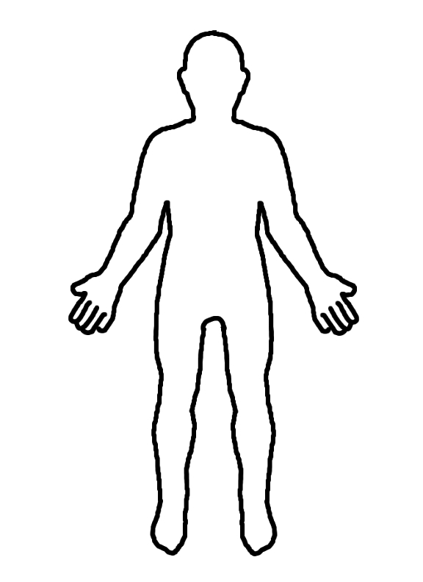
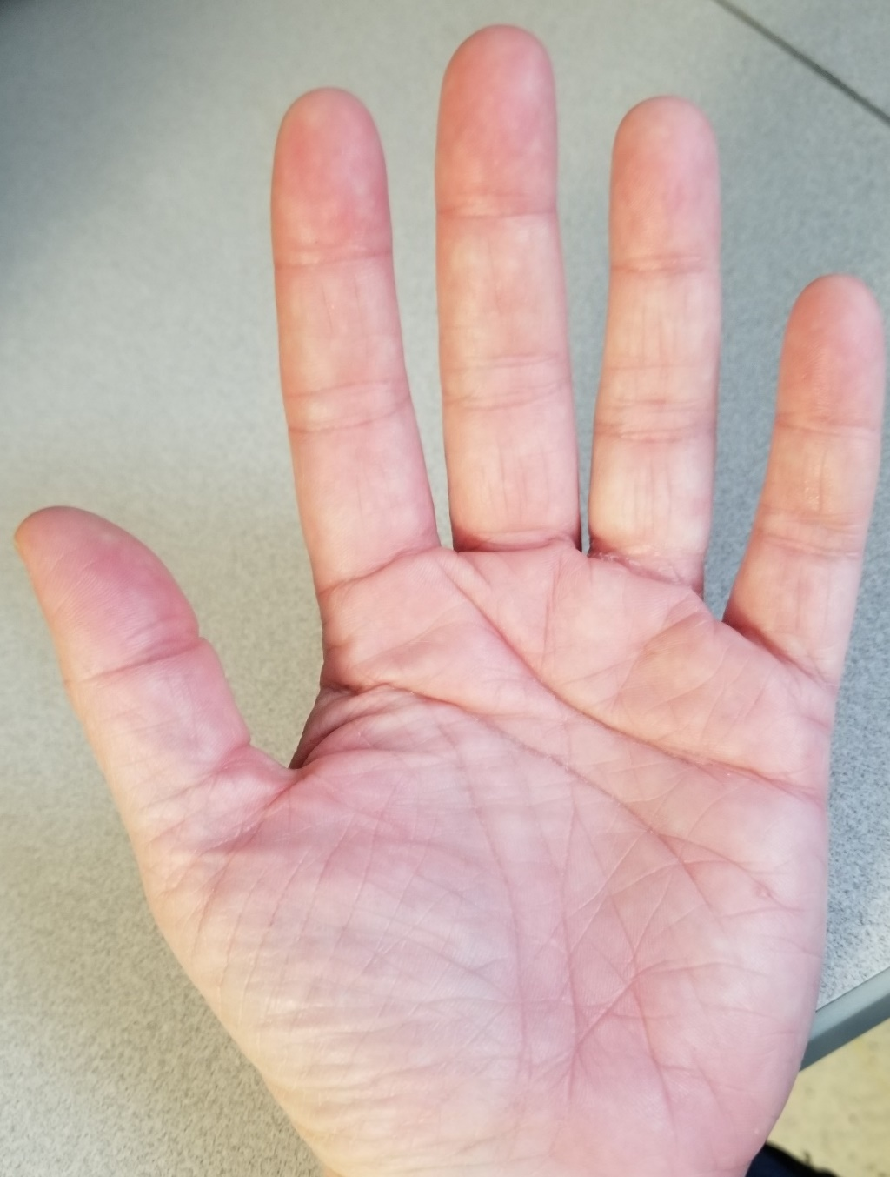
1. Anatomical location
Anterior
L
Know anatomical terms (and use them)
R
Proximal arm
3
2
4
Distal arm
5
1
Upper leg
Lateral leg
Medial leg
Palmar hand
Lower leg
Notes:
Done to here

Slide 6
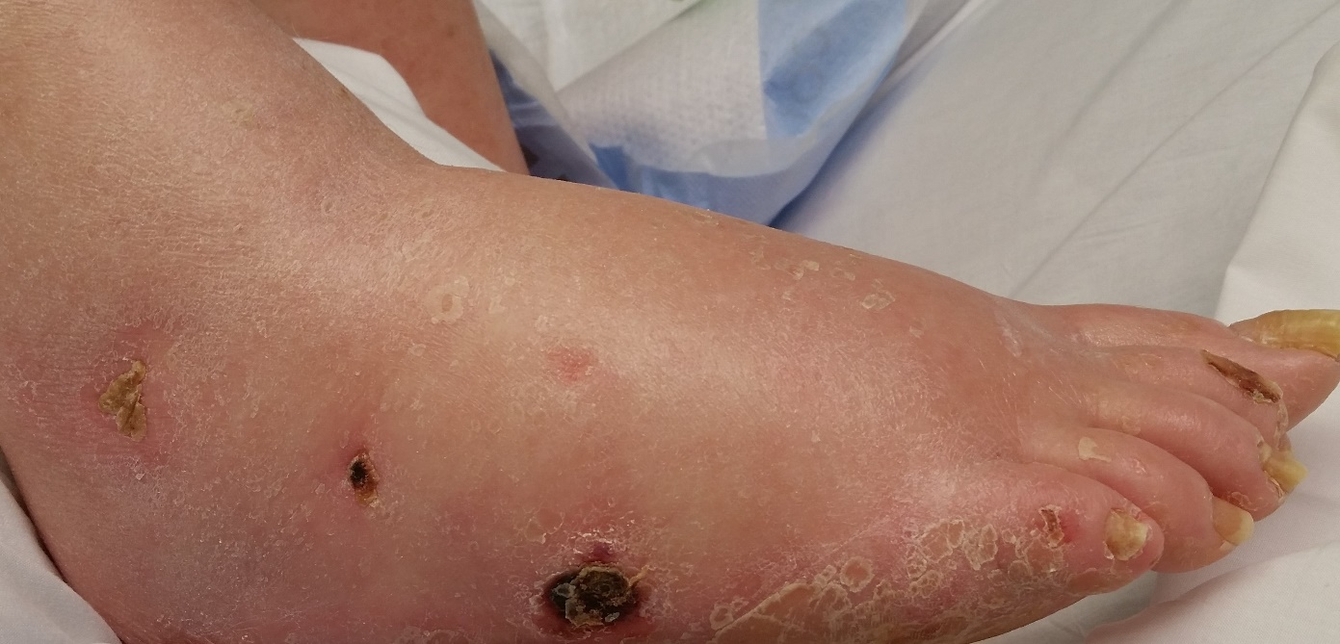
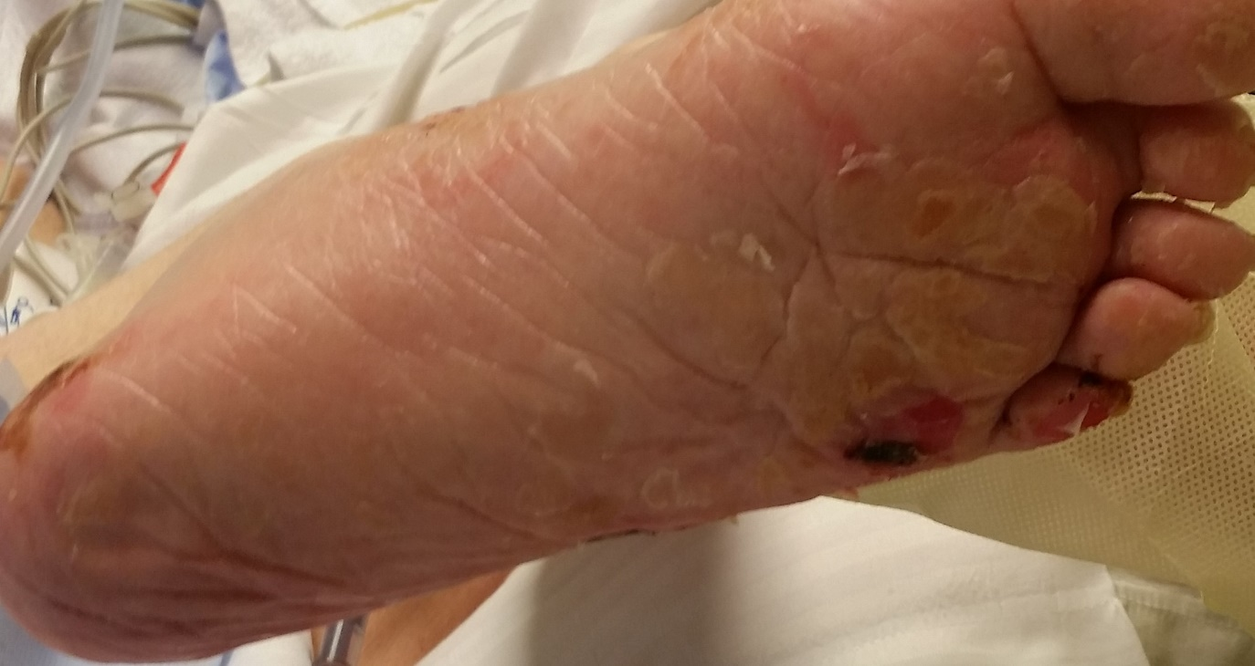
1. Anatomical location
Posterior
L
R
1
Dorsal Foot
2
3
5
4
Dorsal hand
Plantar Foot
Sacrum
Coccyx
Gluteal Cleft = Vertical crevice between left and right buttock.
Notes:
Done to here

Slide 7
2. Wound etiology (Type)
Commonly seen wound types include:
Pressure Injuries
Trauma (i.e. Skin tears, lacerations, abrasions)
Surgical Incision/Open Surgical Wounds
MASD = Moisture Associated Skin Damage
Incontinence Associated Dermatitis (IAD)
Intertrigo (moisture breakdown in skin folds)
Excoriation
Lower Leg Ulcers
Arterial
Venous
Neuropathic (includes diabetic)
Blisters (which can occur for multiple reasons)
Notes:
Done to here

Slide 8
Tips for deciding wound etiology
Use the anatomical location to help identify the wound type. For instance:
Pressure injuries are located on or near a boney prominence (exception: medical device pressure injuries can occur away from boney prominences).
Arterial ulcers are usually on the tips of the toes and tops of the foot.
Venous ulcers are typically on the medial malleolus and the gaiter of the lower legs.
Neuropathic ulcers frequently occur on sides and bottom of the feet.

Slide 9
Tips for defining wound etiology
Why did the wound develop? What caused it to happen?
Skin tears are due to a traumatic cause: fall, tape removal.
Does the patient have poor lower leg circulation?
Has the patient been subjected to prolonged pressure, friction/shear on a boney prominence?
Does the patient have a moisture problem?
Does the patient have neuropathy and/or is diabetic?

Slide 10
Wound Etiology
The type (or etiology) of a wound can tell us a lot:
How the wound developed (the cause):
i.e. Pressure injury means the boney prominence was subjected to prolonged pressure and friction/shear.
What needs to be addressed to stop the wound from deteriorating or more wounds developing:
i.e. Lower leg arterial blood flow will need to be assessed and possibly revascularized in patients with arterial wounds.
What is going on with the patient’s body:
i.e. The patient has a wound with surrounding callus on the plantar foot. He is found to be positive for neuropathy using a Semmes-Weinstein monofilament test. Special shoes are ideal and regular podiatry visits for foot and nail care.

Slide 11
3. Staging
Some wound types have their own staging system:
Pressure Injuries → NPUAP Classification System
Diabetic Foot Ulcers → Wagner Scale
Skin tears → Payne Martin Classification System
Partial thickness: Any wound that only involves the epidermis and dermis.
Full thickness: Any wound that extends deeper than the dermis.
Notes:
Done to here

Slide 12
Pressure injury staging
The deepest level of tissue listed below that you can visualize in a wound bed is also the number stage next to it.
1. Epidermis ----------
2. Dermis ------------
3. Adipose ------------
4. Muscle, Bone, Ligament, and/or Tendon

Slide 13
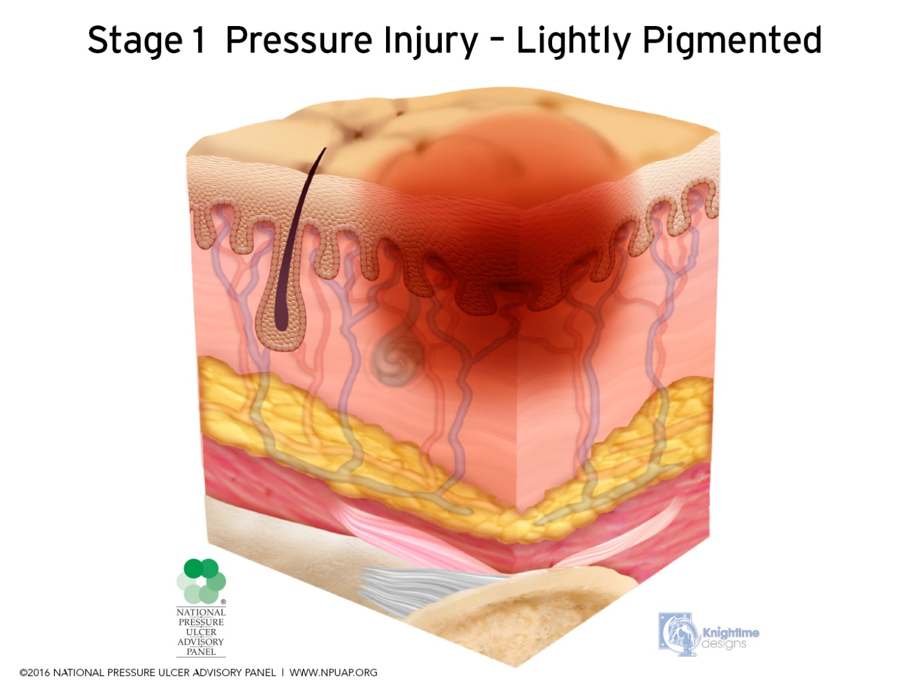
Stage 1: Epidermis (top layer of skin) is intact; Nonblanchable erythema.
You must touch to assess.
1. Epidermis ----------
2. Dermis -------------
3. Adipose ------------
4. Muscle, Bone, Ligament, and/or Tendon

Slide 14
Touch intact skin. If erythema lightens,
then color returns, it is NOT a stage 1

Slide 15
Blanchable Erythema

Slide 16
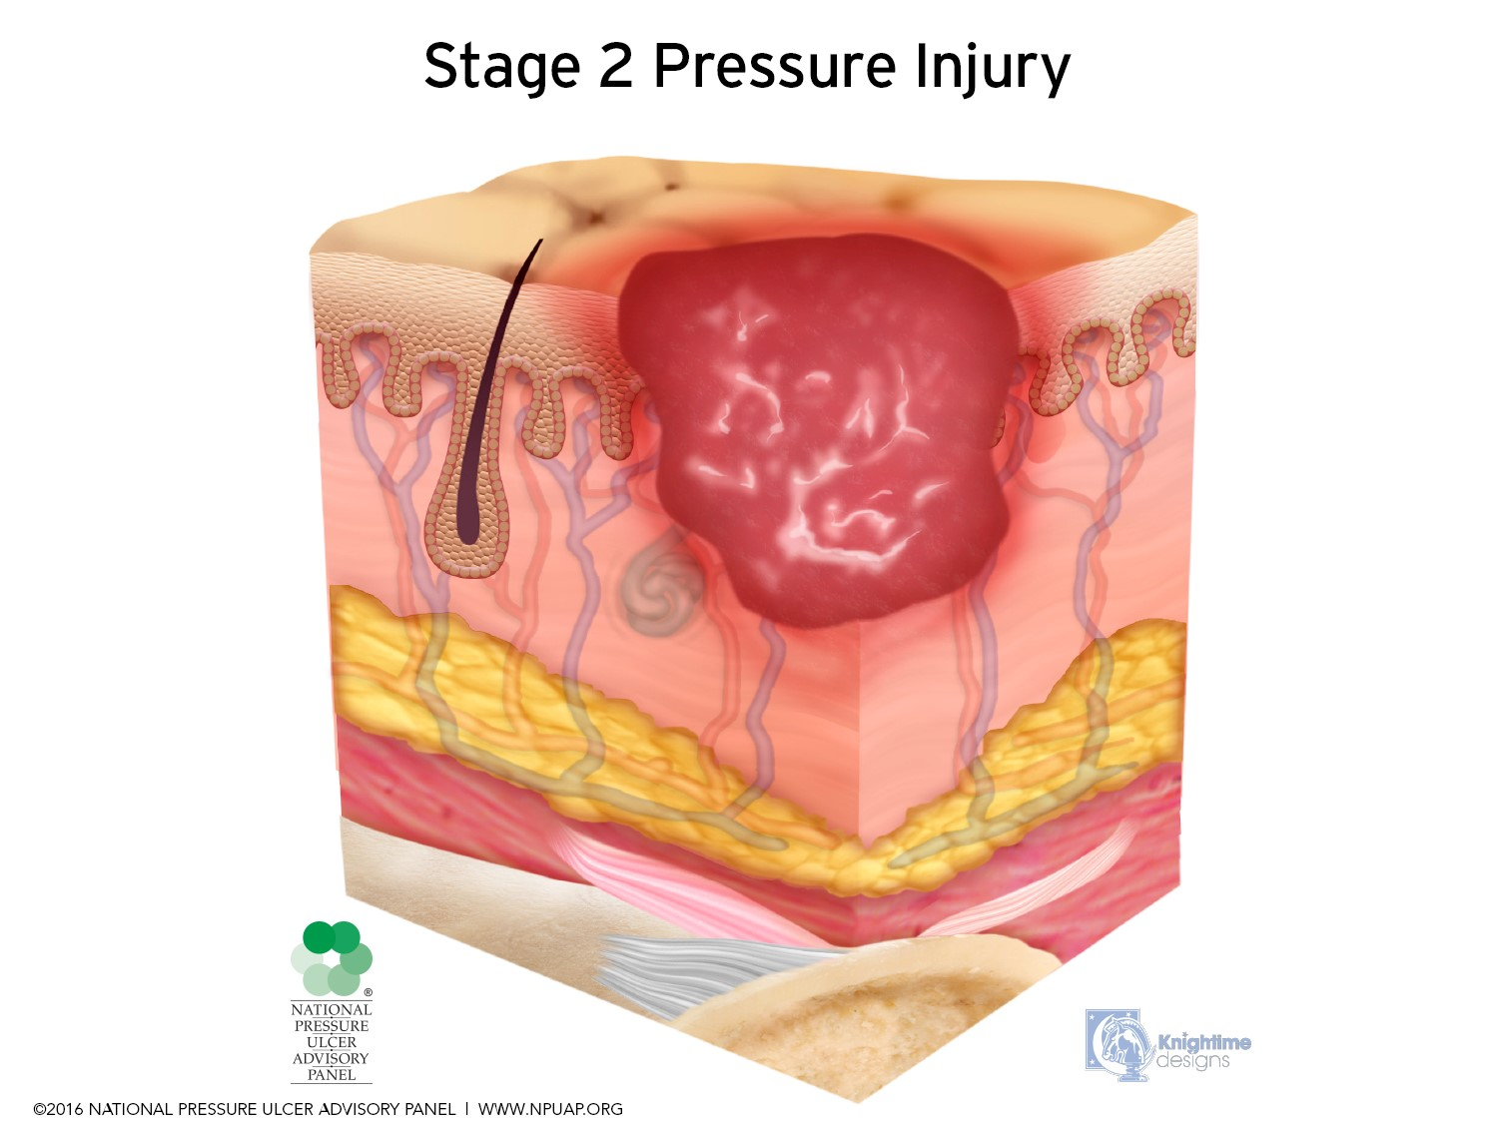
Stage 2: Epidermis is open/lost; Dermis is visible.
VERY shallow wound. NO depth. NO slough.
1. Epidermis ----------
2. Dermis ------------
3. Adipose ------------
4. Muscle, Bone, Ligament, and/or Tendon

Slide 17
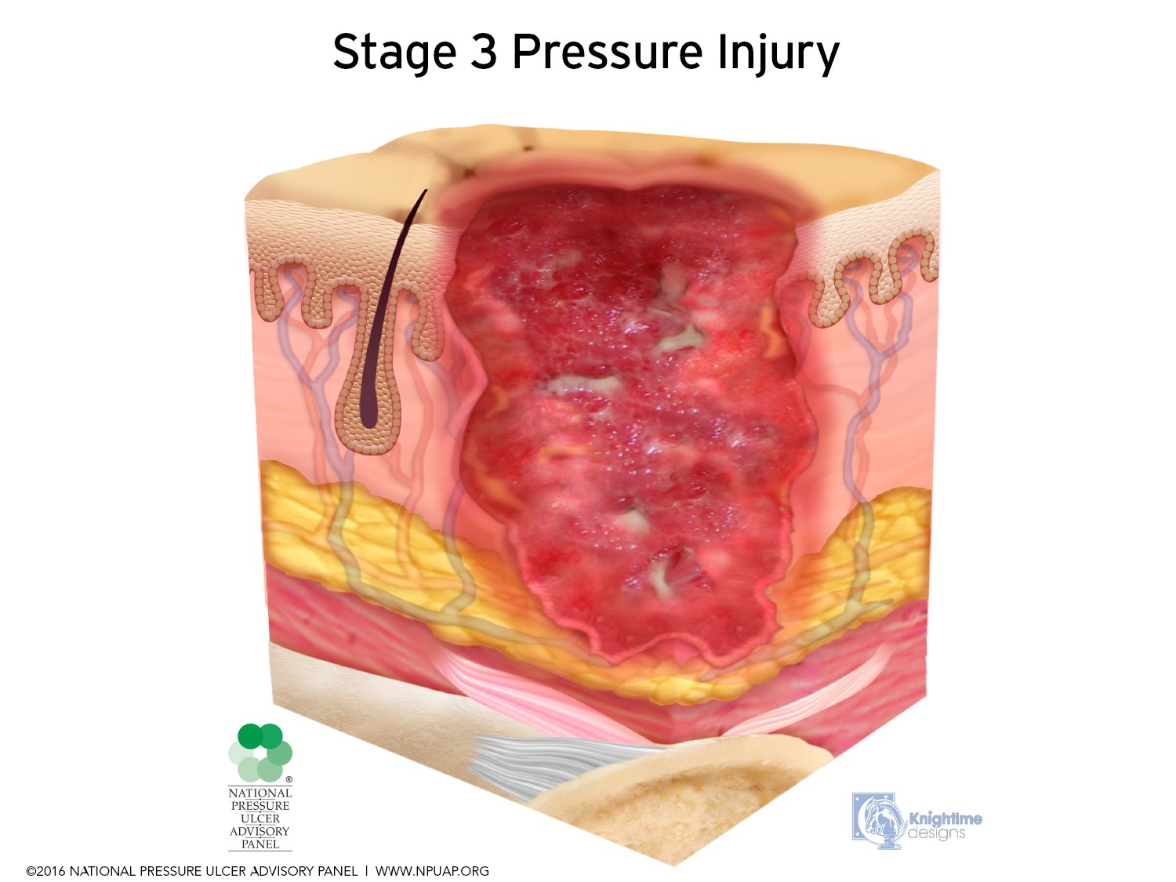
Stage 3: Epidermis is lost; Dermis is lost. Adipose now exposed (may look pink/red & granular). Minimal to moderate depth.
Possibly has slough, undermining, tunneling.
NO bone, NO muscle, NO tendons yet.
1. Epidermis ----------
2. Dermis -------------
3. Adipose ------------
4. Muscle, Bone, Ligament, and/or Tendon

Slide 18
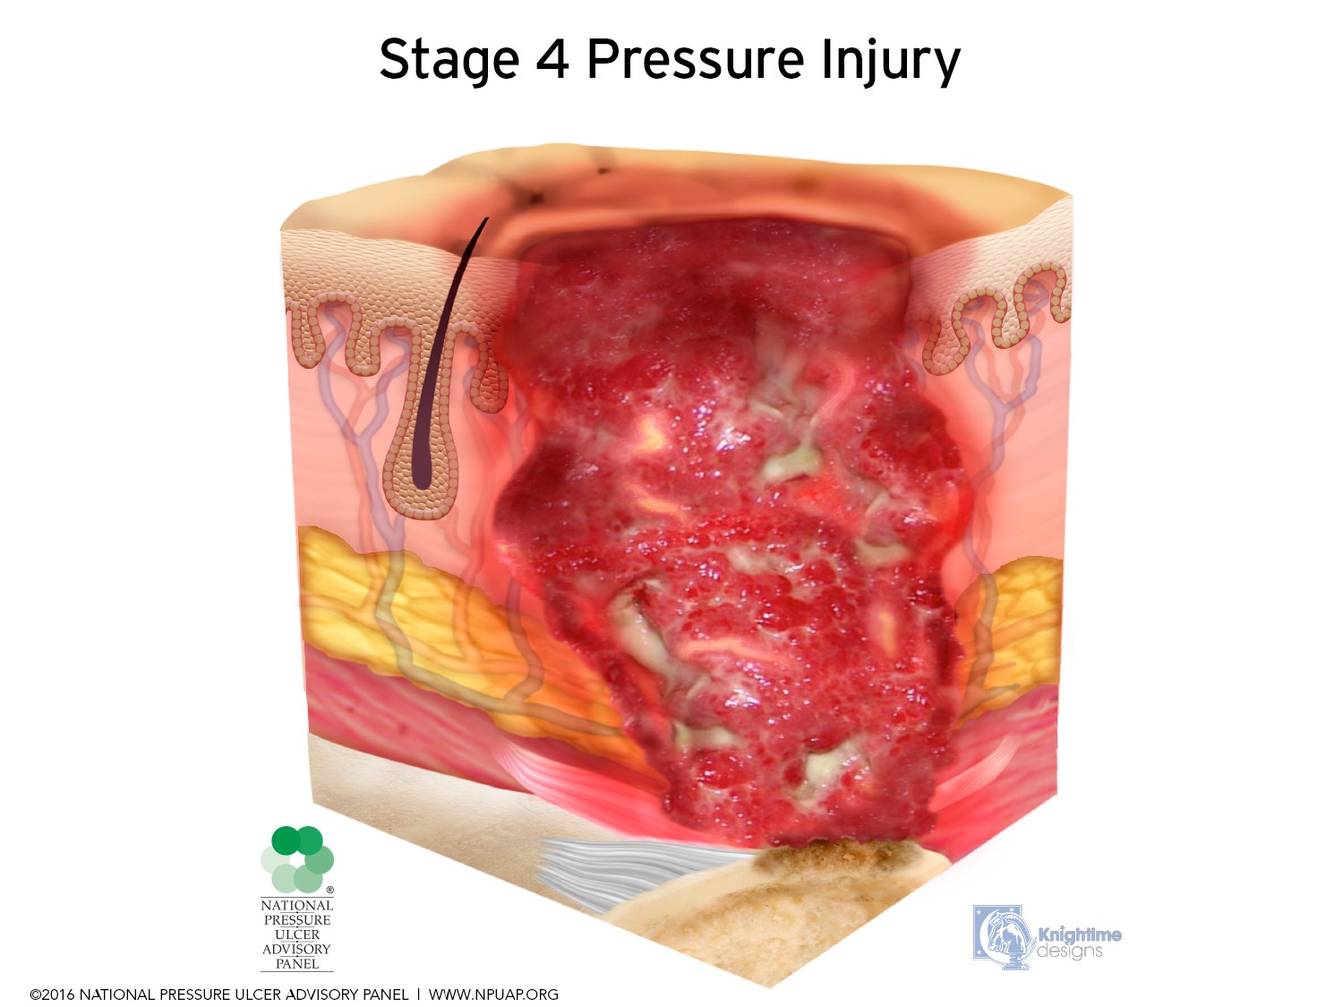
Stage 4: Epidermis is lost; Dermis is lost; Past adipose;
Muscle, Bone, Ligament, and/or Tendon visible.
Moderate to severe depth. Possibly has eschar and/or slough.
1. Epidermis ----------
2. Dermis -------------
3. Adipose ------------
4. Muscle, Bone, Ligament, and/or Tendon

Slide 19
Indeterminate Stages
Sometimes you cannot stage a pressure injury right away as a stage 1,2,3 or 4 for two reasons:
UNSTAGEABLE: there is too much non-viable tissue on the wound bed (slough and/ or eschar) that is blocking the view of possible muscle/bone or ligament. This is called “unstageable”. Unstageable pressure injuries are a stage 3 or 4 underneath that slough or eschar, but we can not tell which one just now.
DEEP TISSUE PRESSURE INJURY: the pressure injury damage began at a level of tissue much deeper than the skin and made its way outwards towards the outer surface. This is called a “deep tissue pressure injury”. Maroon, purple or even blue discoloration is the first visible indication of a DTPI, although bogginess can be detected even earlier. DTPIs are coined “evolving” if the wound appears to still be worsening (in color, size, depth). Once the DTPI stabilizes from good prevention interventions, it will be staged 1, 2, 3 or 4 based on the deepest tissue that ever became visible.

Slide 20
Unstageable: Too much eschar and/or slough is obscuring the wound bed to determine staging.
Unstageable pressure injuries are either stage 3 or 4 underneath but cannot tell which one right now.
1.Epidermis --------
2. Dermis -----------
3. Adipose ----------
4. Muscle, Bone, Ligament, and/or Tendon

Slide 21
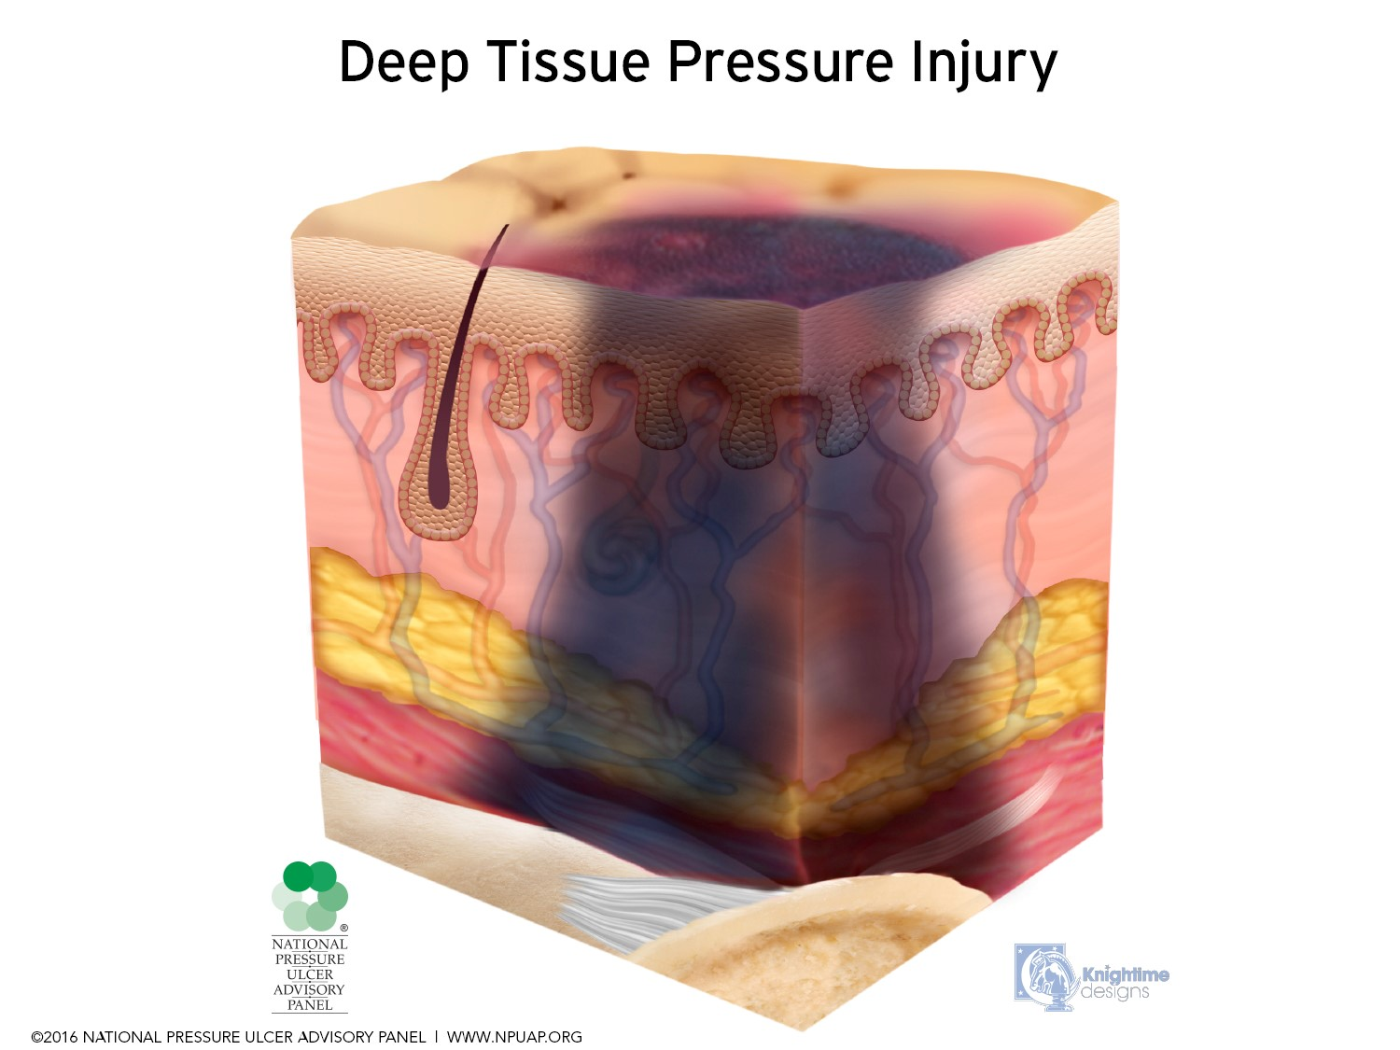
Deep Tissue Injury Pressure down near the bone is injuring the nearby tissue by constricting blood supply & physically crushing cells. The damage spreads out and up towards the surface. We detect bogginess upon palpation, then we visualize maroon or purple discoloration of the skin. It will continue to evolve if no interventions and eventually break open. These wounds can go from bruised looking skin to expose bone very quickly due to the hidden damage that had been occurring for up to 3 full days before anything was visible on the outside.
With interventions, the wound should stop evolving worse and begin to stabilize towards a recognizable stage 1,2,3 or 4 pressure injury. Usually once the purple or maroon discoloration resolves, a stage can be determined.
1.Epidermis -----------
2. Dermis ---------------
3. Adipose ----------
4. Muscle, Bone, Ligament, and/or Tendon
Begins deep down

Slide 22
One page snapshot: Unique Features of Pressure Injury Stages
Stage 1: Skin is intact; Nonblanchable erythema.
You must touch to assess.
Stage 2: Epidermis is open/lost; Dermis is visible.
VERY shallow wound. NO depth. NO slough.
Stage 3: Epidermis is lost; Dermis is lost. Adipose now exposed (may look pink/granular). Minimal to moderate depth.
Possibly has slough, undermining, tunneling. NO bone, NO muscle, NO tendons.
Stage 4: Epidermis is lost; Dermis is lost; Past adipose; Muscle, Bone, Ligament, and/or Tendon visible.
Moderate to severe depth. Possibly has eschar and/or slough.
Unstageable: Too much eschar/slough is obscuring the wound bed to determine staging.
Unstageables are either a stage 3 or 4 pressure injury underneath.
Deep Tissue Injury: Pressure at the bone level is injuring tissue by constricting blood supply. The injury grows outwards to the epidermis and presents as a “bruise”.
Without intervention, wound will continue to enlarge under the surface, eventually may open at the epidermis, and can have an exposed wound bed down to the bone.
Notes:
Intact, erythema is NOT blanchable
Epidermis lost, NO depth.
Fat visible OR slough visible BUT NO muscle/bone
Muscle bone visible
Cannot see enough wound bed to decide b/c slough & eschar
Bruise, maroon/purple/blue, mix of stages

Slide 23
4. measurements
Length
Width
Depth
Tunnels
Undermining
When measuring a wound, always use an actual tool for measuring. Estimating wound measurements is highly inaccurate. All wounds will have a length and width. If the wound is flat, meaning it has no depth, then mark depth as 0 cm. If the wound does not have tunnels or undermining, then comment “no tunnels or undermining”. This way we know the wound was assessed for these things and found absent.
Notes:
Done to here

Slide 24
Measuring Wounds (in centimeters)
Length Longest measurement that runs closest to the head to toe direction.
Width Widest part that is perpendicular (90 degree rotation) to length.
Depth: Touch swab to the deepest part of the main wound bed & measure.
Tunneling: Any tract going inwards through tissue from the main wound bed is a tunnel.
Undermining: When the edge of the wound is an overhang, laying over empty space in the larger wound bed below.

Slide 25
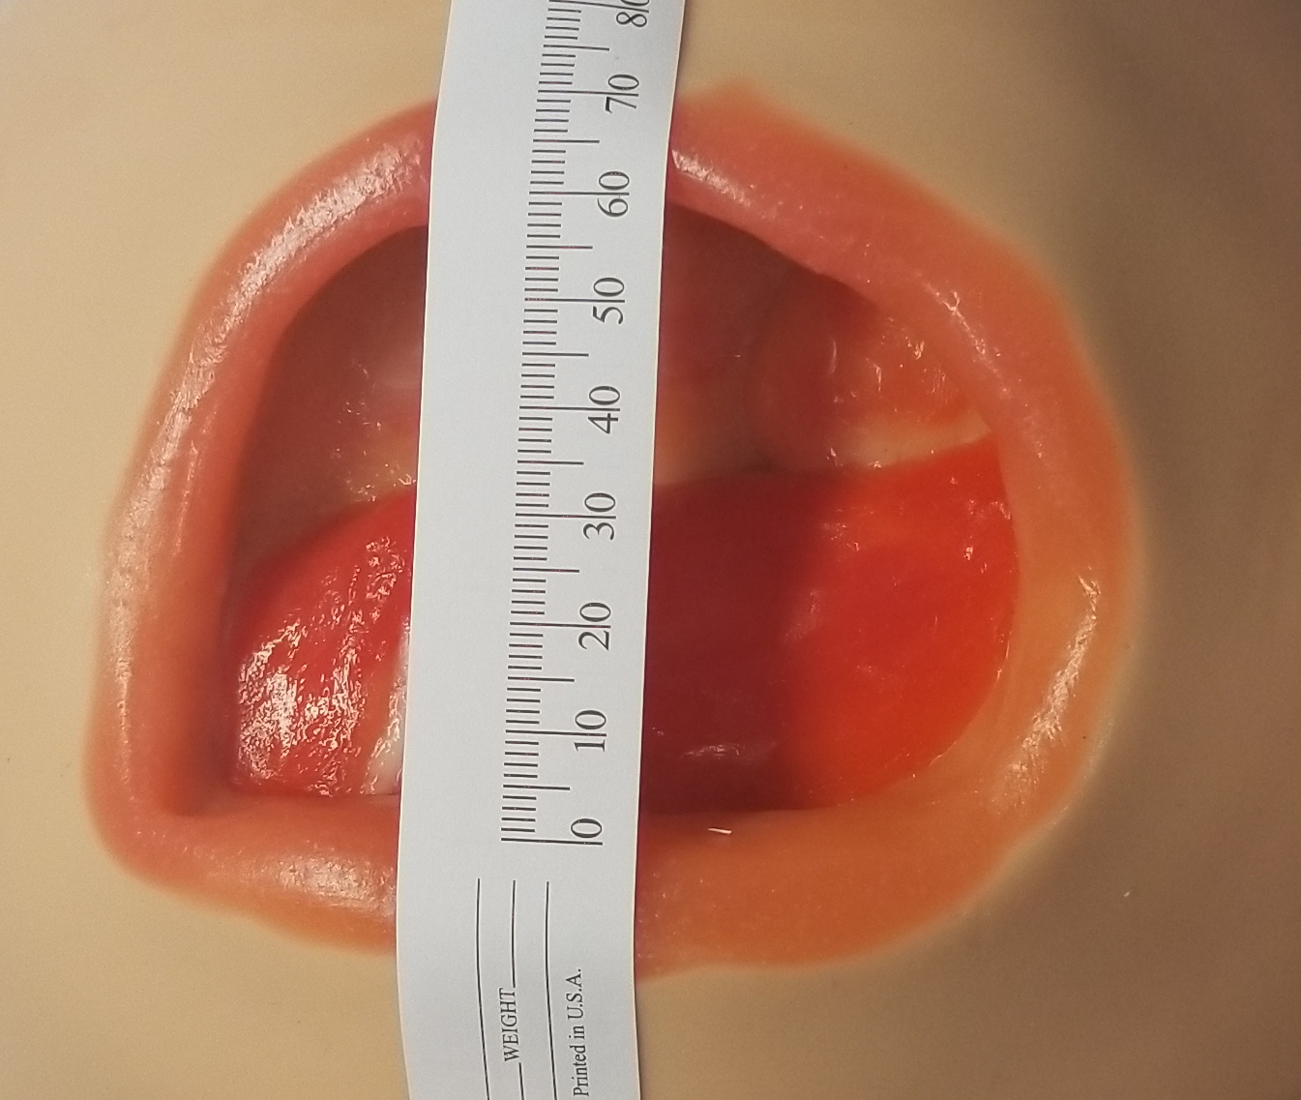
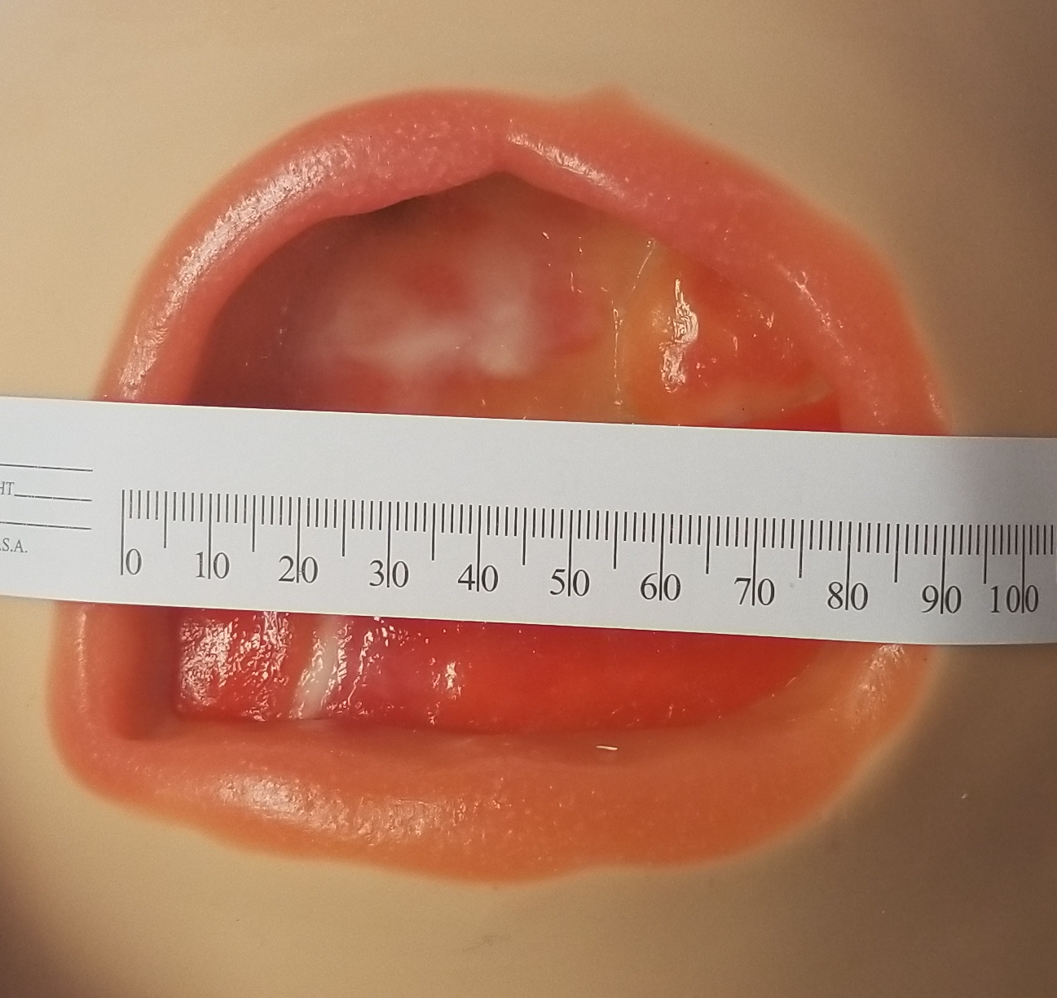
Measuring Wounds (Length & Width)
HEAD
LENGTH
6 cm
WIDTH
8.1 cm
TOE

Slide 26
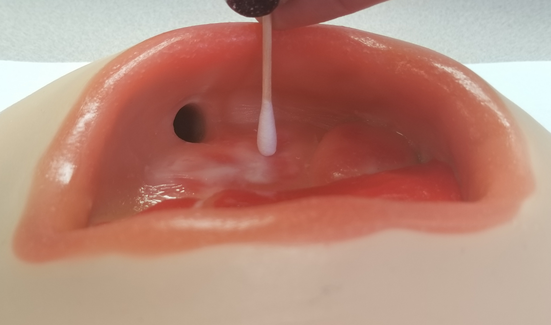
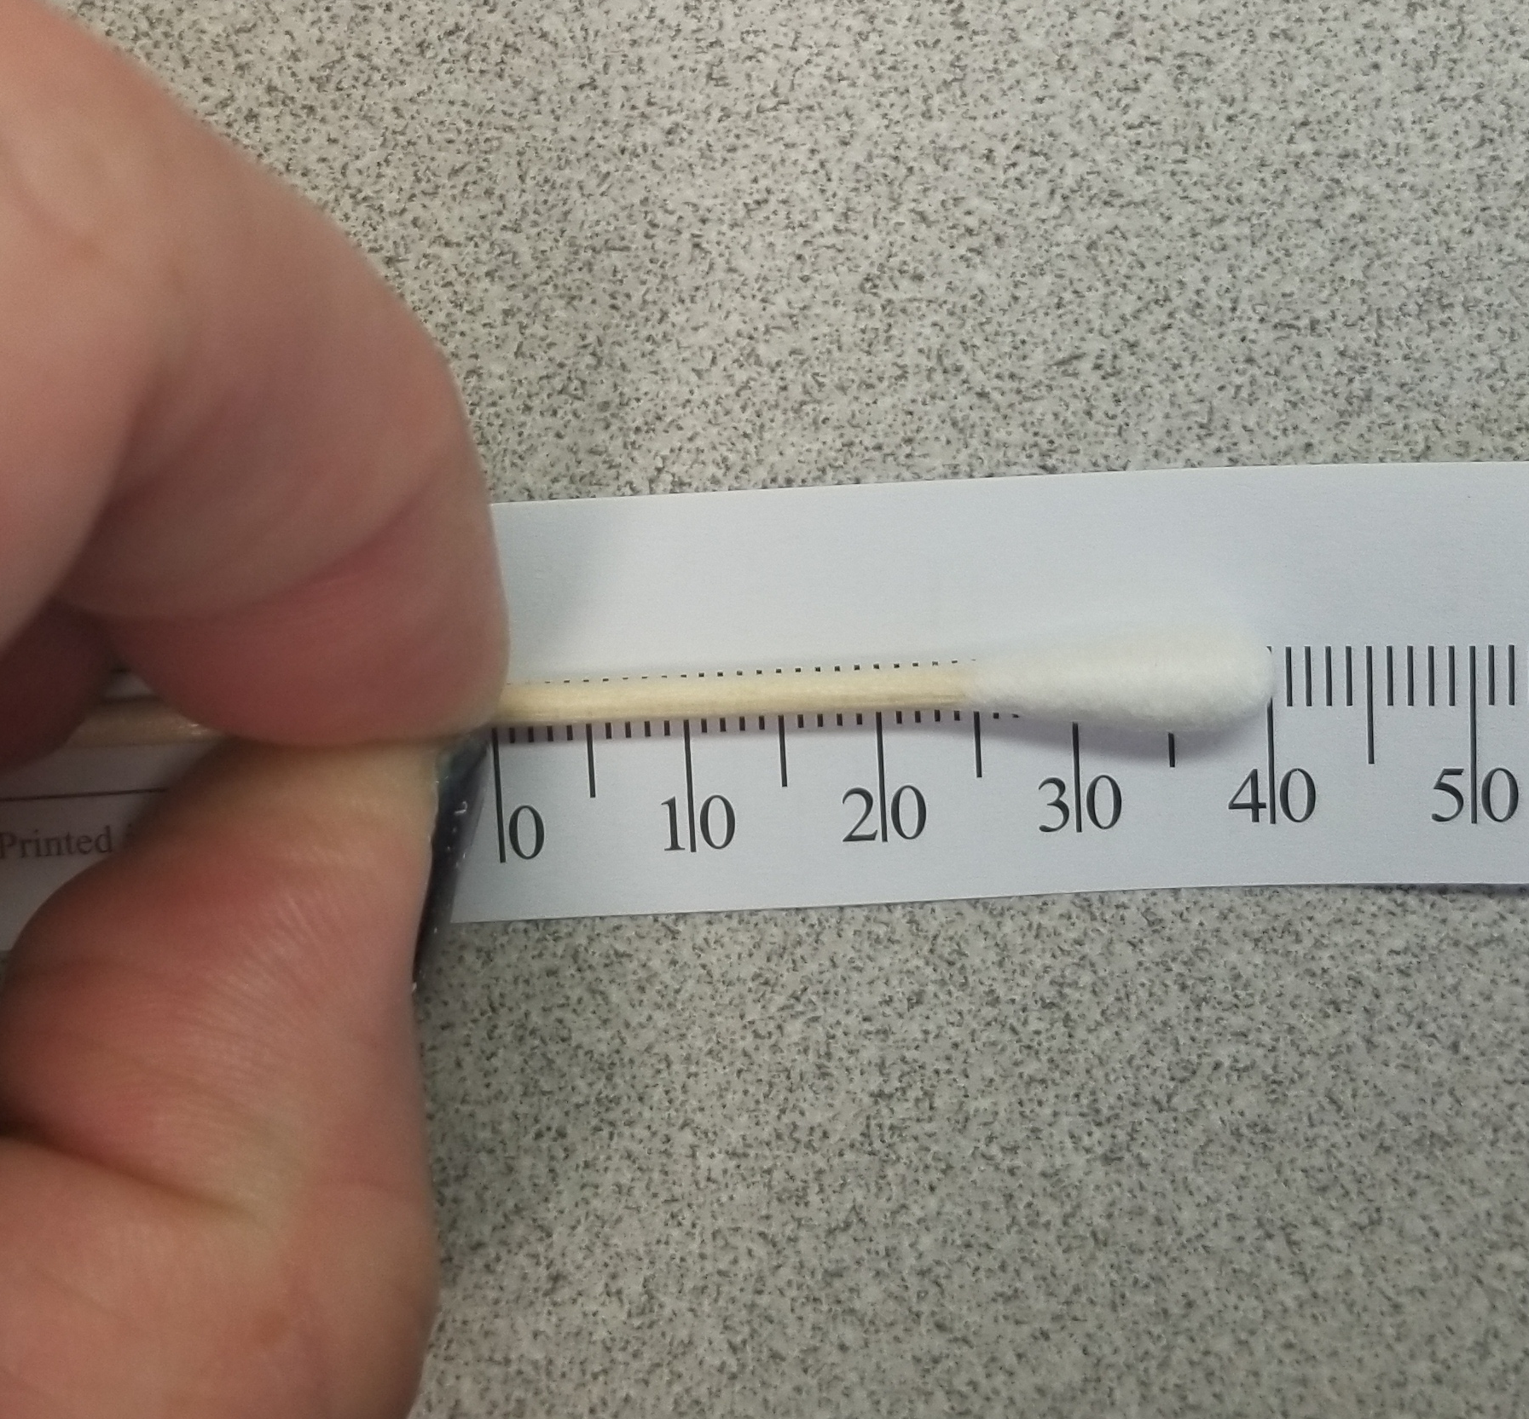
Measuring Wounds (Depth)
Gently place a swab straight down to the deepest part of the main wound bed. Place a fingertip at the level of the wound edge. Hold the swab along a ruler to measure.
Tip: Do not consider the length of a tunnel as the wound “depth”.
DEPTH
4 cm

Slide 27
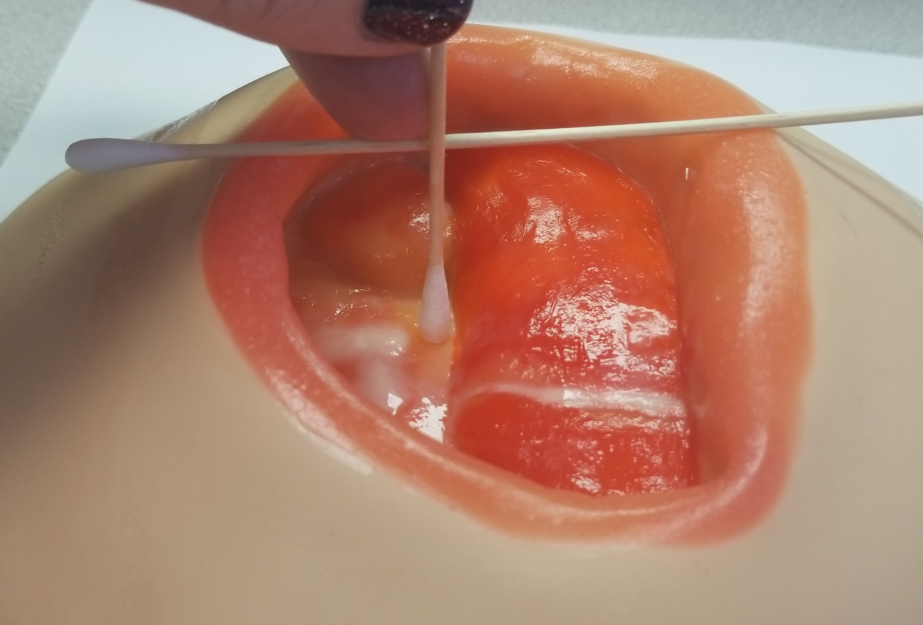
Measuring Wounds (Depth)
If the deepest point is away from the wound edge, touch the swab to the deepest spot of the main wound bed. Then lay another swab across the top of the wound bed. The intersection of the two swabs (on the bottom of the horizontal swab stick) is the depth.
DEPTH

Slide 28
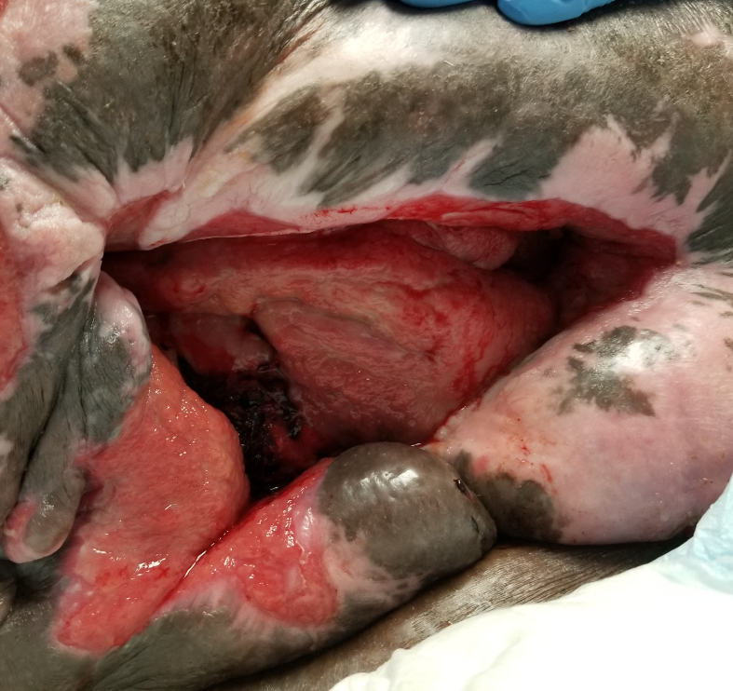
Undermining and Tunneling
Describe location of tunnels or undermining using the hours on a clock. Insert a moisten swab into the depth of the space to record the tunnel depth or the deepest part of the undermining. Tunnels have one spot (or hour) on the clock while undermining will go clockwise from one time to another.
4 cm tunnel at 10 o’clock
Undermining from 3 to 7 o’clock, 2.5 cm greatest depth.

Slide 29
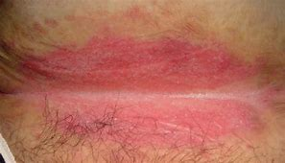
How to measure a closed wound
Closed wounds & abnormalities can be measured by using the edges of the discoloration as markers.
Examples:
Stage 1 pressure injury
Intact deep tissue pressure injury
Blanchable erythema
Intertrigo
Width
Length

Slide 30
5. Wound Bed tissue
Muscle
Tissue Types
Granulation
Hypergranulation*
Epithelial*
Eschar
Bone*
Tendon/Ligament
Slough
Scar tissue
Adipose
Muscle
Fascia*
*List does not include all possible tissues and not all the above are pictured here.
Granulation
Adipose
Tan Slough
Tendon
Black Eschar

Slide 31
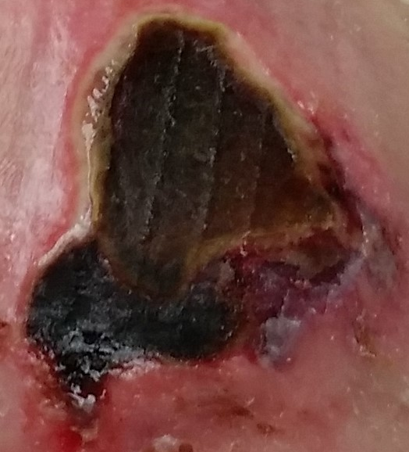
5. Wound bed tissue
To describe the amount of each tissue in a wound bed, consider the wound or affected area as the entire whole: 100%. Estimate what percent of the whole is made up of each tissue type. Sometimes it is just not possible to tell what type of tissue is present. Describe the color and % in these cases.
45% tan slough
15% brown eschar
15% pink dermis
25% pink-red tissue
85% brown-black eschar
5% tan slough
10% maroon-red tissue
100% intact erythema
Notes:
Done to here

Slide 32
6. Exudate (Drainage)
Type | Consistency | Color
Serous | Thin, Watery | Clear, transparent yellow
Sanguineous | Viscous | Bright or dark red
Purulent | Thick | White, cream, green, yellow, tan
Serosanguineous | Thinner than blood | Translucent red or pink
Seropurulent | Thicker than serous (Thinner than purulent) | Transparent cream, yellow, tan, green.
A common scale to use in describing the amount of drainage is:
None
Scant
Small
Moderate
Copious
Most will agree these all seem subjective. To help quantify the terms, look at 1) how much drainage is on the recently removed dressing and 2) how dry, moist or wet is the wound bed. See the next slide for examples.
Notes:
Done to here

Slide 33
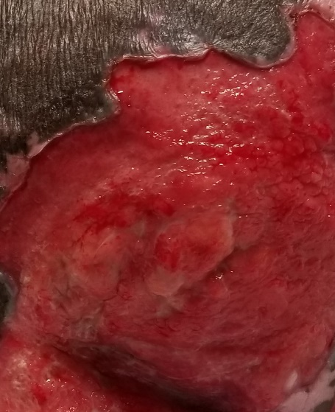
Drainage Amount
NONE
SCANT
SMALL
MODERATE
COPIOUS
Dry wound bed
Moist wound bed
Wet, possibly overflowing wound bed
No drainage on dressing
No measurable drainage on dressing
Less than 25% of dressing has drainage
26-75% of dressing has drainage
More than 75% of dressing has drainage
Notes:
Done to here

Slide 34
7. Odor
After cleansing the wound, note if any malodor is detectable. Describing the odor of a wound that has been under a dressing and drainage has been exiting the body is not an accurate way to measure odor until cleansed.
None
Faint
Moderate
Strong
Notes:
Done to here

Slide 35
8. periwound
The skin directly surrounding the wound is called the “periwound”. This parameter can tell you a lot about the wound etiology, current healing status and how the wound has been responding so far to the specific treatment being provided. Some common terms for describing the periwound are below.
Descriptor | Meaning
Boggy | Feels spongy
Indurated | Feels hardened
Erythema | More pink or red than normal (for ethnicity)
Ecchymotic | Bruised
Edematous | Swollen
Callus | Thickened and toughened skin from repeated trauma
Maceration | Skin is softening and thinning due to moisture
Excoriated | Wearing away of skin, from rubbing or chemical damage (i.e. stool)
Denuded | Epidermal loss due to prolonged contact with moisture and friction
Notes:
Done to here

Slide 36
9. pain
We have become accustomed to asking our patient if they are experiencing pain. When working with a wound, take notice of when the patient shows signs of pain. Is there absence of pain or is there pain present:
during repositioning?
when the dressing is removed?
while cleaning or placing a new dressing?
It is possible to prevent future pain in cases where the type of dressing is causing pain. Knowing what wound care products are available and learning tips for avoiding adhesive are good ways to do this.
Notes:
Done to here

Slide 37
Signs of wound infection
Wound bed infection may be present if any of the following are noted:
Increased drainage
Thickened drainage
Friable tissue (bleeds easily)
Redness around the wound
Warmth around the wound
Induration of the periwound (feels hardened)
Malodorous after cleansing
Increase in pain
Notes:
Malodor after cleaning, heavy exudate, thick exudate, friable tissue, erythema, pain, induration.

Slide 38
Why culture a wound?
When we recognize telltale signs of infection in the wound bed, you can expect the doctor to prescribe a broad spectrum antibiotic.
So why culture the wound?
The organism causing infection may not be susceptible to the initial antibiotics prescribed. Also, a wound culture sample is best collected before any antibiotics are prescribed so as not to affect the bacterial growth in the lab.

Slide 39
Why culture a wound?
Another reason is a wound that is stalled (not healing but not deteriorating either) may have a “silent” infection in the wound bed and should be cultured. Also consider that patients can have more than one infection at a time. This means a person with a confirmed urinary tract infection should also have a thorough wound assessment completed to make sure two infections with multiple pathogens are not simultaneously occurring.

Slide 40
Collection of sample
For a wound culture you will need:
Normal saline & gauze
Proper collection tubes (Anaerobic & Aerobic)
Lab baggie
Pen/Marker
Patient labels
Anything else your facility may include

Slide 41
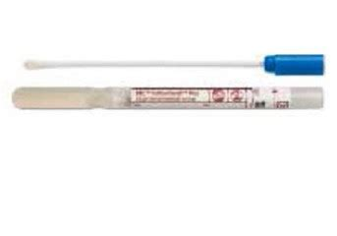
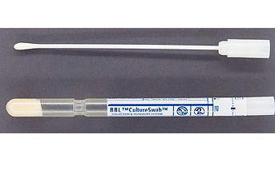
Why two tubes?
Anaerobic Bottom is filled with gel to keep sample (and potential anaerobes) in an oxygen-free environment for transport.
Aerobic Bottom is filled with moist foam to keep sample from drying out during transport while also oxygenated
Do not be surprised if products have come out or will in the future that can do the job of both tubes. Advances are constantly occurring.

Slide 42
Collection method:
Cleanse the wound
Pop the transport tube top off; Remove swab from culture package.
Select a pink or red section of the wound bed. Press the swab into the tissue and roll. Repeat in several sections. FYI: This is called the “Levine method” of sampling and is considered the best method.
Place sample swab down into transport tube.
Label with at minimum patient label, your initials, collection date/time and wound site.
Repeat for all culture tubes.

Slide 43
Approximate Microbiology timeline
A gram stain of specimen to see what broad category of organism is present will be done (i.e. Gram negative rods, gram positive cocci). Same day results.
Inoculate nutrient rich plates with the specimen to coax the bacteria to grow.
Once organism(s) grow, isolate bacteria and identify it (i.e. MRSA, E. Coli, Pseudomonas). Results 2-3 days.
Test the isolated bacteria against a battery of antibiotics to determine resistant or susceptible options. Results usually within a day of #2 above.

Slide 44
Wound assessment summary
A thorough wound assessment is the basis for setting the patient up for success.
The basic parameters of a wound assessment:
Anatomical location
Wound Type
Stage/Category (if applicable)
Measurements
Tissue type & amount
Exudate type & amount
Odor (after cleansing)
Periwound description
Pain
Breakdown the wound assessment into each parameter, look up unfamiliar terms and practice assessment with a wound care professional to gain more confidence. Use what you assess to help you see the bigger picture with regards to the patient’s overall well being.

Slide 45
References
McNichol, L., Watts, C., Mackey, D., Beitz, J., & Gray, M. (2015). Identifying the right surface for the right patient at the right time. Journal of Wound, Ostomy and Continence Nursing, 42(1) pages 19-37. Doi: 10.1097/WON.0000000000000103
National PI Advisory Panel (2019) Support surface standards initiative. https://cdn.ymaws.com/npiap.com/resource/resmgr/terms_and_defs_nov_21_2019_u.pdf
Wound Ostomy Continence Nurse Society (2016) Wound treatment associate participant workbook. Wound Ostomy Continence Nurse Society Publishing.

